Slide 1
The Evolution of Halloween
From Ancient Origins to Modern Celebrations

Slide 2
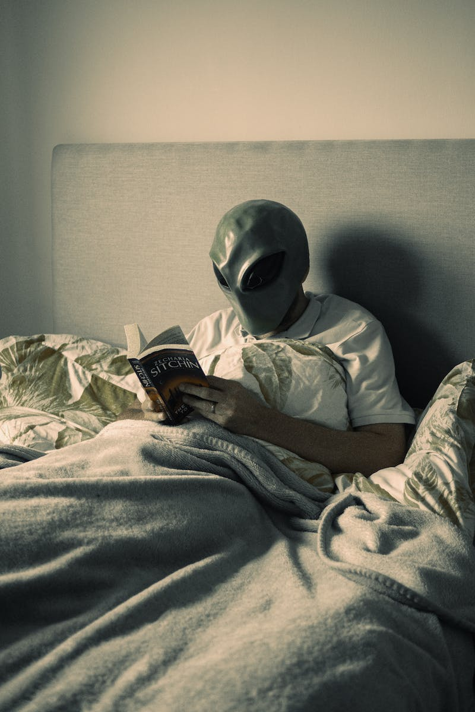
Introduction
• Halloween is an annual holiday celebrated on October 31st.
• It has ancient roots and has evolved over time into a festive and spooky occasion.
• The holiday is known for costumes, trick-or-treating, and haunted houses.
• Let's explore the fascinating history and traditions of Halloween!
Photo by Pexels

Slide 3
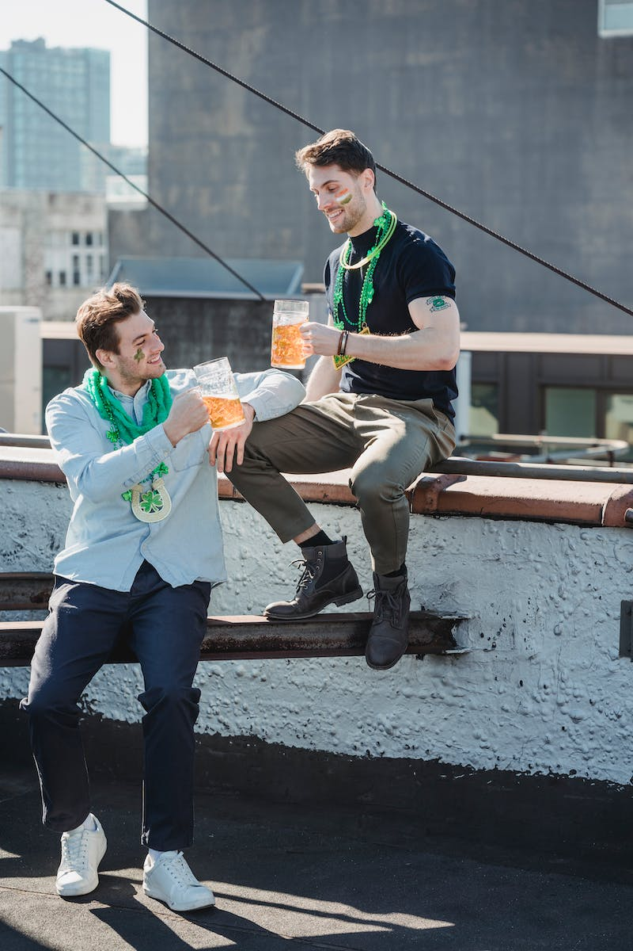
Ancient Origins
• Halloween can be traced back to the ancient Celtic festival of Samhain.
• Samhain marked the end of the harvest season and the beginning of winter.
• People believed that the boundary between worlds of the living and the dead was blurred on this night.
• Bonfires, costumes, and divination rituals were common during Samhain.
Photo by Pexels

Slide 4
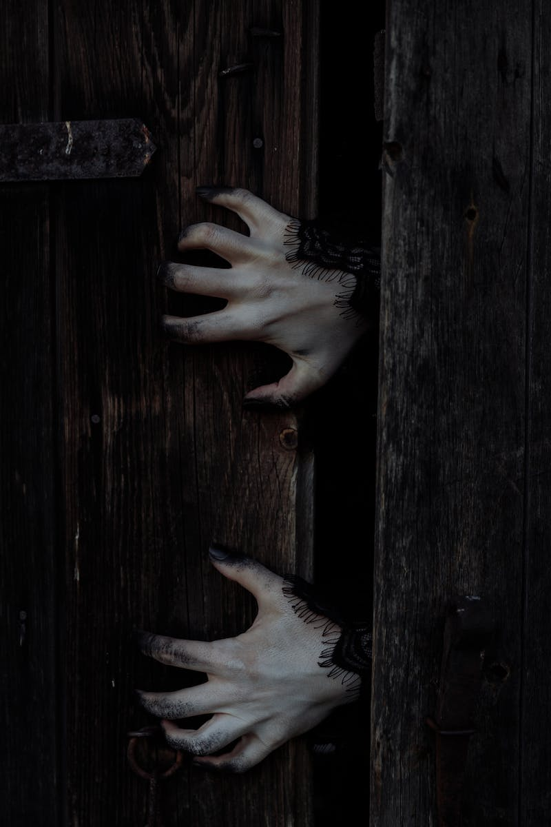
Christian Influence
• During the Middle Ages, the Catholic Church incorporated Samhain-like traditions into the Christian holiday of All Hallows' Eve.
• All Hallows' Eve eventually became Halloween as we know it today.
• Costumes and masks were worn to ward off evil spirits, and people went door-to-door for soul cakes.
• This blend of Celtic and Christian traditions shaped Halloween's modern celebrations.
Photo by Pexels

Slide 5
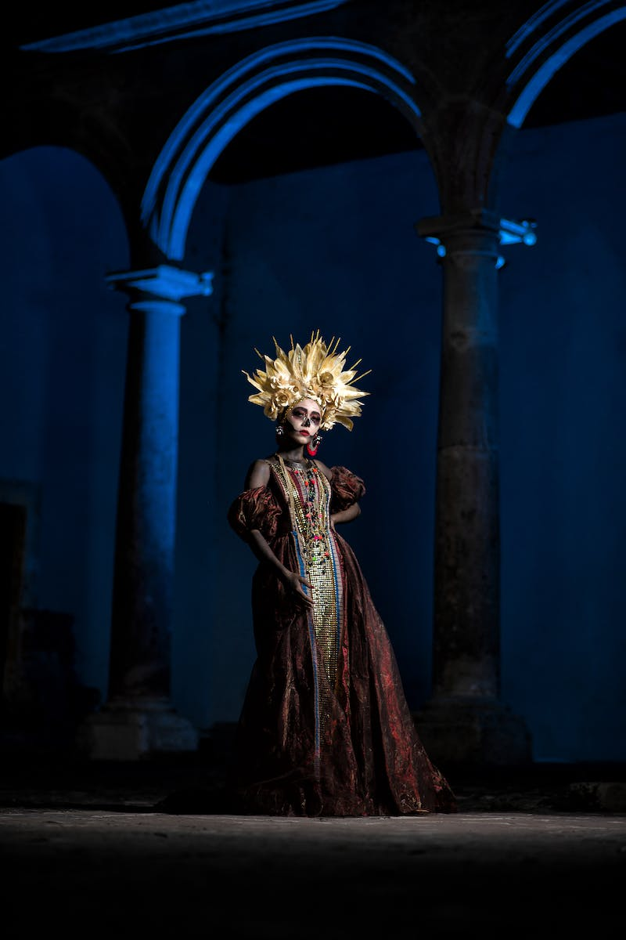
Halloween in America
• Halloween was brought to America by Irish and Scottish immigrants in the 19th century.
• Trick-or-treating became popular in the early 20th century, with children going door-to-door for treats.
• Jack-o'-lanterns, carved out of pumpkins, also became an iconic Halloween tradition.
• Today, Halloween is widely celebrated in the United States with parades, parties, and themed decorations.
Photo by Pexels

Slide 6
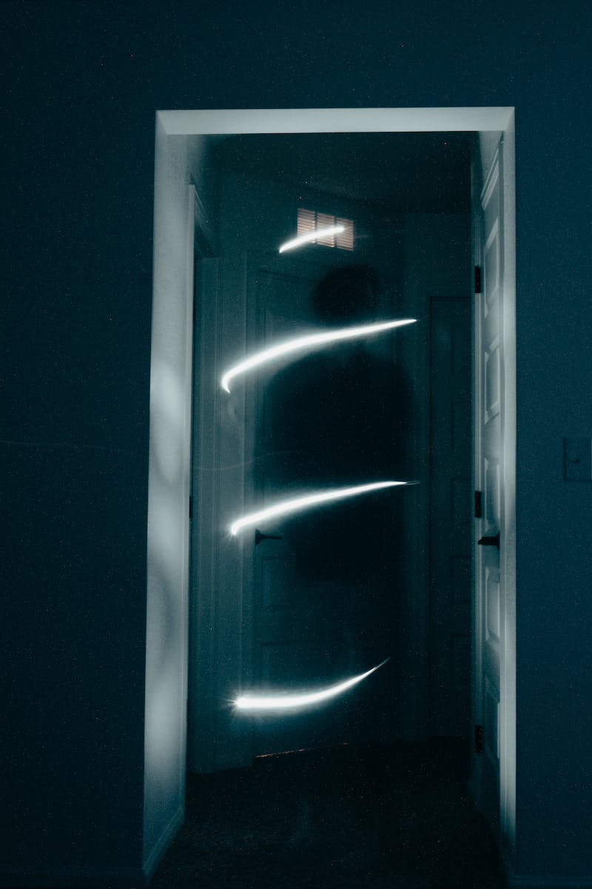
Modern Halloween
• Today, Halloween is a highly commercialized holiday with a focus on costumes and decorations.
• Haunted houses and horror movies have become popular attractions during Halloween season.
• Halloween-themed parties and events are organized in various venues.
• While Halloween retains some of its ancient traditions, it has evolved into a more secular celebration of fun and fright.
Photo by Pexels

Slide 7
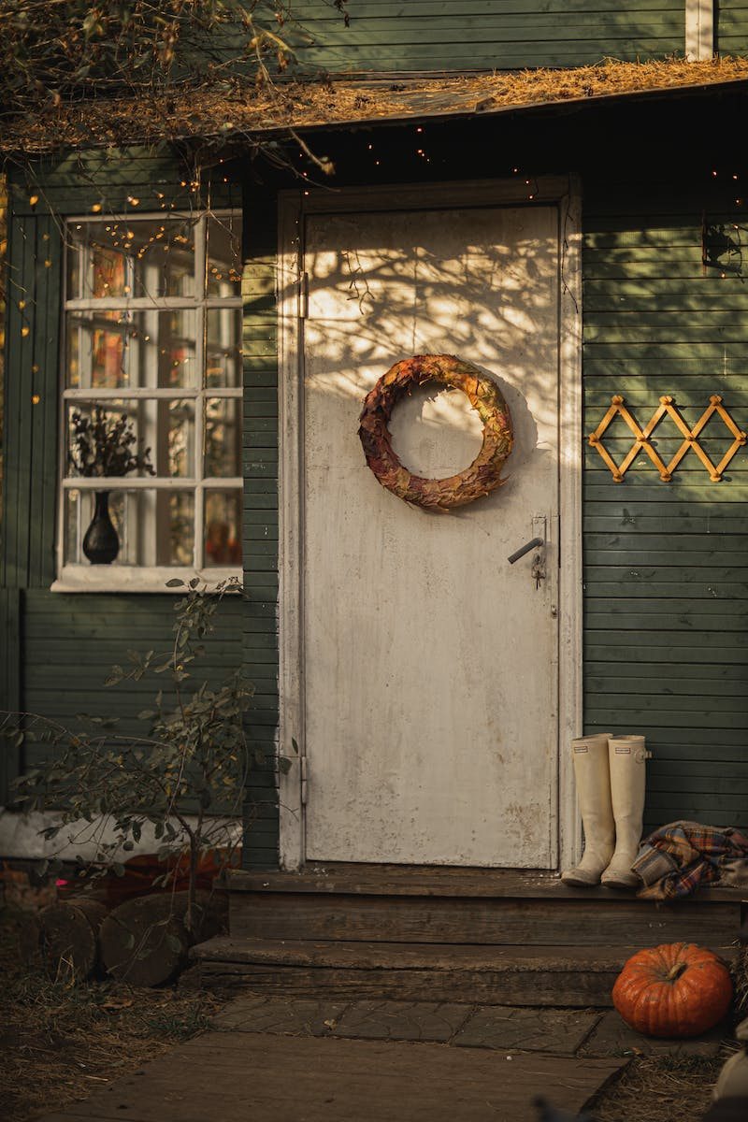
Conclusion
• Halloween is a holiday with ancient roots and a rich history.
• It has evolved over time, blending Celtic and Christian traditions along with modern commercial elements.
• Despite the changes, Halloween remains a beloved celebration of creativity, imagination, and the thrill of the spooky and supernatural.
Photo by Pexels

