Slide 1
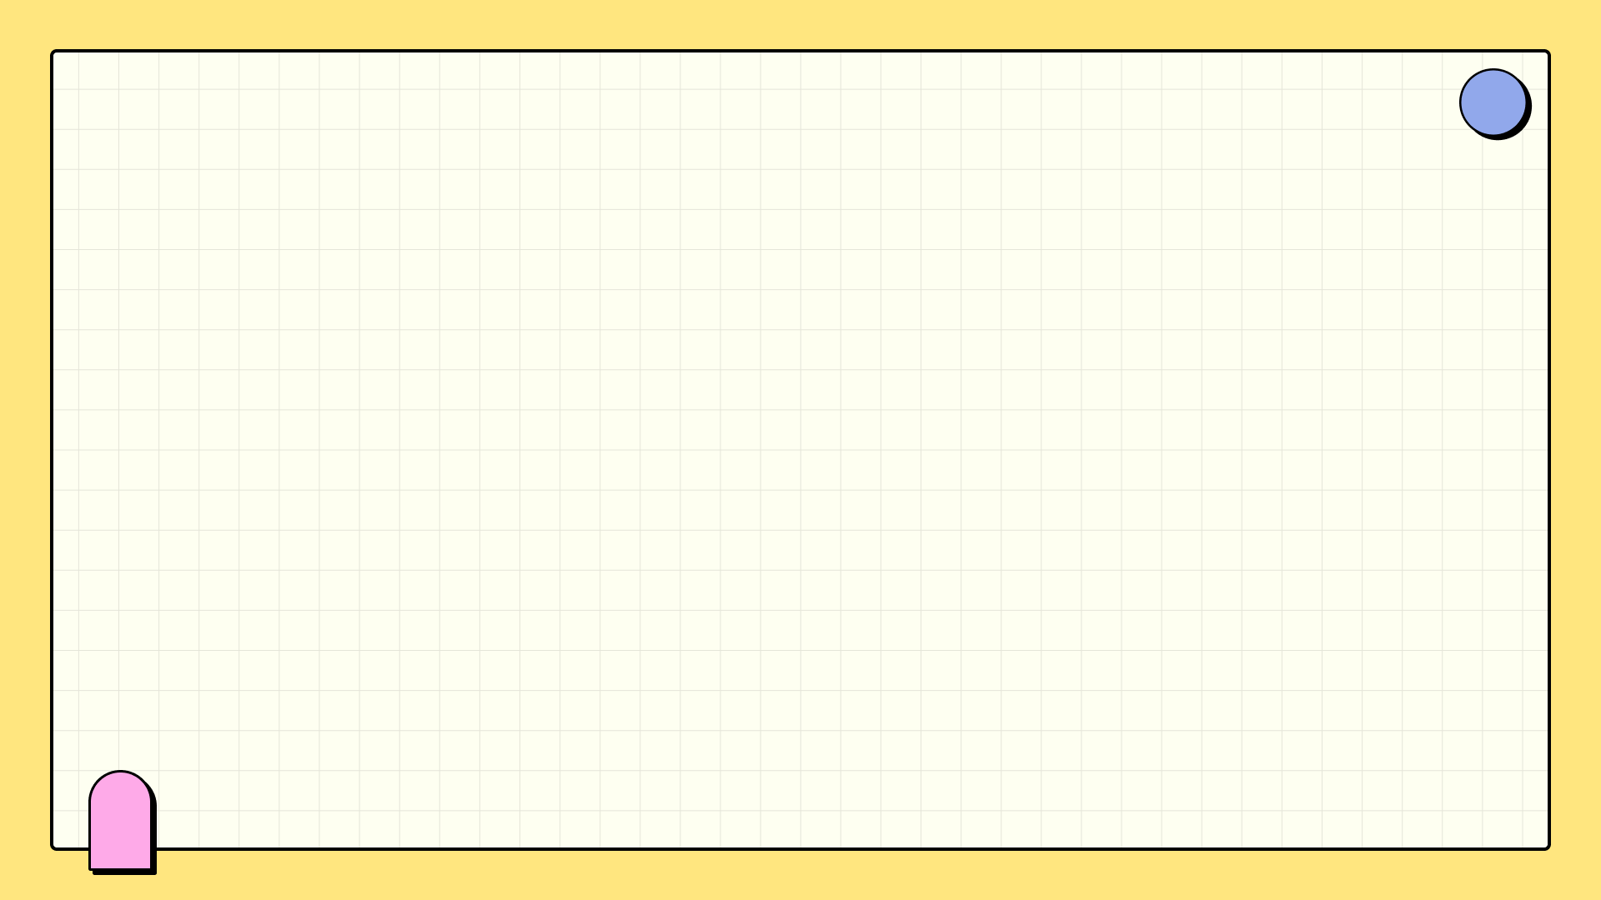

April 2025
Mind Your Likes: Taming Social Media for Mental Wellness
A guide to balancing online engagement and mental well-being in digital age.

Slide 2


Table of Contents
1
Social Media: The Good & The Bad
5
Reclaim Your Time: Digital Wellbeing
2
Digital Town Square
6
Curated Positivity: Social Media Detox
3
Social Media's Impact: The Mental Health Link
7
Offline Bliss
4
Digital Detox: Time Regained
8
Social Media: The Upside

Slide 3
Table of Contents
9
Digital Dilemmas
10
Cultivating Mindful Tech Use

Slide 4
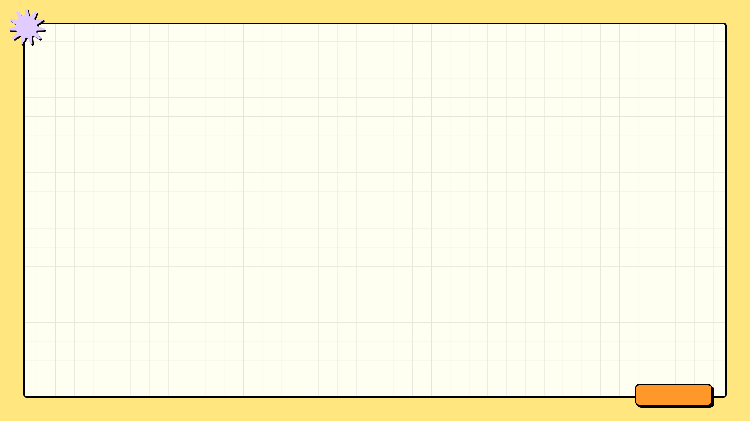



Social Media: The Good & The Bad
Yay!
Nay!
Global connectivity fosters relationships across geographical boundaries, facilitating communication and collaboration on a worldwide scale.
Instant information access empowers users with real-time news, updates, and educational resources, promoting informed decision-making.
Creative expression is amplified through diverse platforms, enabling individuals to showcase talents and share unique perspectives.
Addiction and time consumption can lead to decreased productivity, impacting personal well-being and professional achievements significantly.
Misinformation and fake news proliferate rapidly, eroding trust in credible sources and potentially influencing public opinion negatively.
Privacy concerns arise from data collection and surveillance, raising ethical questions about individual rights and corporate responsibility.

Slide 5

Digital Town Square
1.Facebook Focus
2.Instagram Impact
Community building and broad reach. Ideal for engaging diverse audiences with a personal touch.
Visually driven storytelling. Capture attention with compelling images and short-form video content.
3.Twitter Trends
4.LinkedIn Leverage
Real-time updates and concise messaging. Excellent for news dissemination and quick interactions.
Professional networking and thought leadership. Connect with industry peers and build credibility online.

Slide 6
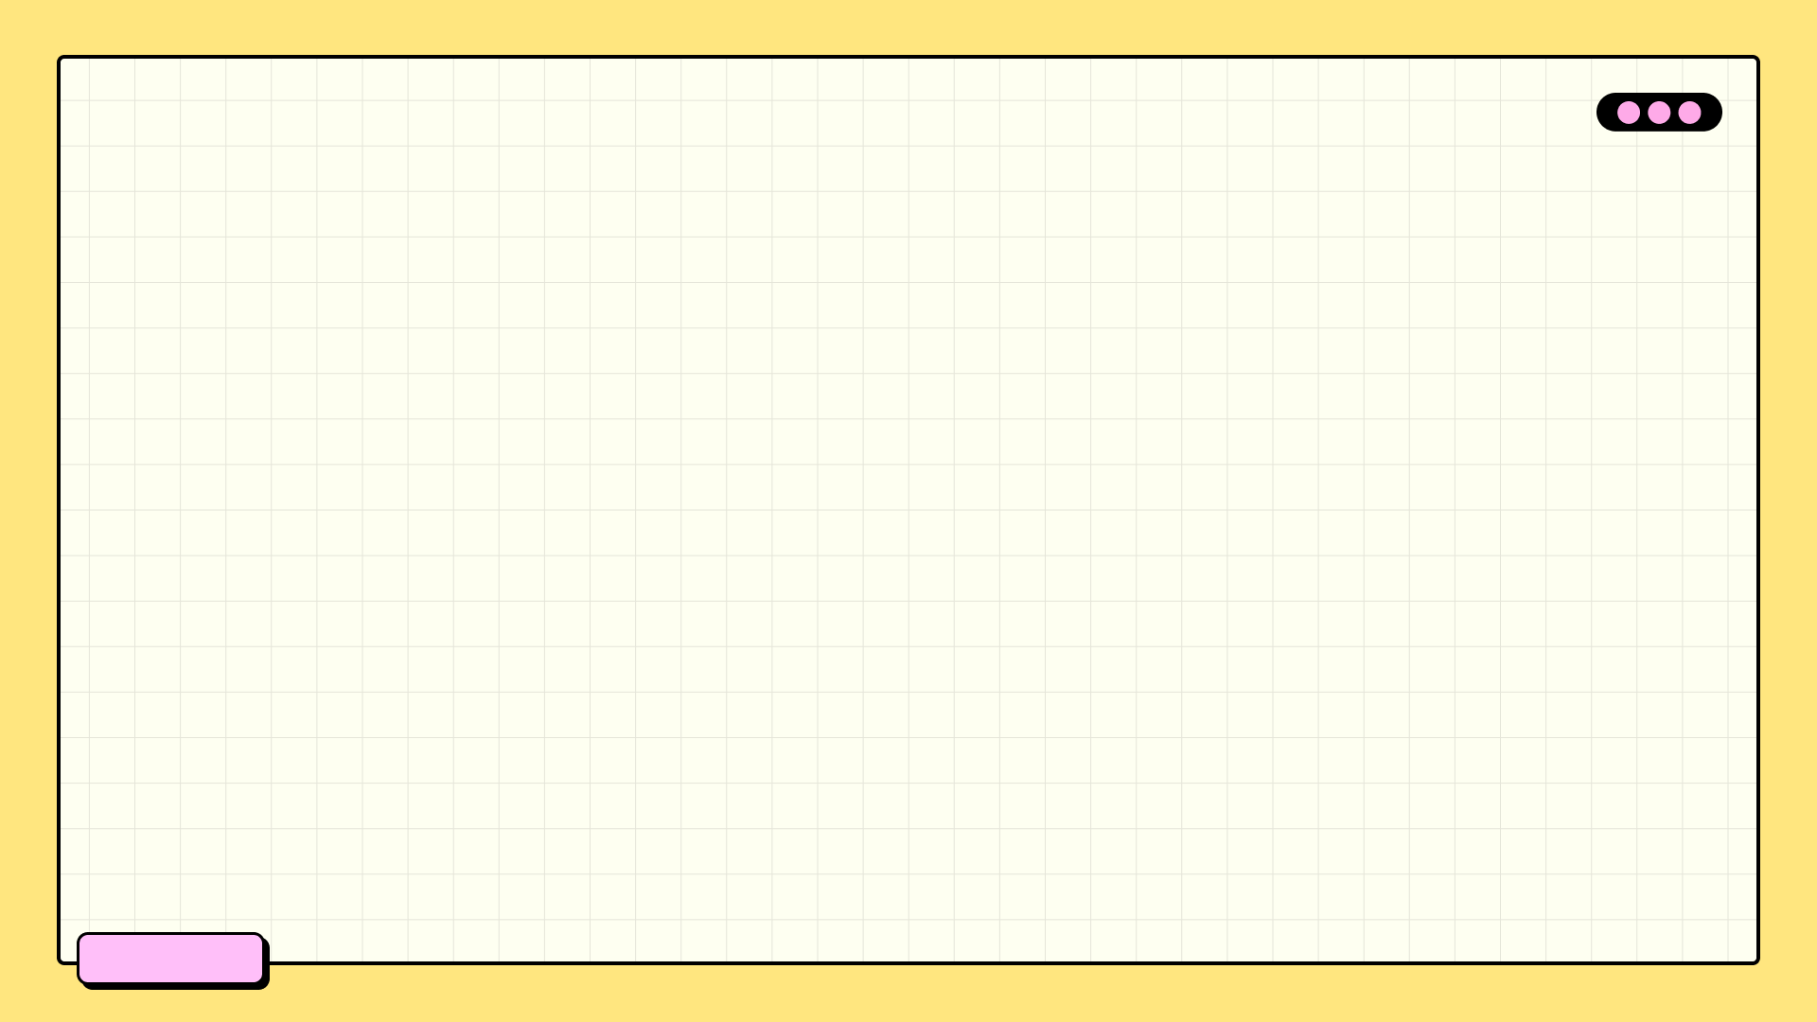

Social Media's Impact: The Mental Health Link
Anxiety Increase
35%
Depression Cases
22%
Validation Seeking
40%
Screen Time
6h+

Slide 7
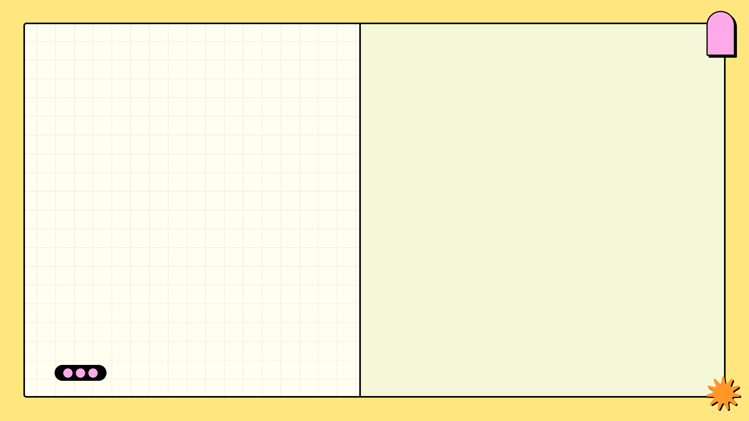
2007
✓
Digital Detox: Time Regained
Smartphone Surge
The rise of smartphones dramatically increased digital consumption. Ubiquitous internet access and addictive app design led to heightened engagement and potential for over-reliance on digital devices, impacting daily routines and attention spans.
Reduce screen time, boost focus. Reclaim your mental well-being with mindful digital habits.
✓
2012
Social Media Boom
Social media platforms became deeply integrated into everyday life. Constant connectivity fostered comparison, validation-seeking, and a potential fear of missing out (FOMO), driving increased usage and contributing to digital dependency and associated anxieties.
2017
✓
Awareness Dawns
Growing concerns emerged regarding the negative effects of excessive screen time. Studies highlighted impacts on sleep, mental health, and productivity, sparking initial conversations about digital wellbeing and strategies for managing technology use more effectively.

Slide 8
Reclaim Your Time: Digital Wellbeing
Daily Limit
2 Hrs
Focus Time
80%
Screen Free
3 Hrs
App Usage
30%

Slide 9
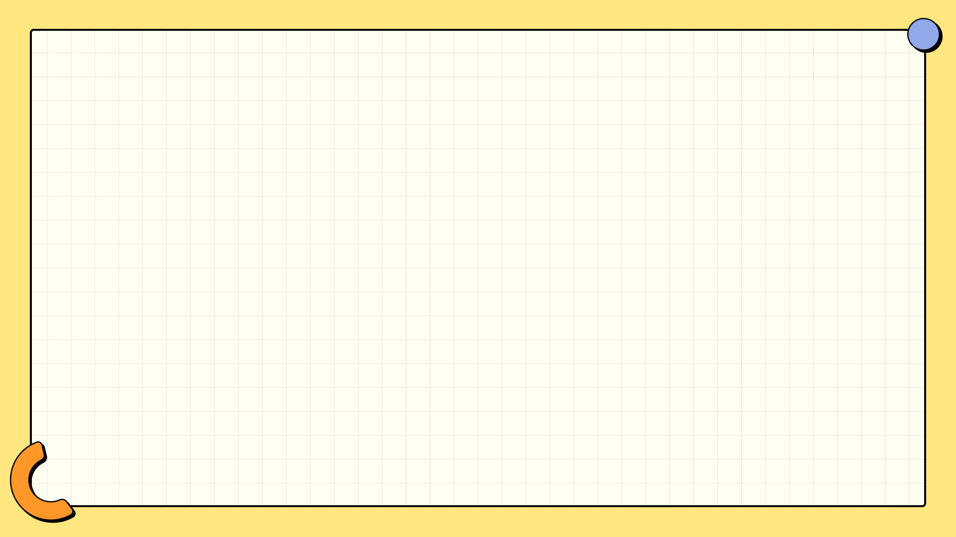
Curated Positivity: Social Media Detox
Actively remove accounts that trigger negativity or anxiety to improve your daily experience.
Follow accounts offering positive messages, motivational content, or valuable life lessons regularly.
Discover and follow accounts that share knowledge, skills, or insights to enrich your mind.
Limit your time spent scrolling and engage only with content that brings you genuine joy.

Slide 10
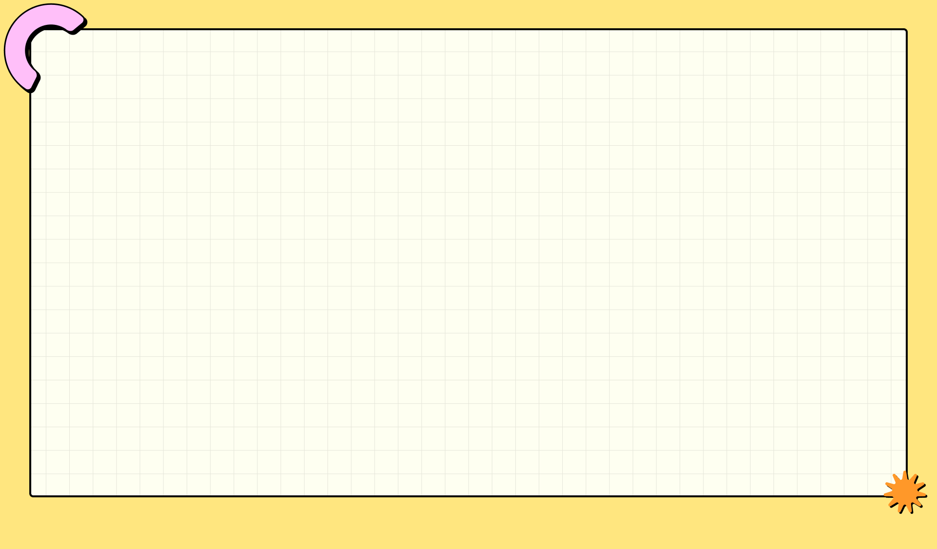

Offline Bliss
Explore new hobbies like painting, knitting, or gardening to spark creativity and reduce screen time significantly.
Engage in sports or fitness activities to boost physical health and mental well-being, and reduce digital dependence.
Immerse yourself in books to expand your knowledge, reduce stress, and disconnect from the digital world efficiently.
Explore creative outlets like writing, music, or crafting to express yourself and foster a sense of accomplishment offline.

Slide 11
Social Media: The Upside
Social media provides a platform for individuals to share their creative works with a global audience.
It simplifies staying in touch with friends and family, regardless of geographical location or time zone.
Access to diverse information and educational content fosters continuous learning and personal growth opportunities.
Social media facilitates community building around shared interests, hobbies, or professional goals.

Slide 12
Digital Dilemmas
Bright Side
Dark Side
Enhanced communication tools connect people globally, fostering collaboration and breaking down geographical barriers for information sharing.
Access to vast educational resources empowers individuals with knowledge and skills, promoting lifelong learning and personal development opportunities.
Increased efficiency through automation streamlines tasks, freeing up time for creativity, innovation, and pursuing personal passions in life.
Screen addiction, cyberbullying, and the pressure of likes can harm mental health, especially among young people facing social media pressures.
Overconsumption of digital media can lead to decreased attention spans, impacting productivity and hindering the ability to focus on complex tasks.
Privacy concerns arise from data collection and surveillance, potentially compromising personal information and eroding individual autonomy and trust.

Slide 13
Cultivating Mindful Tech Use
Anchor yourself in the present. Notice surroundings and bodily sensations to combat digital distractions.
Deliberately decide when to use technology. Avoid mindless scrolling and reactive checking of notifications.
Identify emotional triggers linked to tech use. Understand what prompts excessive or unhealthy engagement.
Develop strategies for managing triggered feelings without relying solely on technology for comfort or escape.

