Slide 1
Empowering School Children through Group Development Programs
Creating a Positive Learning Environment for Young Minds

Slide 2
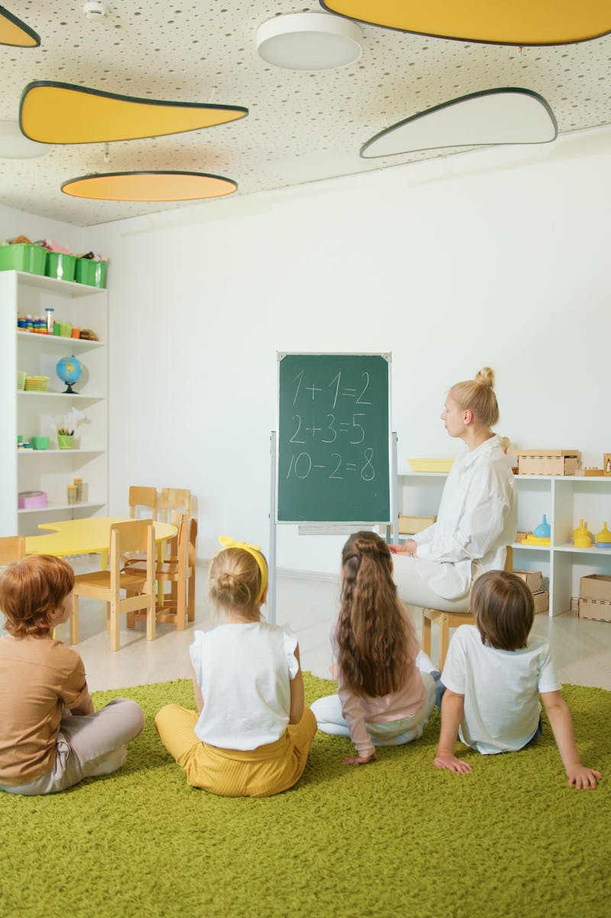
Introduction
• Importance of group development programs for school children
• Understanding the need for an adjusted agenda
• Benefits of fast-paced learning
• Emphasizing the role of school in personal growth
Photo by Pexels

Slide 3
Program Objectives
• Enhancing social and emotional skills
• Developing teamwork and collaboration
• Improving communication and problem-solving abilities
• Building self-confidence and resilience
Photo by Pexels

Slide 4
Agenda Adjustment
• Flexible scheduling to suit different learning styles
• Incorporating interactive and experiential activities
• Ensuring balance between academic and personal development
• Aligning with the curriculum and educational goals
Photo by Pexels

Slide 5
Fast Sheet Approach
• Condensed presentation of key concepts and skills
• Promoting quick understanding and retention
• Utilizing visual aids and memory techniques
• Encouraging active participation and engagement
Photo by Pexels

Slide 6
Empowering School Children
• Fostering independence and decision-making
• Nurturing leadership and critical thinking
• Encouraging creativity and innovation
• Instilling a growth mindset
Photo by Pexels

