Slide 1
Discovering New York City: The Big Apple's Endless Wonders
Unveiling the rich history, cultural diversity, and iconic landmarks of New York City

Slide 2
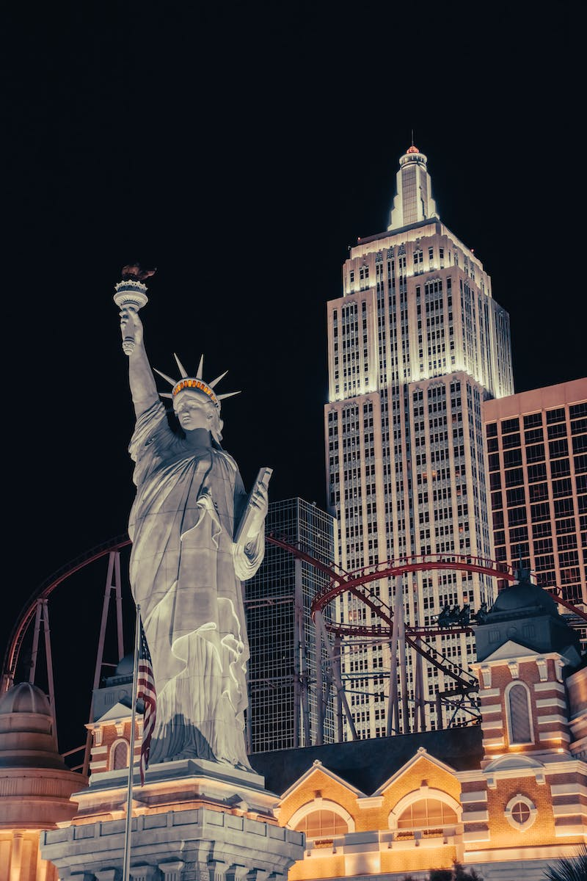
Welcome to New York City
• Located in the northeast region of the United States
• Home to over eight million residents and fifty million annual visitors
• Shaped by waves of immigrants in search of hope and liberty
• Influences radiate globally, touching every corner of the world
Photo by Pexels

Slide 3
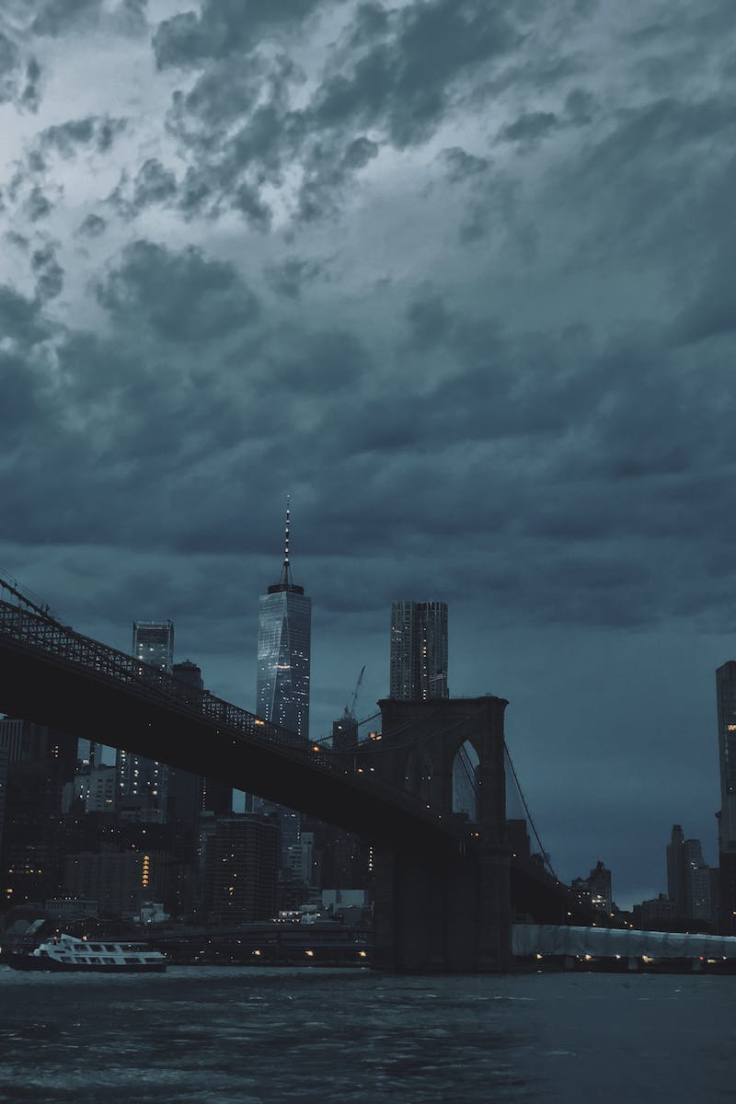
Exploring the Heart of the City: Manhattan
• Manhattan's midtown district boasts iconic symbols of New York City
• The Empire State Building, an impressive and historic skyscraper
• Rockefeller Center, a visionary complex with stunning views
• Grand Central Terminal, an iconic transportation hub
Photo by Pexels

Slide 4
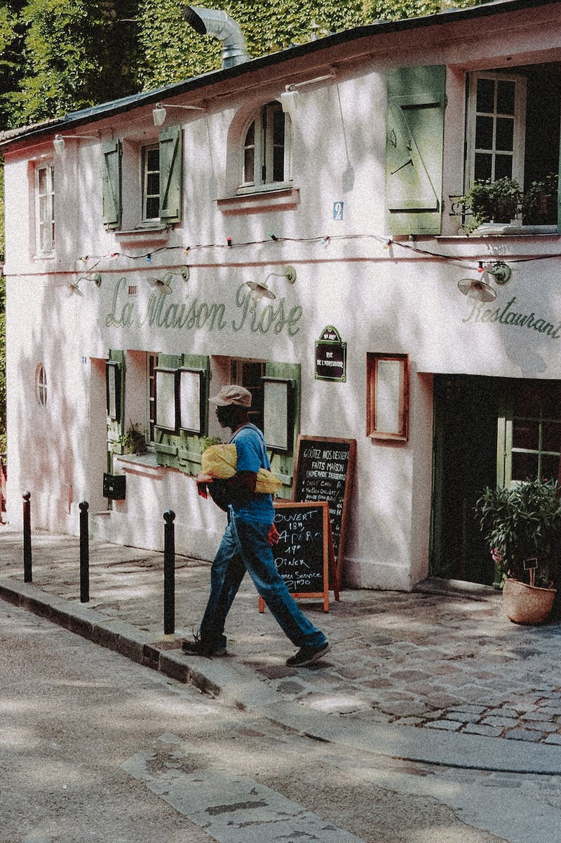
The Shopping Paradise: Fifth Avenue & Times Square
• Fifth Avenue, a high temple of the retail world
• Eye-popping window displays and exclusive shopping experiences
• Times Square, a globally renowned tourist attraction
• Broadway shows and half-price tickets
Photo by Pexels

Slide 5
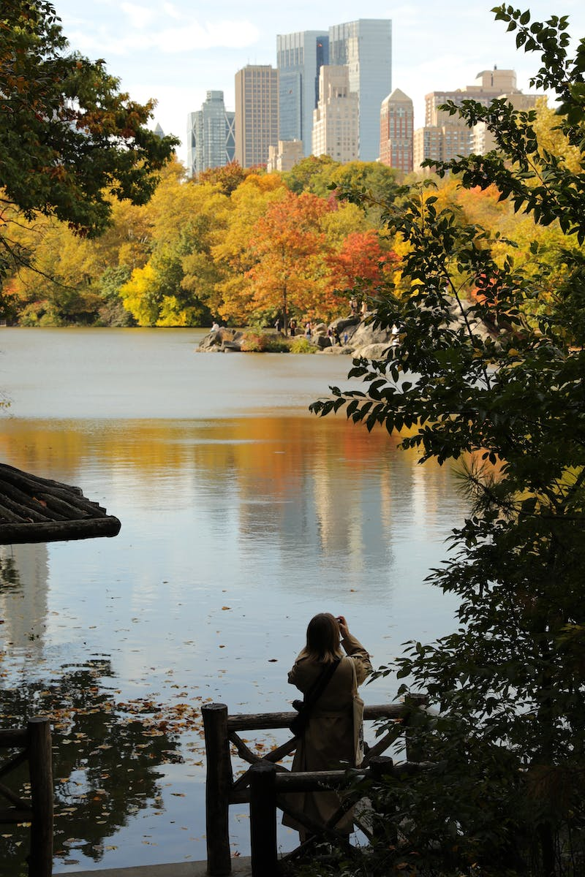
Nature's Oasis in the Concrete Jungle: Central Park
• Central Park, an expansive green oasis in the heart of the city
• Eight hundred and fifty acres of meadows, lakes, and serenity
• A place for relaxation, romance, and self-expression
• Escape from the bustling urban environment
Photo by Pexels

Slide 6
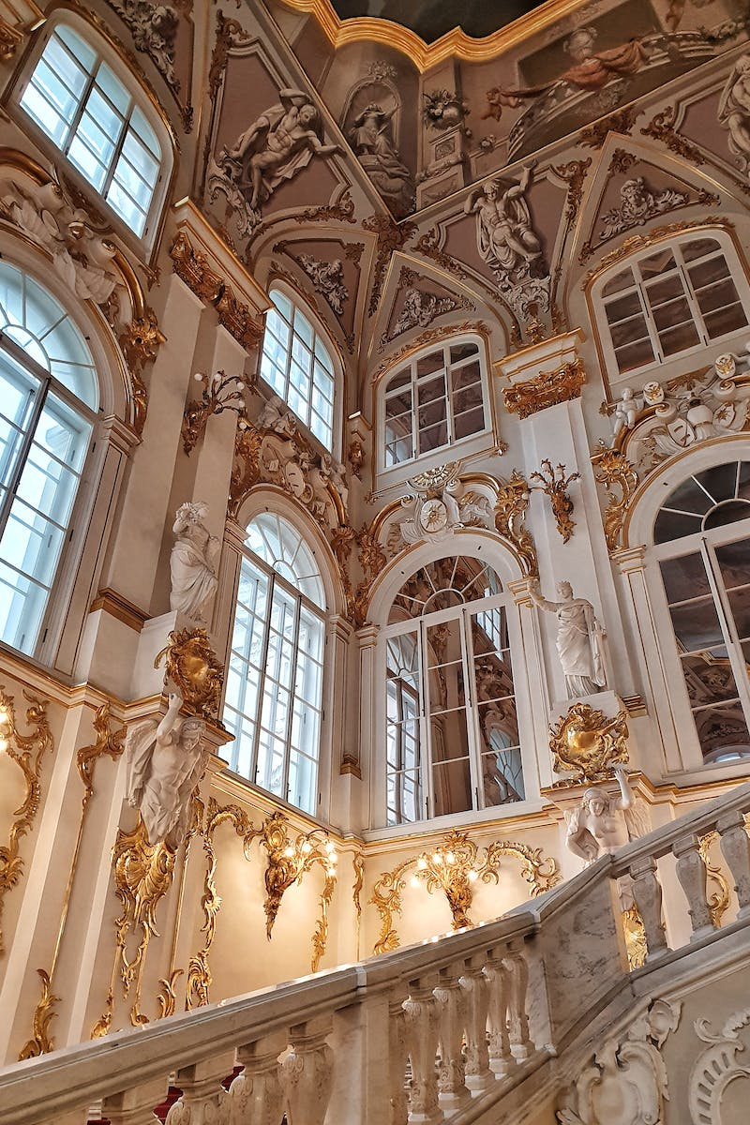
Artistic Masterpieces: The Metropolitan Museum of Art & Guggenheim
• The Metropolitan Museum of Art: a treasure trove of historical and contemporary artwork
• Five thousand years of creative achievements from around the world
• The Guggenheim: a unique architectural marvel
• Exhibiting twentieth and twenty-first century masterpieces
Photo by Pexels

Slide 7
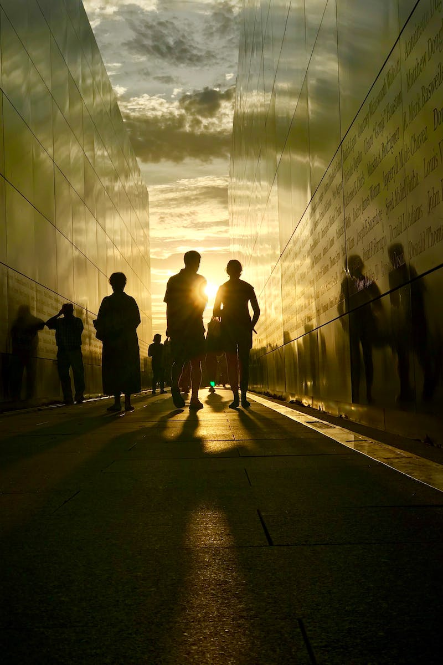
Honoring the Past: Reflecting Absence Memorial & Museum
• Reflecting Absence Memorial & Museum commemorates the victims of 9/11
• A solemn tribute to the lives lost on that fateful day
• A place to reflect, remember, and pay respects
• A reminder of resilience and unity
Photo by Pexels

Slide 8
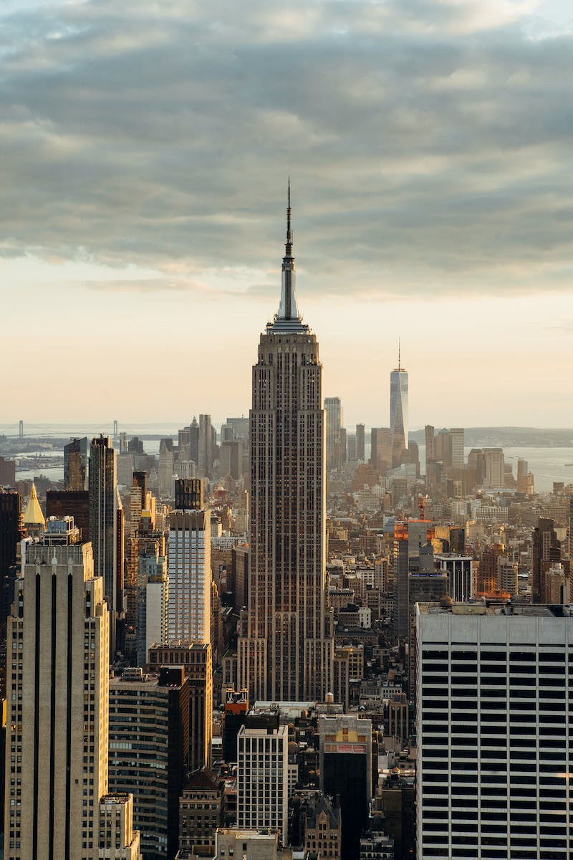
Celebrating Diversity: Neighborhoods of New York City
• Little Italy: an enclave of Italian culture and cuisine
• Soho: a trendy hub attracting global creative talents
• Greenwich Village: a historic neighborhood with artistic heritage
• Brooklyn: a melting pot of distinctive neighborhoods and attractions
Photo by Pexels

Slide 9
Indulge in the Best: A City of Endless Possibilities
• New York City offers endless opportunities for a fulfilled life
• A melting pot of art, culture, culinary experiences, and more
• A destination brimming with excitement and adventure
• Discover the finest life has to offer in the Big Apple
Photo by Pexels

