Slide 1
Principles of Biochemistry and Clinical Chemistry Tests
Understanding the Measurement and Calibration Process

Slide 2
Introduction to Clinical Chemistry Tests
• Biochemistry and clinical chemistry tests measure concentrations or activities of biological substances called analytes in various body fluids.
• Common body fluids include whole blood, plasma, serum, urine, and cerebrospinal fluid.
• These tests provide diagnostic and clinical meanings for the values obtained from the measurements.
• The quantitation of routine chemistry analytes is typically based on photometry or potentiometry.
Photo by Pexels

Slide 3
Measurement Principles in Clinical Chemistry
• Measurement of light using photometry or spectrophotometry is one principle used for quantitation of analytes.
• Measurement of electrochemical potential, also known as potentiometry, is another principle used.
• The amount of light or electrical voltage is predictably related to the amount of analyte in the solution.
• Calibrators are solutions of known concentration and establish the relationship between the signal and analyte concentration.

Slide 4
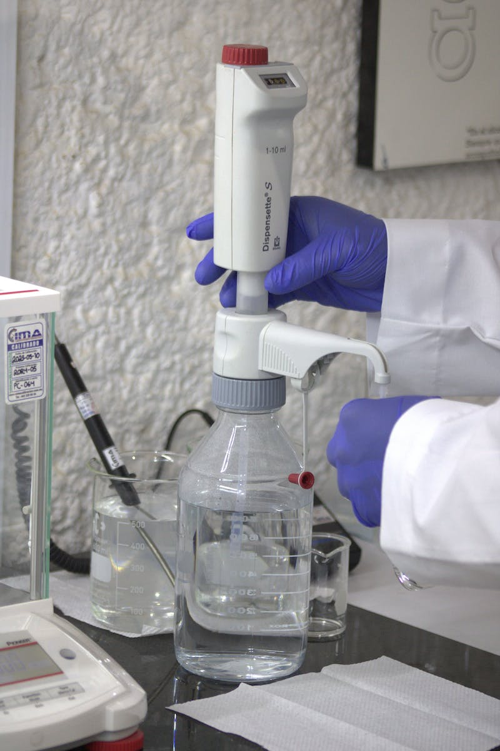
Calibration in Biochemistry Analysis
• Calibration is the process of creating a standard curve using samples with known values.
• This curve is used for analyzing unknown samples and determining their concentration.
• Calibrators have a specified value traceable to the standard units, ensuring accuracy.
• Both single point and multi-point calibrations can be used based on the assay requirements.
Photo by Pexels

Slide 5
Quality Controls in Clinical Chemistry
• Quality controls (QCs) are patient-like materials with known analyte concentrations.
• QCs should be tested using the same procedure as patient samples to ensure the accuracy of the analytical system.
• The absorbance values of QCs should lie within a specified range determined by the laboratory.
• Regular calibration and QC testing ensure the analytical system is functioning properly.
Photo by Pexels

Slide 6
Endpoint Reaction in Biochemistry Analysis
• Endpoint reactions are used to estimate analytes that are completely consumed in the chemical reaction.
• The absorbance increases over time until it reaches a stable value, which marks the endpoint of the reaction.
• Absorbance is proportional to the analyte concentration and is measured at a specific wavelength.
• Glucose measurement using the glucose oxidase or peroxidase method is an example of an endpoint reaction.
Photo by Pexels

Slide 7
Fixed Time Method in Biochemistry Analysis
• Fixed time methods assess the difference in absorbance between an initial and final value during a specified time interval.
• These tests have a pre-incubation period to remove substances interfering with the reagent system.
• The difference in absorbance is used to calculate the analyte concentration.
• Creatinine measurement using the Jaffe's method is an example of a fixed time method.
Photo by Pexels

Slide 8
Kinetic Method in Biochemistry Analysis
• Kinetic methods measure the difference in absorbance between two points over a specified time period.
• A constant amount of product is assumed to be produced during this time period.
• The difference in absorbance is used to calculate the analyte concentration.
• SGOT measurement using the FCC method without pyridoxal phosphate is an example of a kinetic method.
Photo by Pexels

