Slide 1
The Significance of Replica Vessels
Exploring the Seamlessness of Replicas in Historical Context

Slide 2
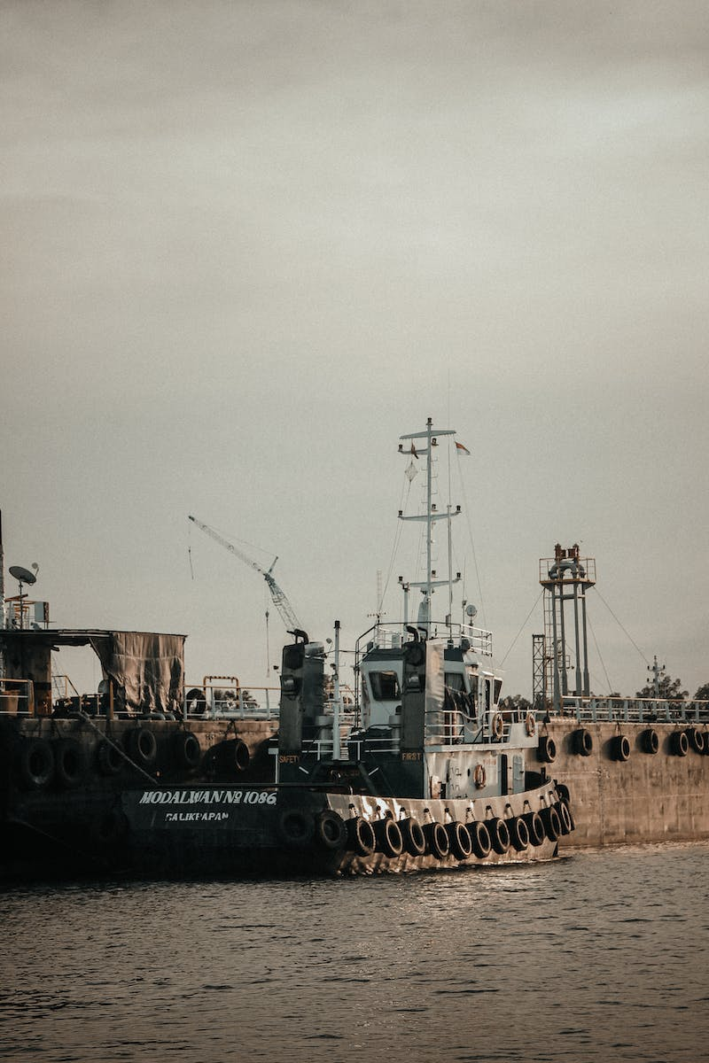
Introduction: The Importance of Replicas
• Replicas hold historical and cultural significance
• Allow for preservation and study of original artifacts
• Provide accessibility to a wider audience
• Replicate the aesthetic and craftsmanship of the originals
Photo by Pexels

Slide 3
The Role of Replicas in Naval History
• Replica vessels help in understanding historical naval practices
• Provide insights into shipbuilding techniques and design
• Allow for experimental archaeology and practical understanding
• Enable reenactments and immersive experiences
Photo by Pexels

Slide 4
Replicas for Education and Research
• Replica vessels serve as educational tools
• Allow for hands-on learning experiences
• Contribute to maritime research and exploration
• Enable experimental restoration and conservation
Photo by Pexels

Slide 5
Replicas and the Preservation of Cultural Heritage
• Replica vessels preserve cultural heritage
• Protect original artifacts from wear and tear
• Safeguard against potential loss or destruction
• Facilitate the sharing of cultural traditions
Photo by Pexels

Slide 6
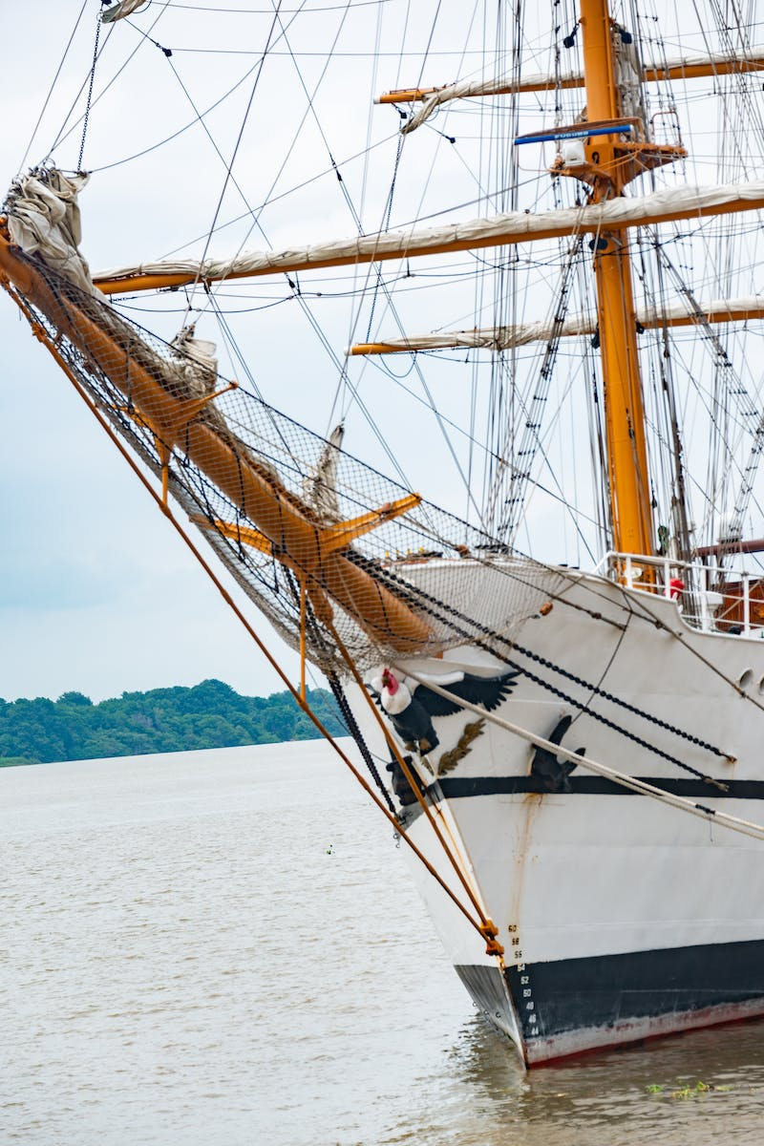
Conclusion: The Seamless Value of Replicas
• Replicas provide a seamless connection to historical contexts
• Enable the appreciation of craftsmanship and design
• Expand accessibility and understanding for future generations
• Continue to inspire and spark curiosity
Photo by Pexels

