Slide 1
Licensing System of Securities and Futures Commission
Understanding the requirements and exemptions

Slide 2
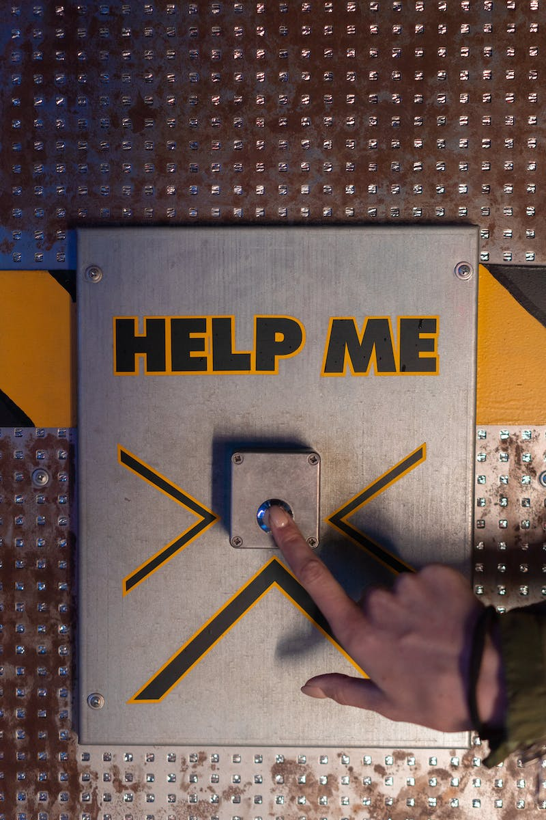
Introduction to Licensing System
• Chapter three discussed the need to apply for a license for regulated activities
• Licensing system of Securities and Futures Ordinance
• Types of regulated activities and single license regime
• Who can obtain licenses or registrations
Photo by Pexels

Slide 3
Registered Institutions
• Authorized financial institutions engaged in regulated activities
• Registration required for authorized financial institutions
• Registered Institution: Authorized financial institution approved by Hong Kong Monetary Authority
• Engaged in activities regulated by Securities and Futures Commission
Photo by Pexels

Slide 4
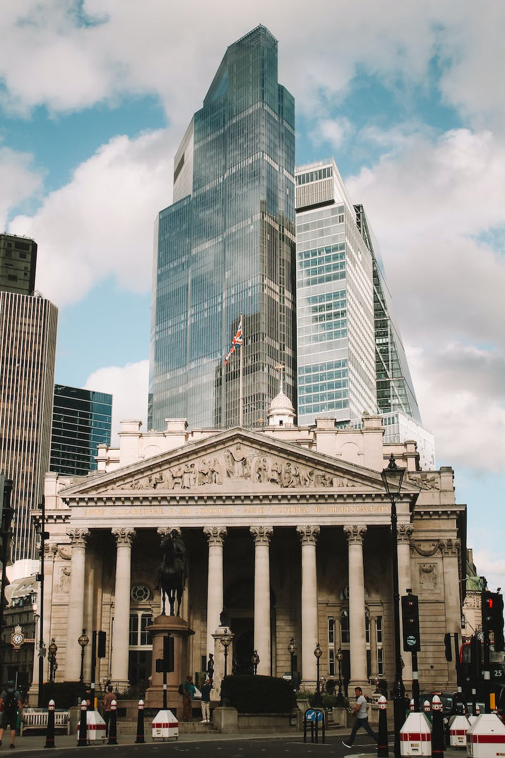
Exemptions for Authorized Financial Institutions
• Special circumstances exempting Authorized Financial Institutions
• Type three or type eight regulated activities exemption from registration requirements
• No need to become a registered institution
Photo by Pexels

Slide 5
Conditions for Individual Engagement
• Conditions for individuals to engage in regulated activities for registered institutions
• Name in the register maintained by Hong Kong Monetary Authority
• Recognition as a recognized person
• Involvement with a specific registered institution
• Engaging in a certain type of regulated activity
Photo by Pexels

Slide 6
Responsible Officers for Registered Institutions
• Responsible officers in registered institutions
• Appointment by the registered institution
• Approval and supervision by the Hong Kong Monetary Authority
• Supervisory functions and responsibilities for regulated activities
• Nomination and application process for responsible officers
Photo by Pexels

Slide 7
Licensing and Registration Requirements
• Other requirements for licensing and registration
• Permission for licensed persons to conduct certain regulated activities
• Temporary and provisional licenses
• Approval for substantial shareholders
• Fit and proper guidelines for eligibility
Photo by Pexels

Slide 8
Conditions Imposed on Licenses
• Imposing conditions on licenses
• Limitations on client servicing and business conduct
• Protection of retail investors
• Restrictions on certain titles by unlicensed persons
• Imposing limitations on licensed corporations
Photo by Pexels

Slide 9
Responsibilities of the Board
• Board's responsibility for conduct, operations, and financial soundness
• Board's involvement in license applications
• Submission of data and confirmation of information
Photo by Pexels

Slide 10
Licensed Representative's Resignation
• Notification requirement for licensed representative's resignation
• Notify the Securities and Futures Commission within seven days
• License transfer to another licensed company
• Revocation of license after 180 days without new employment
Photo by Pexels

Slide 11
Temporary and Provisional Licenses
• Temporary licenses for corporations principally conducting business overseas
• Limited validity and total duration
• Allowed regulated activities
• Provisional licenses for individuals or corporations applying for formal licenses
• Validity until final decision by the Securities and Futures Commission
Photo by Pexels

Slide 12
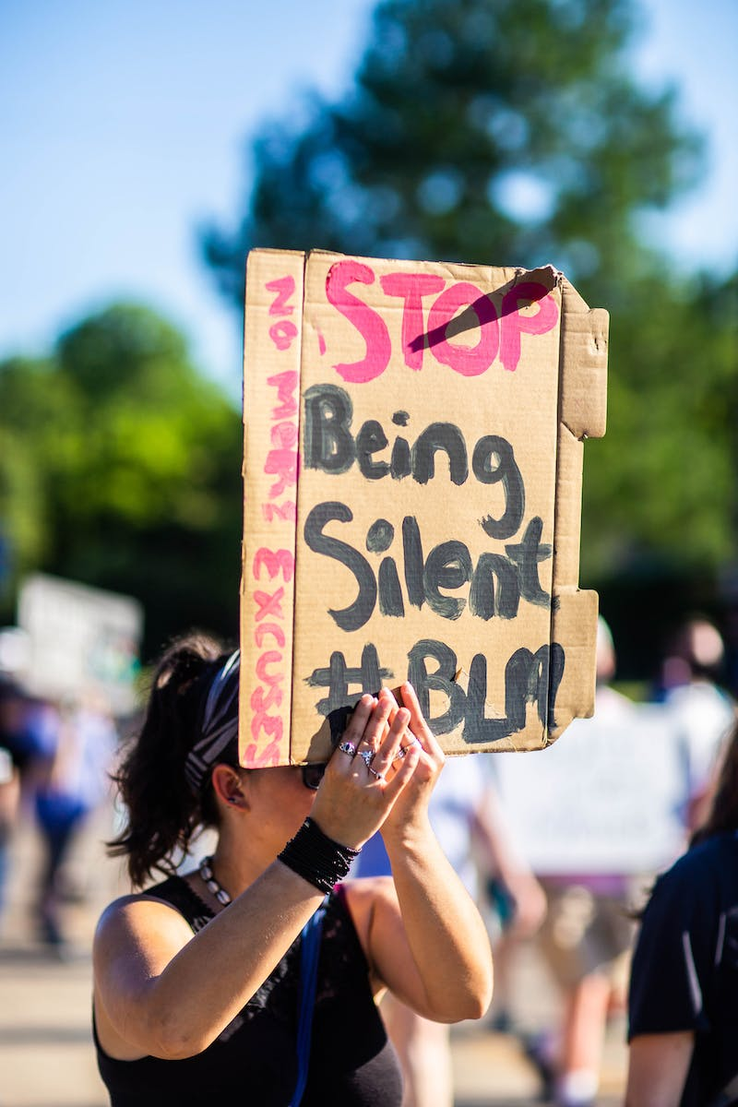
Restrictions on Title Usage
• Title restrictions for unlicensed persons
• Prohibition of using certain titles without a license
• Prevention of misrepresentation and false claims
• Reputational and trust-building measures
Photo by Pexels

Slide 13
Fit and Proper Guidelines
• Requirements for fit and proper individuals and institutions
• Financial status, competence, and capability
• Character and integrity assessment
• Ongoing monitoring and compliance
• Importance of meeting fit and proper criteria
Photo by Pexels

Slide 14
Sponsor Guidelines
• Additional competence requirements for sponsors and compliance advisors
• Appointment of principles for supervision
• Minimum capital requirement
• Continuous professional training for individuals
• Regulatory compliance for sponsors and compliance advisors
Photo by Pexels

