Slide 1
Exploring New York City
A journey through the iconic landmarks and hidden gems of the Big Apple

Slide 2
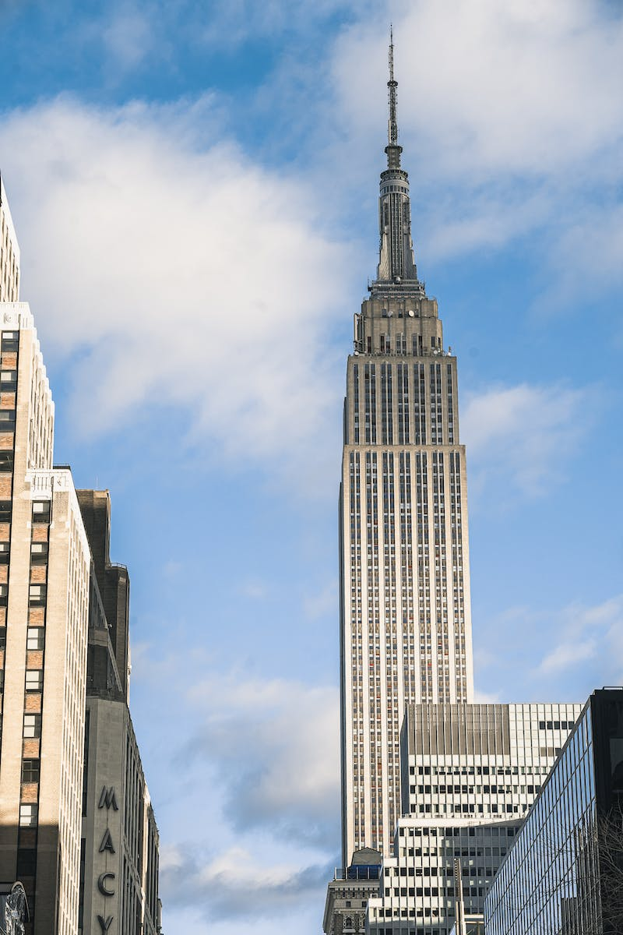
Introduction to New York City
• One of the most vibrant and diverse cities in the world
• Home to over 8.4 million people
• Known as the cultural, financial, and media capital of the world
• Famous for its iconic skyline, bustling streets, and rich history
Photo by Pexels

Slide 3
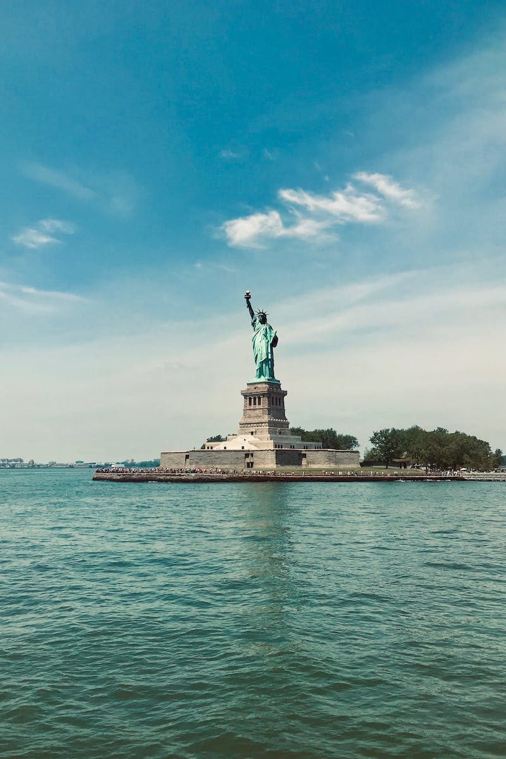
Landmarks of New York City
• Statue of Liberty - a symbol of freedom and democracy
• Empire State Building - an architectural marvel and a must-visit observation deck
• Central Park - a peaceful oasis amidst the concrete jungle
• Times Square - the bustling heart of entertainment and lights
• Brooklyn Bridge - an iconic example of engineering and a pedestrian-friendly pathway
Photo by Pexels

Slide 4
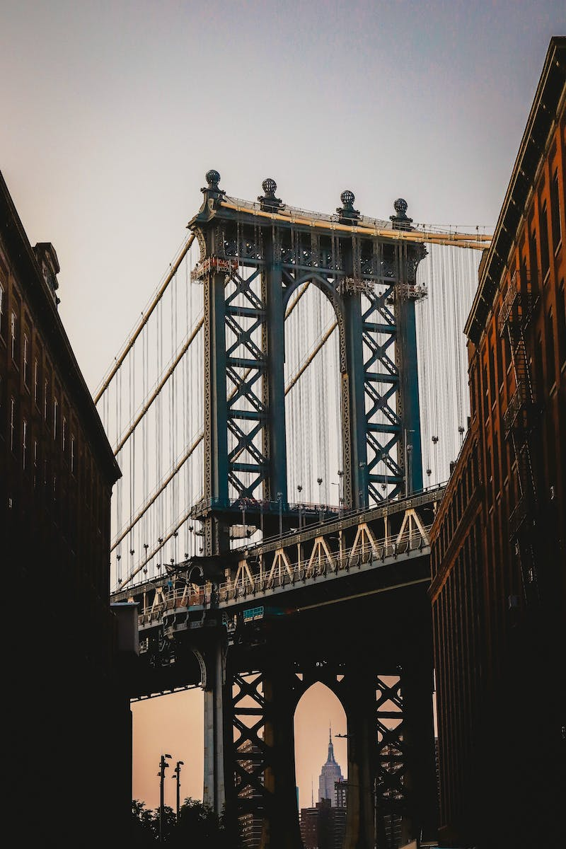
Cultural Diversity in New York City
• Melting pot of cultures and ethnicities
• Little Italy - renowned for its delicious Italian cuisine
• Chinatown - a vibrant neighborhood offering authentic Asian experiences
• Harlem - the historic center of African-American culture and music
• Queens - the most ethnically diverse urban area in the world
Photo by Pexels

Slide 5
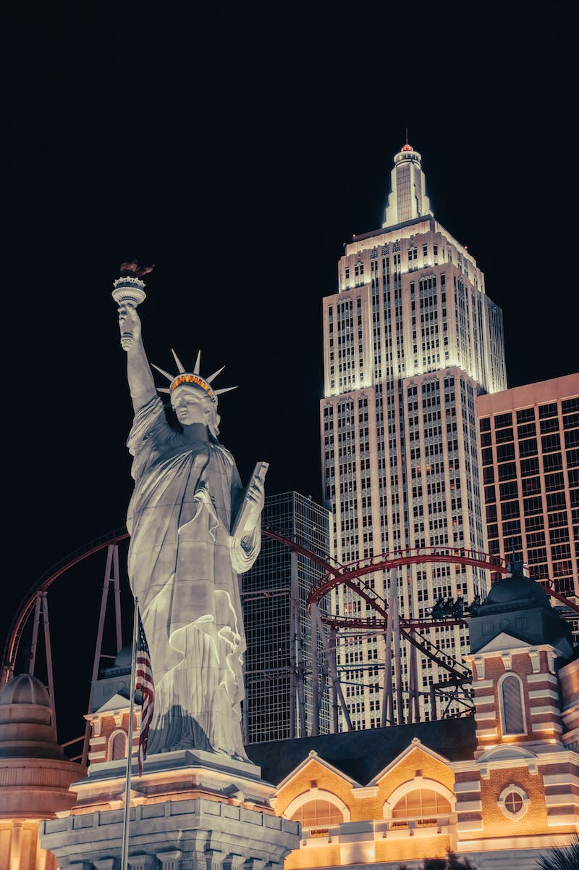
Hidden Gems of New York City
• High Line Park - an elevated park with stunning views and unique green spaces
• Brooklyn Flea Market - a treasure trove of vintage finds and artisanal goods
• The Cloisters - a medieval art museum nestled in Fort Tryon Park
• Coney Island - a nostalgic beachfront amusement district with historic rides
• Williamsburg - a trendy neighborhood known for its artsy vibe and hipster culture
Photo by Pexels

Slide 6
Conclusion
• New York City is a city like no other, offering endless possibilities for exploration
• From iconic landmarks to diverse cultural experiences and hidden gems
• Plan your visit to this vibrant metropolis and immerse yourself in its energy and charm
Photo by Pexels

