Slide 1
Understanding the Immune System Response
Exploring the Adaptive Immune System

Slide 2
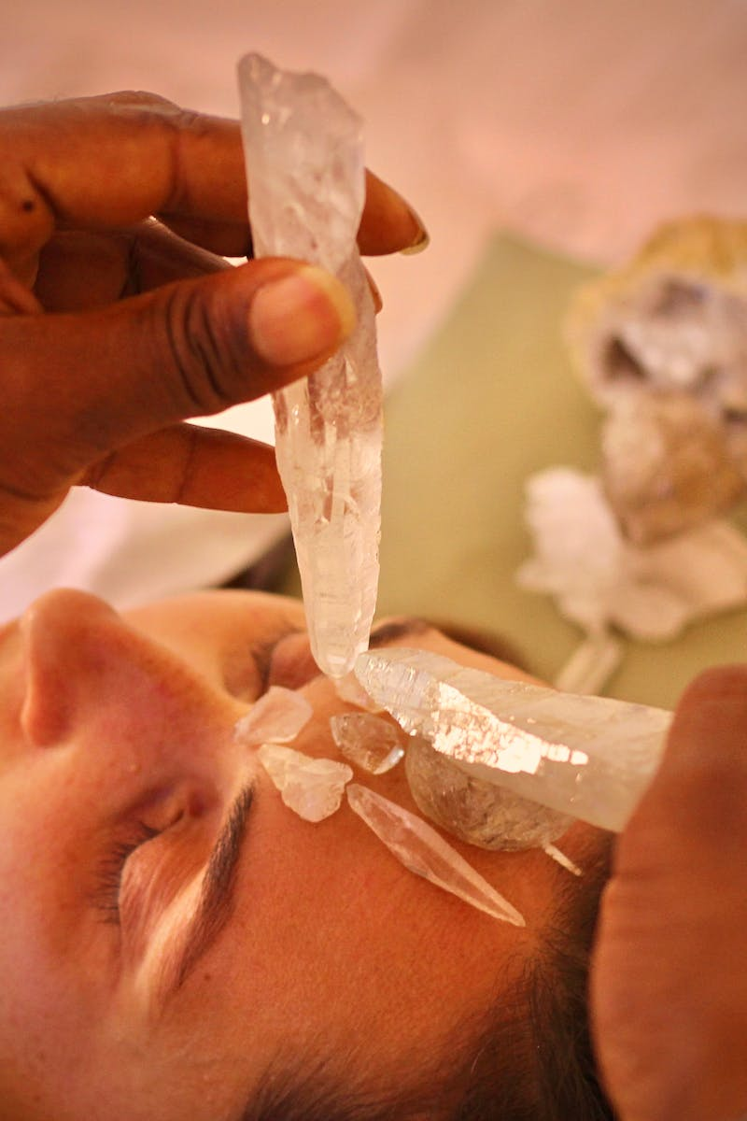
Introduction to the Immune System
• Two branches: innate and adaptive
• Innate response immediate but non-specific
• Adaptive response specific and targeted
• Adaptive response necessary to contain infections
Photo by Pexels

Slide 3
Adaptive Immune Response
• B cells and T cells are fundamental
• Humor mediated immunity by B cells
• Cell mediated immunity by T cells
• B cells provide immunity in fluids
• T cells protect from infections within cells
Photo by Pexels

Slide 4
Containing Infections
• B cells produce and release antibodies
• Antibodies bind to bacteria and viruses
• Phagocytes engulf and destroy pathogens
• Innate immune response involved in destruction
Photo by Pexels

Slide 5
Cell Mediated Immunity
• T cells respond by killing infected cells
• Cd eight cy T cells for virus-infected cells
• Cd eight cy T cells can also kill cancer cells
• Preserving overall health by stopping spread
• Ph cells destroy cell particles and viral proteins
Photo by Pexels

Slide 6
Specificity of Adaptive Immunity
• Antibodies and T cells are specific to pathogens
• Antibodies have specific binding sites
• One B cell secretes one type of antibody
• Multiple B cells needed for proper immunity
• T cell receptors determine infected cell binding
Photo by Pexels

