Slide 1
The Power of Artificial Intelligence
Exploring the Impact and Potential of AI Technologies

Slide 2
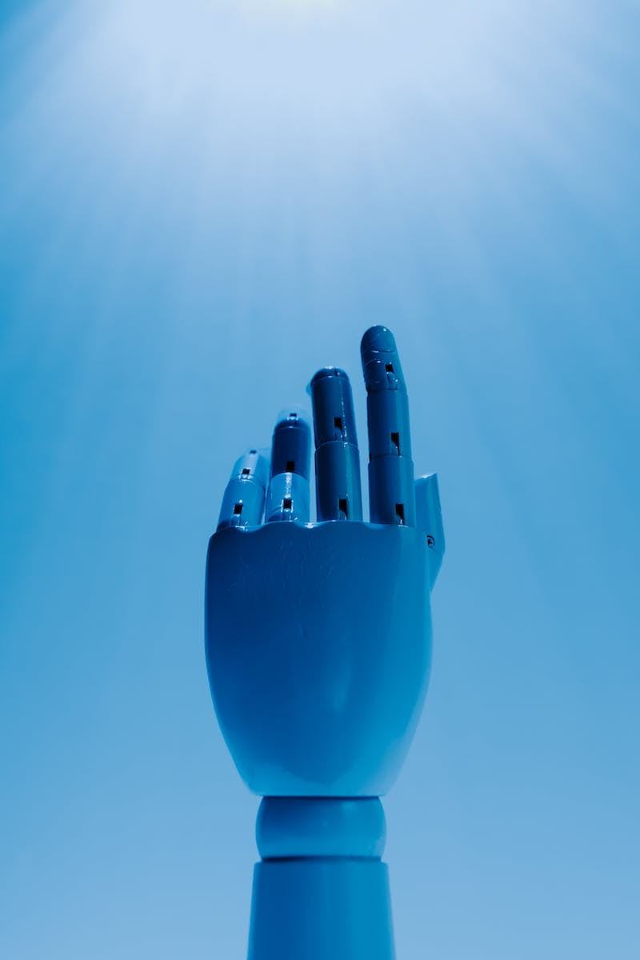
Introduction to Artificial Intelligence
• AI is a branch of computer science that focuses on creating intelligent machines.
• It involves simulating human intelligence in machines to perform tasks that would typically require human intelligence.
• AI technologies include machine learning, natural language processing, and computer vision.
• AI has the potential to revolutionize industries and improve various aspects of our lives.
Photo by Pexels

Slide 3
Applications of Artificial Intelligence
• AI is used in various industries, including healthcare, finance, and transportation.
• In healthcare, AI can assist in diagnosing diseases and developing personalized treatment plans.
• In finance, AI algorithms can analyze large datasets to detect fraud and make investment predictions.
• In transportation, AI is employed for autonomous vehicles and improving traffic management.
• These are just a few examples of how AI is transforming different sectors.
Photo by Pexels

Slide 4
Challenges and Risks of Artificial Intelligence
• While AI offers numerous benefits, it also presents several challenges and risks.
• One challenge is the ethical implications of AI, such as privacy concerns and biases in algorithms.
• Another challenge is the potential job displacement due to automation in various industries.
• Additionally, AI can be vulnerable to malicious use, raising concerns about cybersecurity.
• Addressing these challenges and managing the risks is crucial for responsible AI development.
Photo by Pexels

Slide 5
Future Trends in Artificial Intelligence
• The field of AI is rapidly evolving, with several exciting future trends.
• One trend is the development of explainable AI, which aims to provide transparency and understandability in AI decision-making processes.
• Another trend is the integration of AI with other emerging technologies like blockchain and the Internet of Things.
• Furthermore, AI is expected to play a crucial role in addressing global challenges, such as climate change and healthcare.
• These future trends indicate a promising and impactful future for artificial intelligence.
Photo by Pexels

