Slide 1
The Impact of Climate Change on Biodiversity
Exploring the consequences of global warming on Earth's ecosystems

Slide 2
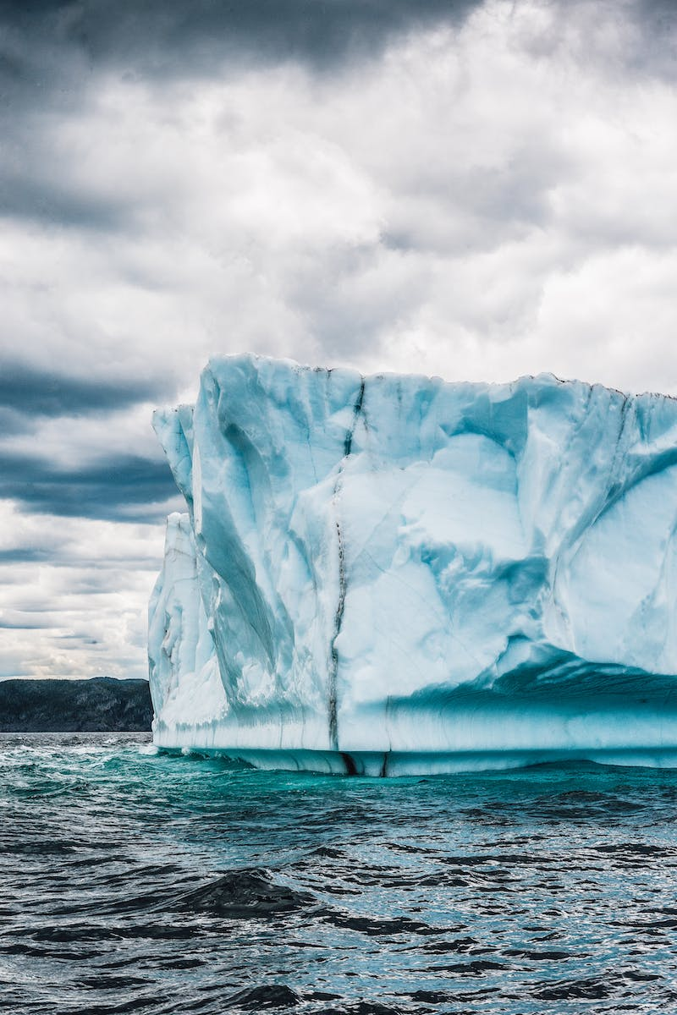
Introduction
• Definition of climate change
• Overview of its causes
• Importance of biodiversity
• Objective of the presentation
Photo by Pexels

Slide 3
Current Climate Patterns
• Rise in global temperatures
• Increase in extreme weather events
• Changing precipitation patterns
• Ocean acidification
Photo by Pexels

Slide 4
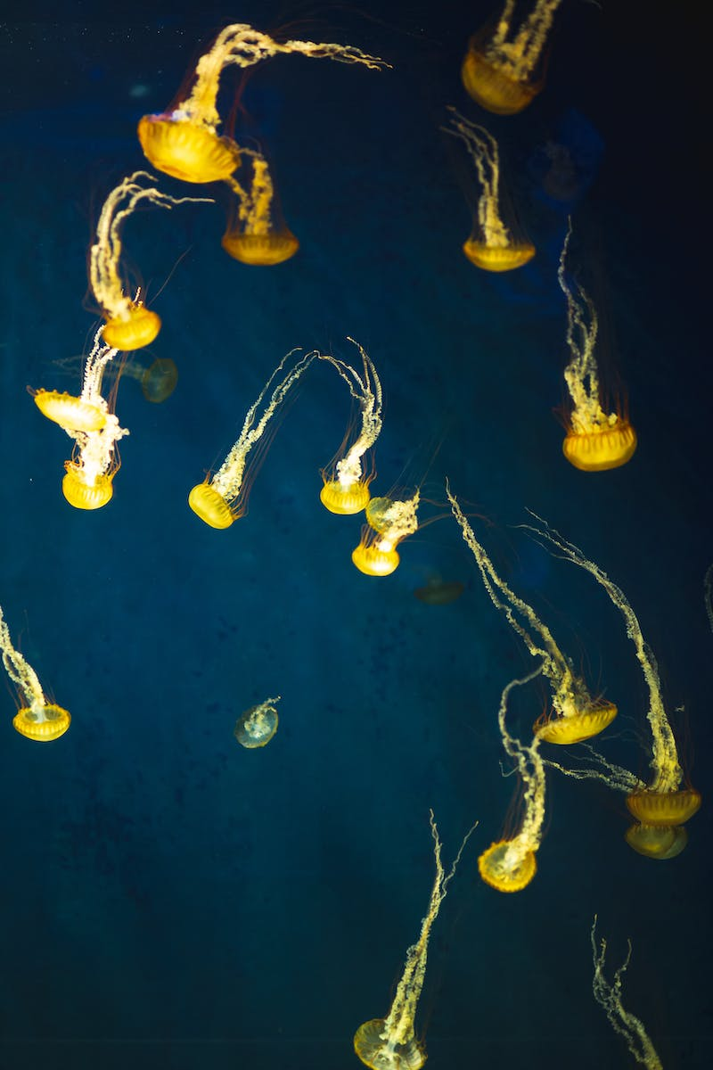
Climate Change and Species Extinction
• Impact of habitat loss and degradation
• Shifts in species distribution
• Altered phenology and reproductive cycles
• Increased vulnerability to diseases
Photo by Pexels

Slide 5
Ecosystem Disruption
• Changing food webs and trophic interactions
• Loss of keystone species
• Reduced ecosystem resilience
• Increased risk of invasive species
Photo by Pexels

Slide 6
Conservation Strategies
• Protected area management
• Habitat restoration and connectivity
• Species conservation and reintroduction
• Mitigation of climate change
Photo by Pexels

Slide 7
Conclusion
• Summary of key points discussed
• Importance of global collaboration
• Call to action for individuals
• Future prospects and challenges
Photo by Pexels

