Slide 1
The Power of Gathering
Unleashing the potential of collaboration

Slide 2
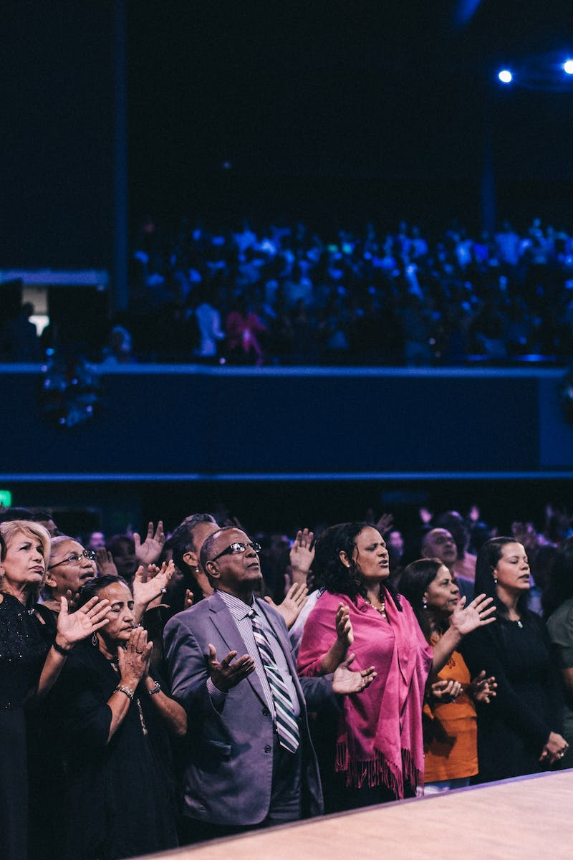
Introduction
• Gathering fosters creativity and innovation
• Connecting ideas and knowledge
• Building strong relationships and networks
• Unleashing the power of collaboration
Photo by Pexels

Slide 3
The One Kappa
• The One Kappa concept promotes focused and purposeful gathering
• Selecting a key objective and specific participants
• Creating an environment for deep discussions and exchanges
• Maximizing the value and impact of the gathering
Photo by Pexels

Slide 4
Flores Approach
• The Flores Approach enhances collaboration and decision-making
• Applying linguistic-action perspective
• Using speech acts and commitments
• Enabling effective communication and coordination
Photo by Pexels

Slide 5
To Lung Then Per
• To Lung Then Per strategy for continuous improvement
• Identifying areas of improvement
• Implementing changes incrementally
• Continuously assessing and adapting
Photo by Pexels

