Slide 1
The Power of Music
Exploring the impact of music on individuals and society

Slide 2
Introduction
• Music is a universal language that connects people across cultures
• It has the power to evoke emotions and inspire action
• Music can be a form of personal expression and a tool for social change
• Join us as we explore the profound influence of music
Photo by Pexels

Slide 3
The Healing Power of Music
• Music can be therapeutic, providing comfort and relief from pain
• It has been shown to reduce stress and anxiety
• Music therapy is used to improve the well-being of individuals
• Music can bring people together and create a sense of community
Photo by Pexels

Slide 4
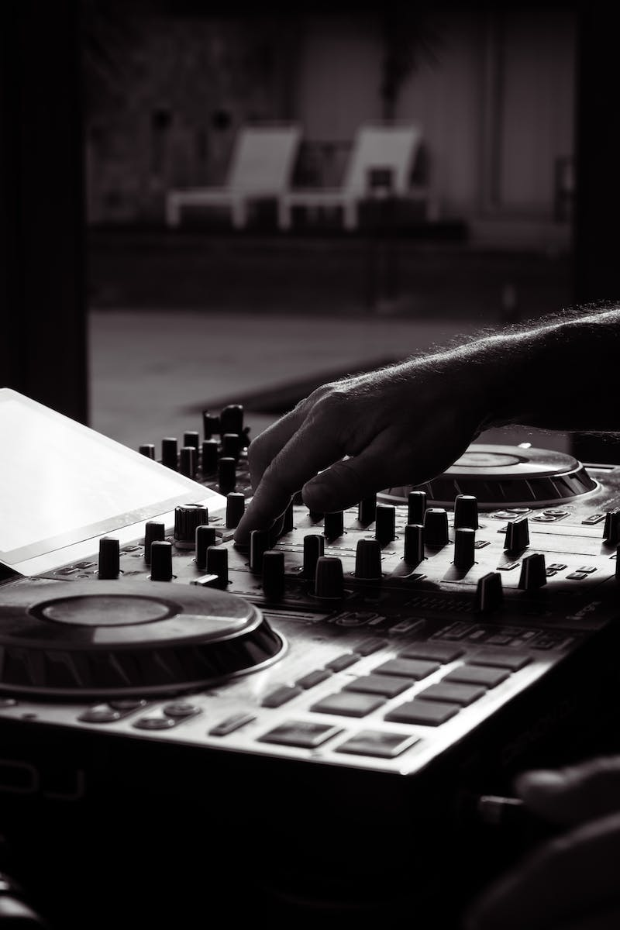
Music and Social Change
• Throughout history, music has played a role in social movements
• Protest songs have inspired activism and challenged the status quo
• Musicians have used music as a platform to raise awareness and promote social justice
• Music can unite people and amplify marginalized voices
Photo by Pexels

Slide 5
Music and Personal Expression
• Music allows individuals to express their emotions and experiences
• Songwriting can be a form of catharsis and self-discovery
• Listening to music can provide a sense of identity and belonging
• Music can be a powerful tool for storytelling and communication
Photo by Pexels

Slide 6
The Evolution of Music
• Music has evolved over time, reflecting changes in society and culture
• Different genres and styles emerge in response to social, political, and technological developments
• Advancements in technology have transformed how music is created and consumed
• Music continues to evolve and adapt to changing tastes and preferences
Photo by Pexels

Slide 7
Conclusion
• Music is a powerful force that transcends boundaries and brings people together
• It has the ability to heal, inspire, and challenge societal norms
• Whether through personal expression or social change, music has the power to make a difference
• Let us embrace the power of music and harness it for positive impact
Photo by Pexels

