Slide 1
The Impact of Climate Change on the Caspian Sea
An examination of rising sea levels and its effects on the region

Slide 2
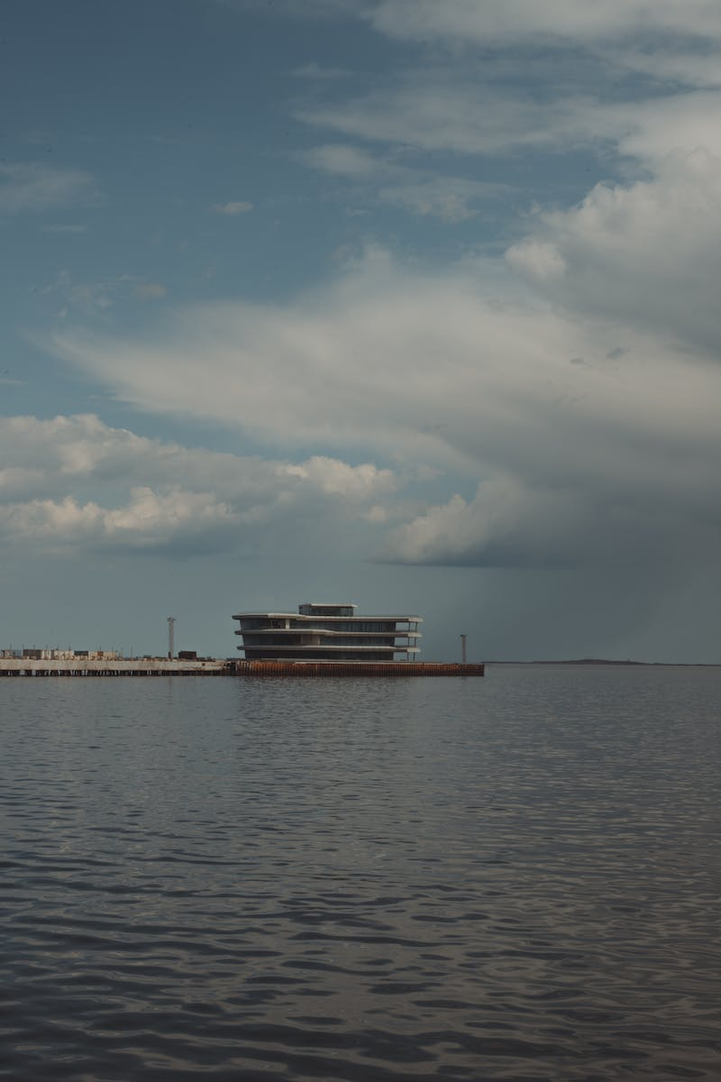
Introduction
• The Caspian Sea is the largest enclosed body of water on Earth
• It is bordered by Europe and Asia
• The region is home to various big cities
• Climate change is causing rising sea levels in the Caspian Sea
Photo by Pexels

Slide 3
The Current State of the Caspian Sea
• The Caspian Sea covers an area of over 307,000 square kilometers
• It is larger in size than Germany
• Sea levels are expected to rise up to 20 centimeters in the next century
• Coastal areas are already experiencing devastating effects
Photo by Pexels

Slide 4
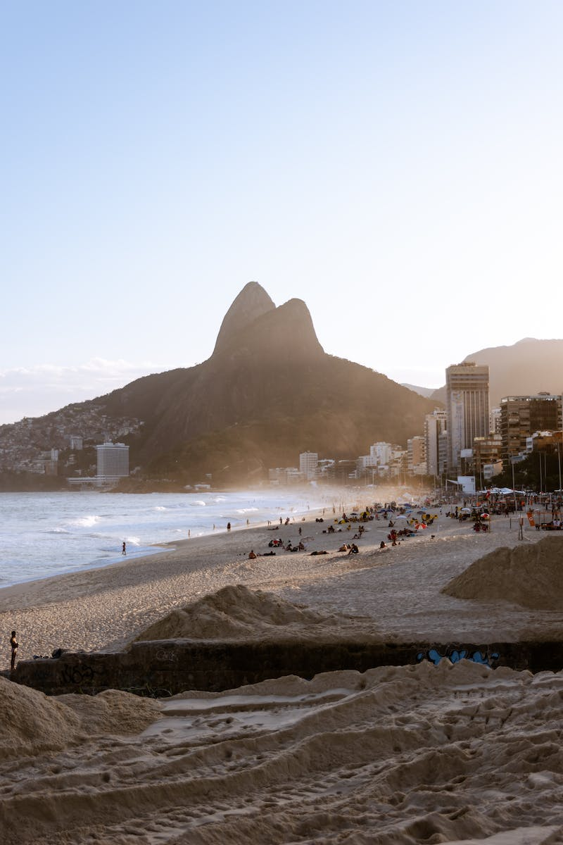
Implications for the Region
• The Caspian Sea coastline stretches across multiple countries
• Cities like Almaty, Baku, and Turkmenbashi are at risk
• Wetlands, major food supplies, and unique species are in jeopardy
• Salty environment and changing conditions will affect cities and towns
Photo by Pexels

Slide 5
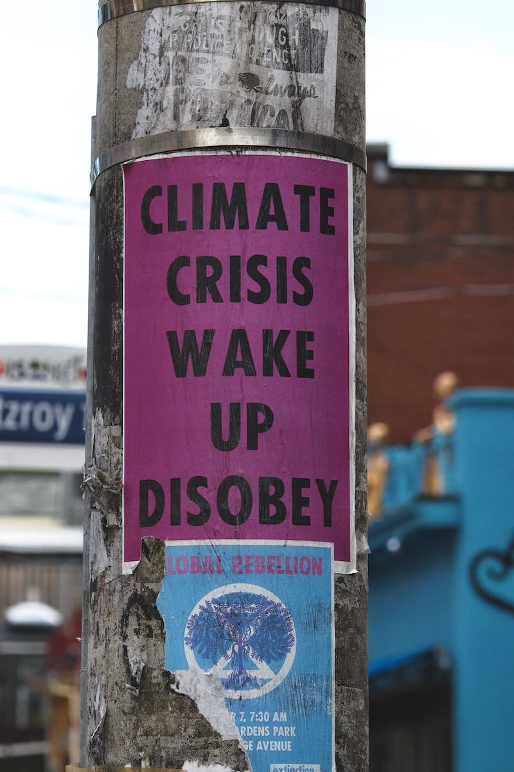
The Urgency of Dealing with Climate Change
• Global warming and CO2 levels are driving climate change
• Efforts to mitigate global warming require international collaboration
• The Caspian Sea region is not alone in facing this issue
• Climate change is a complex and urgent global problem
Photo by Pexels

Slide 6
The Future of the Caspian Sea
• Sea levels are currently falling due to various factors
• However, with climate change, the trend is expected to reverse
• Predicted sea level rise is between 9 to 10 meters
• The region will face significant challenges and transformations
Photo by Pexels

Slide 7
Conclusion
• The impact of climate change on the Caspian Sea is significant
• It poses threats to cities, ecosystems, and unique species
• Addressing climate change requires global cooperation
• The Caspian Sea region is an urgent case that needs attention
Photo by Pexels

