Slide 1
Understanding Hydrometeorological Hazards
Identifying and Explaining Tropical Cyclones, Monsoons, Floods, and Tornadoes

Slide 2
Introduction
• Focus on learning competency using hazard maps
• Identify areas prone to hazards caused by tropical cyclones
• Learn about monsoons, floods, and tornadoes
• Understand the impact of these hazards on the Philippines
Photo by Pexels

Slide 3
Hydrometeorological Hazards
• Definition of hydrometeorological hazards
• Causes and impacts of these hazards
• Loss of life, property damage, and economic disruption
• Examples include tropical cyclones, thunderstorms, and floods
Photo by Pexels

Slide 4
Tropical Cyclones
• Characteristics of tropical cyclones
• Formation and naming conventions
• Impact of strong winds, heavy rains, and storm surges
• Philippines' vulnerability due to its location
Photo by Pexels

Slide 5
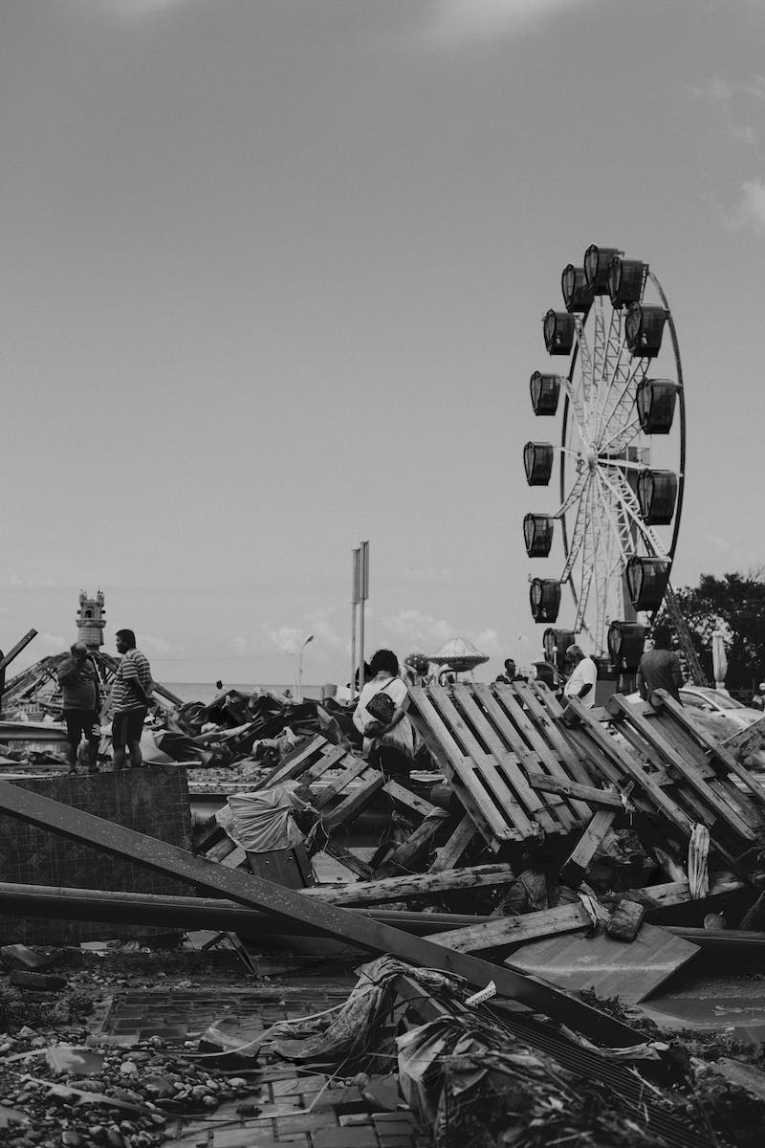
Case Study: Super Typhoon Haiyan
• Devastating impact of Super Typhoon Haiyan
• Historic wind speeds and destruction
• Challenges in rescue and recovery efforts
• Lessons learned from the catastrophe
Photo by Pexels

Slide 6
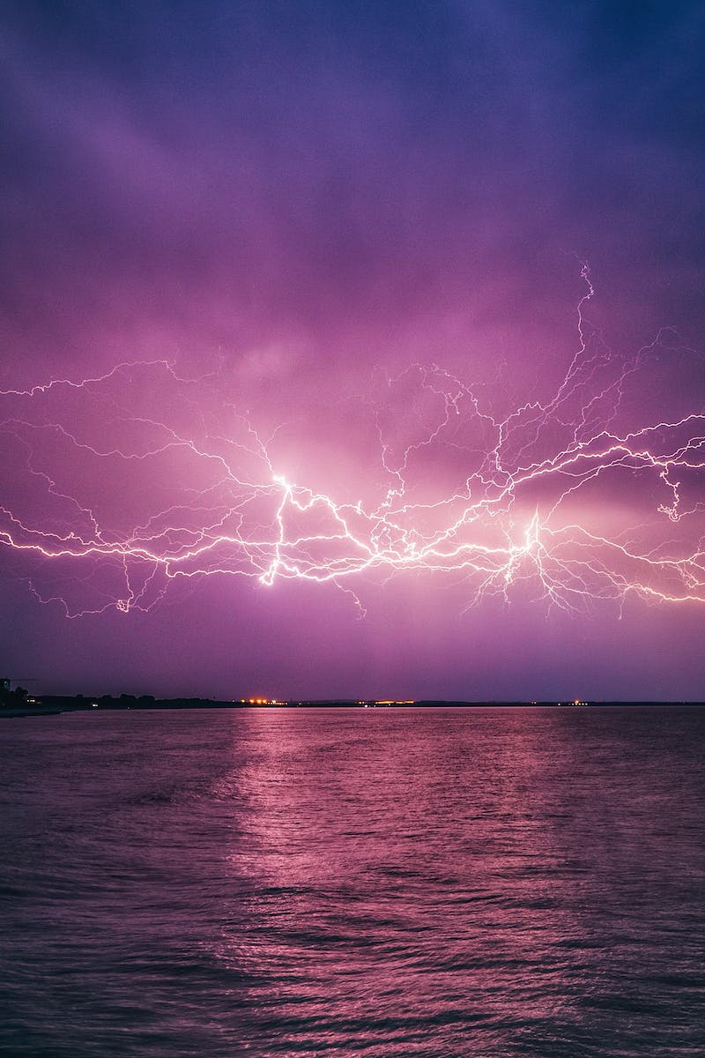
Thunderstorms and Tornadoes
• Characteristics and formation of thunderstorms
• Risk of lightning strikes and flash flooding
• Introduction to tornadoes and their destructive power
• Impact on infrastructure and communities
Photo by Pexels

Slide 7
Monsoons and El Nino
• Different types of monsoons in the Philippines
• Characteristics and impact of southwest and northeast monsoons
• Introduction to El Nino and La Nina phenomena
• Effects of prolonged drought and increased rainfall
Photo by Pexels

Slide 8
Hazard Maps and Risk Mitigation
• Importance and use of hazard maps
• Promoting risk awareness and evacuation procedures
• Designing evacuation facilities and shelter locations
• Limitations and uncertainties of hazard maps
Photo by Pexels

Slide 9
Conclusion
• Recap of key learnings
• Significance of understanding hydrometeorological hazards
• Call to action for preparedness and risk mitigation
• Thank you for watching
Photo by Pexels

