Slide 1
Chimpanzees: Our Closest Relatives
Understanding the Sentience and Conservation of Chimpanzees

Slide 2
Introduction
• Jane Goodall: A Journey to Study Chimpanzees
• Similarity Between Humans and Chimpanzees
• Chimpanzees' Sentient Nature
• Conserving the Environment: A Personal Mission
Photo by Pexels

Slide 3
Emotional Bond
• Emotional Reactions and Behaviors of Chimpanzees
• Grief and Mourning Rituals
• Similarity in Emotional Spectrum
• Sentiments Towards Deceased Chimps
Photo by Pexels

Slide 4
Spirituality in Chimpanzees
• Debunking the Notion of Exclusive Human Spirituality
• Chimpanzees as Sentient Beings
• Expression & Experience of Spirituality
• Acknowledging the Holistic Nature of Sentience
Photo by Pexels

Slide 5
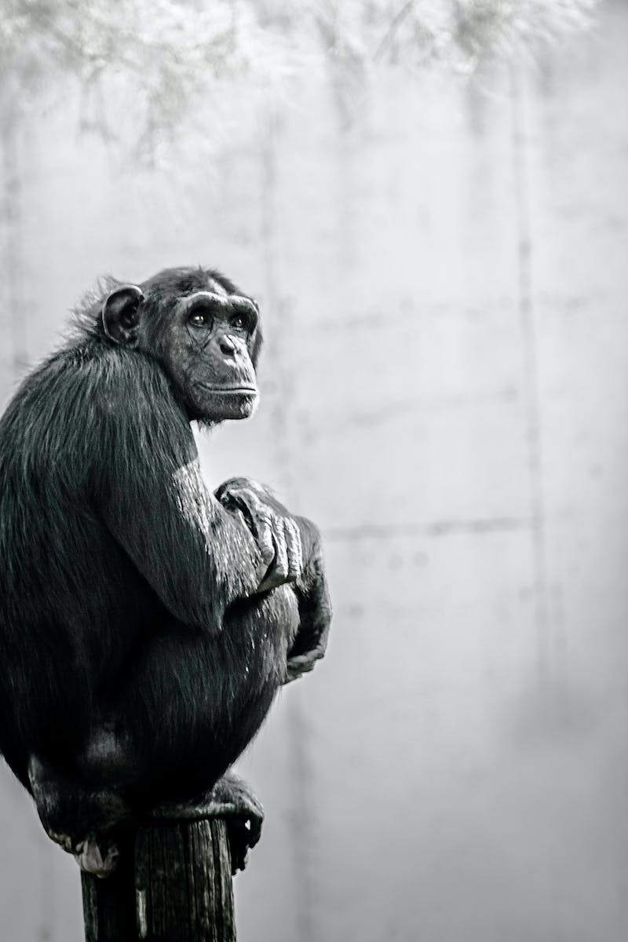
Conservation Efforts
• Jane Goodall: Scientist Turned Activist
• Discoveries Fostering Conservation Motivation
• Critical Role of Individuals in Conservation
• Empowering Change Through Daily Action
Photo by Pexels

Slide 6
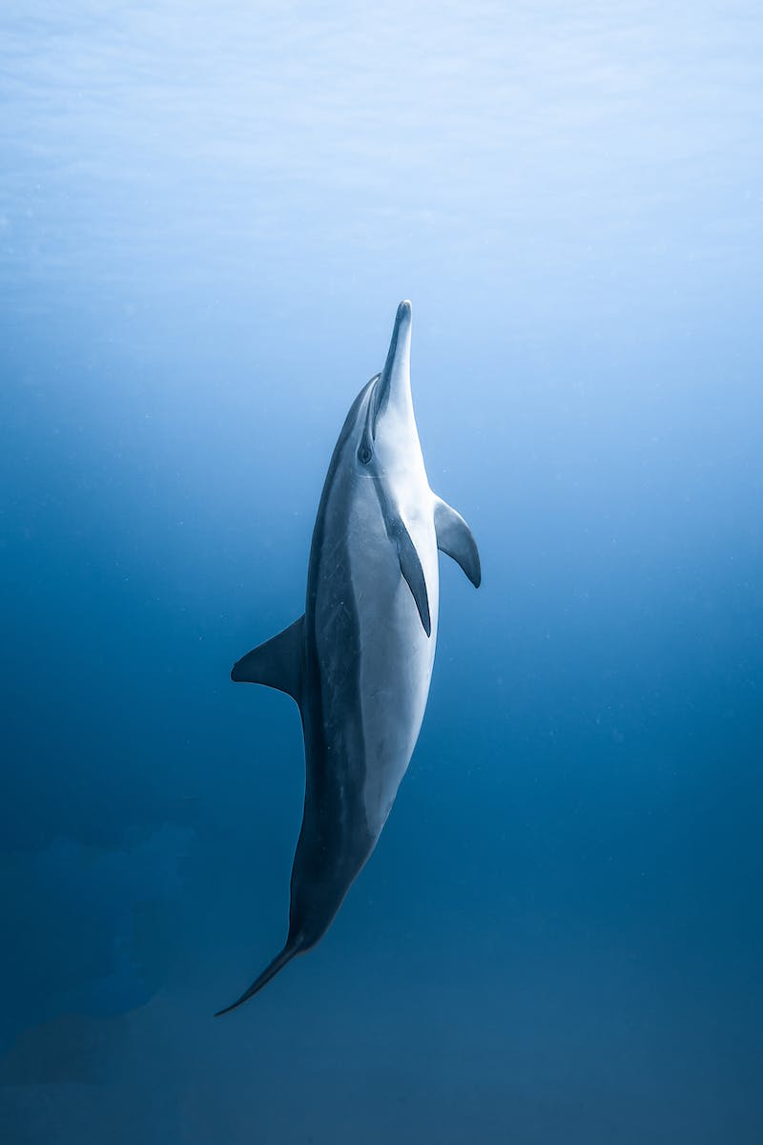
Call to Action
• Power of Indomitable Spirit
• Collective Responsibility for a Better World
• Realizing the Urgency to Preserve Nature
• Making the Difference Every Day
Photo by Pexels

