Slide 1
Pitching the Perfect CR for Summer
Exploring the Benefits of Collectible Ceramic Crabs

Slide 2
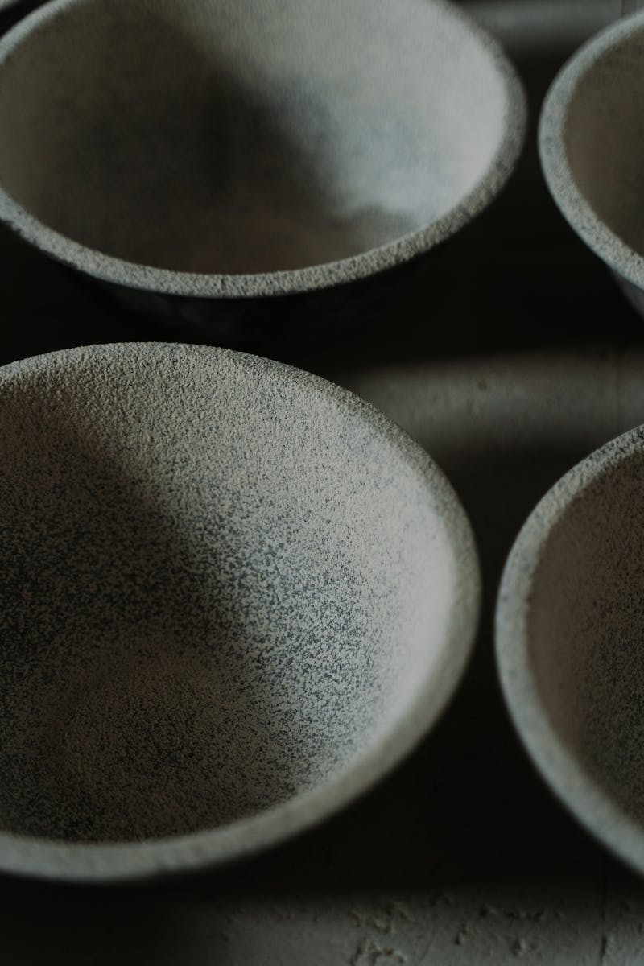
Introduction
• Overview of the topic
• Importance of summer collections
• Crab ceramics as a popular choice
• Introduce the presenter and their expertise
Photo by Pexels

Slide 3
Benefits of Crab Ceramics
• Unique and eye-catching designs
• Limited edition and exclusivity
• Great investment potential
• Versatile home decor options
Photo by Pexels

Slide 4
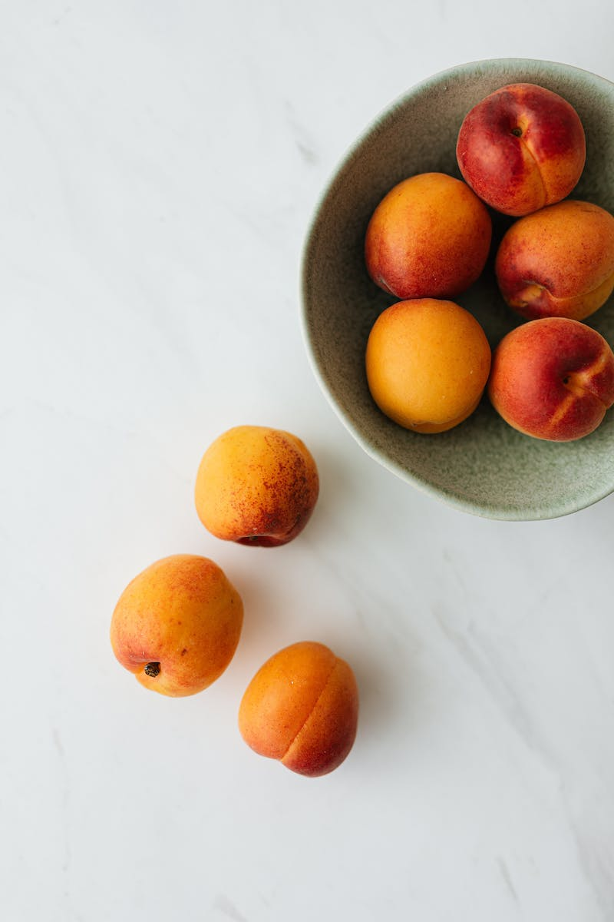
The Summer Collection CR
• Unveiling the latest crab ceramic collection
• Highlighting summer-themed designs
• Limited-time offer and exclusivity
• Pricing and availability details
Photo by Pexels

Slide 5
Why Choose Our Crab Ceramics?
• Superior craftsmanship and quality
• Hand-painted details
• Attention to detail
• Variety of sizes and colors
Photo by Pexels

Slide 6
Testimonials from Satisfied Customers
• Positive feedback from previous buyers
• Customer testimonials and reviews
• Quotes highlighting satisfaction
• Social media engagement
Photo by Pexels

Slide 7
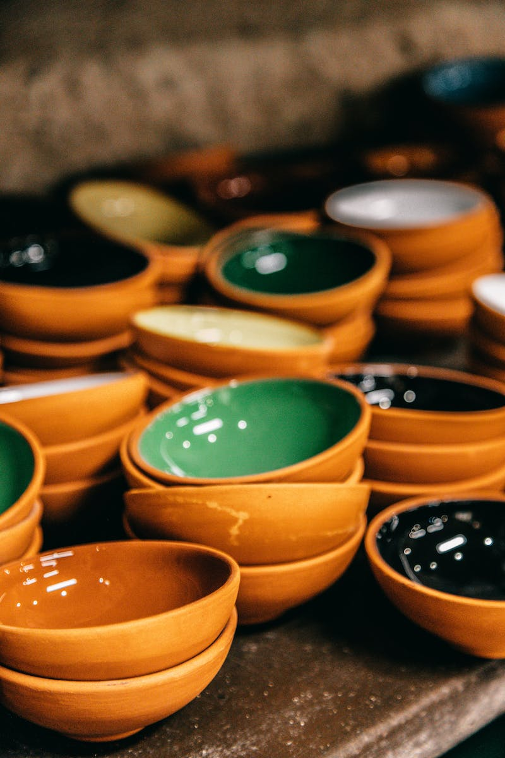
Investment Potential and Future
• Rising demand for collectible ceramic art
• Increase in value over time
• Potential for future collaborations
• Building a community of collectors
Photo by Pexels

Slide 8
Closing and Call to Action
• Recap key points and benefits
• Reiterate limited availability for summer collection
• Encourage audience to take action
• Provide contact information and website
Photo by Pexels

