Slide 1
Creating Loop Animated Background Patterns
Add Visual Impact to Your Videos with Cam

Slide 2
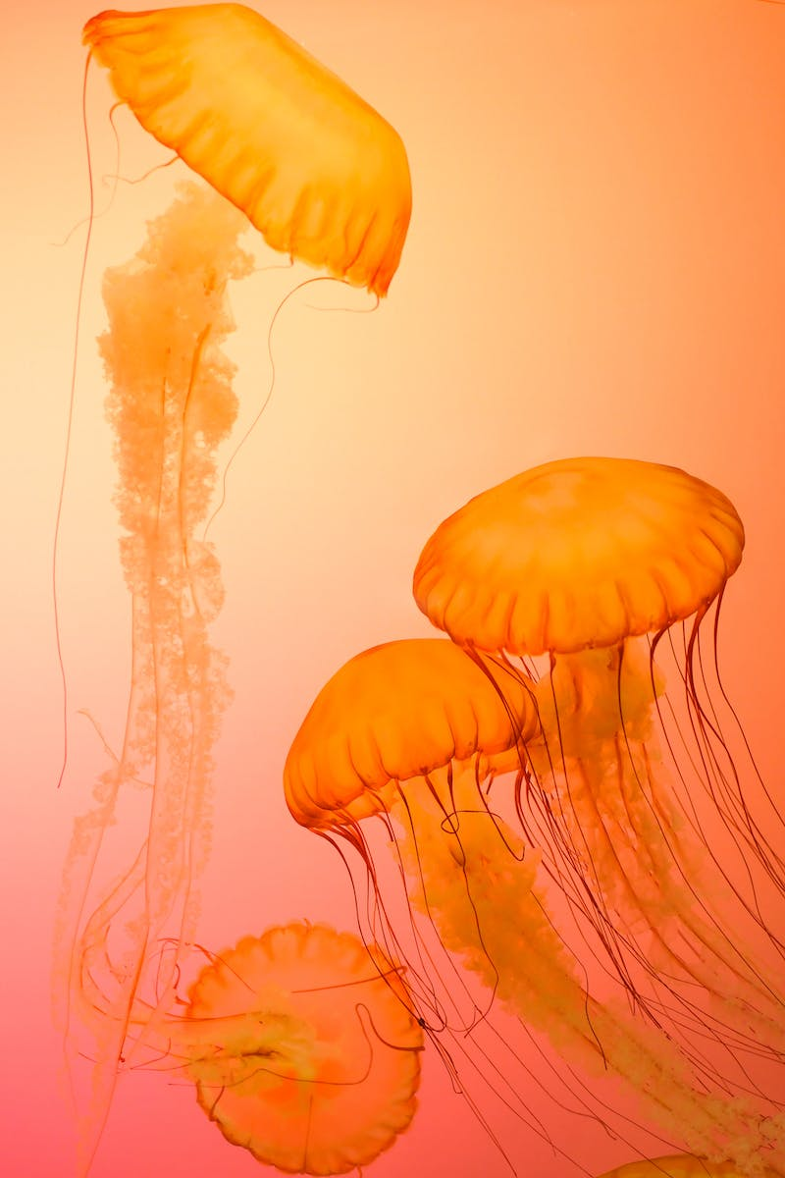
Introduction
• Learn how to make loop animated background patterns
• Useful for interstitials, titles, and intros
• Add visual impact to negative space in your videos
• Can be applied to logos and other shapes
• Explore cool treatments and effects
Photo by Pexels

Slide 3
Creating Basic Patterns
• Start by locating the annotations tab in Cam
• Go to the shapes tab and select the basic rectangle
• Draw rows of rectangles horizontally and vertically
• Ensure the rectangles are flush to the canvas
• Experiment with different shapes like circles or triangles
Photo by Pexels

Slide 4
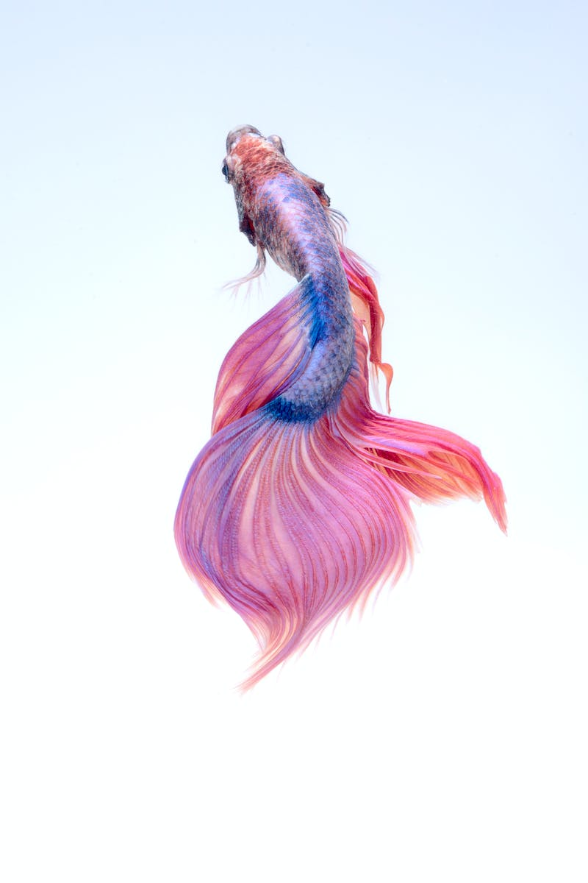
Adding Animation and Looping
• Select the shapes and go to properties
• Adjust the vertical position to align the rows
• Copy and paste the shapes to create more rows
• Group the shapes for easy manipulation
• Apply custom animation to make the patterns loop
Photo by Pexels

Slide 5
Applying Styling and Effects
• Duplicate the patterns and explore visual styling
• Use gradients and colorful adjustment for effects
• Experiment with opacity for different looks
• Group and rotate gradients for intersecting effects
• Create multiple looped patterns for variety
Photo by Pexels

Slide 6
Conclusion
• Looped animated background patterns are a powerful tool for video editing
• They can be used for interstitials, titles, and intros
• Try applying the techniques to your own shapes and designs
• Experiment with different effects and visual treatments
• Have fun and unleash your creativity!
Photo by Pexels

