Slide 1

Investment Opportunity in Community Farming Projects
Reviving Rural Lands Through Sustainable Agricultural Partnerships

Slide 2

Table of Contents
01
Unlock Community Farming Investments
02
Urban Migration's Rural Dilemma
03
Transforming Land into Profits
04
Exclusive Green Investor Partnership
05
Rapid ROI Gains
06
Join the Green Rural Revolution
07
Rising Trends in Sustainable Markets
08
24-Month Phased Implementation Journey

Slide 3
Table of Contents
09
Risk Mitigation in Farming
10
Embark on Community Farming

Slide 4

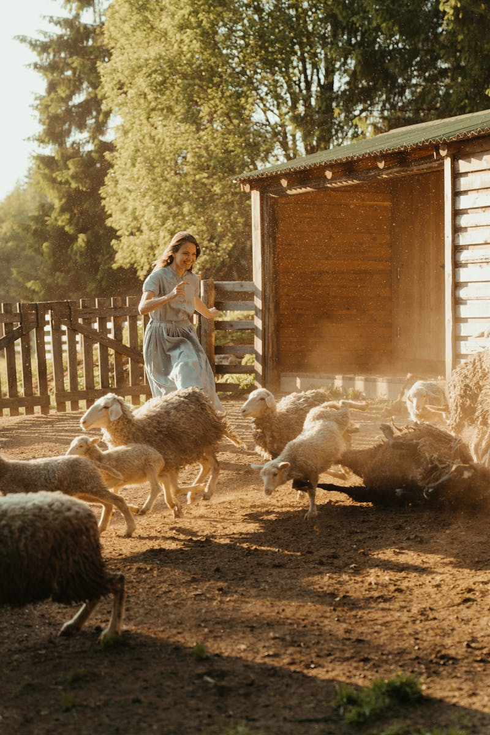



Unlock Community Farming Investments
1.
Project Overview
Go by Green Foundation identifies unused rural lands and partners with locals to develop them into productive agricultural ventures.
2.
Investment Benefits
Investors receive returns from crop yields and community shares, while supporting environmental conservation and rural economic development.
3.
Environmental Impact
These projects reduce land degradation through sustainable farming, increasing biodiversity and combating climate change effectively.
Photo by Pexels

Slide 5
Unlock Community Farming Investments
4.
Community Involvement
Local communities gain training, jobs, and ownership, empowering them for long-term social and economic stability.
5.
Success Stories
Past initiatives have converted barren lands into thriving farms, creating livelihoods and delivering strong returns for investors.

Slide 6


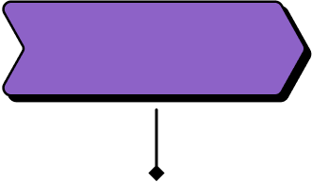
Urban Migration's Rural Dilemma
Industrial Revolution Starts
Globalization Drives Exodus
The late 19th century Industrial Revolution began drawing people from rural farms to urban factories for higher wages and modern...
In the 1980s, globalization and economic reforms created urban job opportunities, accelerating the migration of younger generations from rural regions....
1900
1950
1980
2020
Post-WWII Urban Surge
Digital Age Migration
After World War II, rapid economic recovery and urbanization pulled young people to cities for manufacturing and service jobs. This...
The 2020s digital revolution has intensified urban migration as youth seek tech jobs and connectivity in cities. This trend continues...

Slide 7
Transforming Land into Profits
1.
Initial Assessment
Evaluate land potential, soil quality, and resources to identify viable community farming opportunities.
2.
Planning Phase
Develop a strategic plan for crop selection, community engagement, and resource management to ensure sustainability.
3.
Land Preparation
Clear and prepare the soil, install irrigation systems, and address environmental factors for optimal farming conditions.

Slide 8
Transforming Land into Profits
4.
Implementation Strategy
Execute planting, train community members, and establish operational systems to launch the farming venture effectively.
5.
Monitoring and Optimization
Track crop performance, community involvement, and finances, making adjustments to enhance profitability and growth.
6.
Scaling Success
Expand the model to additional lands, build partnerships, and measure long-term impacts on community and economy.

Slide 9
Exclusive Green Investor Partnership
Foundation Establishment
Expansion Initiatives
In 2005, the Go by Green Foundation was founded with a mission to advance sustainable agriculture and environmental protection. This...
In 2015, Go by Green scaled up to 10+ acre projects, collaborating with local communities to implement advanced irrigation and...
2005
2010
2015
2020
First Project Launch
Investor Engagement
By 2010, the foundation initiated its inaugural agricultural project on a modest plot, showcasing innovative organic farming techniques that boosted...
By 2020, the foundation began actively engaging investors in its agricultural ventures, offering stakes in expanding projects that emphasized profitability...

Slide 10
Exclusive Green Investor Partnership
Exclusive Opportunities
In 2023, Go by Green introduced an exclusive program for land investors to join 10+ acre agricultural projects, promising substantial...
2023

Slide 11





Rapid ROI Gains
Achieve 30-40% ROI in just 24 months.
Benefit from land appreciation and sustainable income streams.
35%
5%
Expected ROI
Income Yield
24 months
40%
Investment Period
Total Returns
15%
10%
Land Appreciation
Annual Growth

Slide 12
Join the Green Rural Revolution
Environmental Movement Starts
Rural Lands Transformation
In the 1970s, the first wave of environmental awareness highlighted the need for sustainable practices, leading to global discussions on...
In 2005, pilot programs began implementing eco-friendly practices across rural areas, focusing on reforestation and water conservation to restore degraded...
1970
1990
2005
2023
Sustainable Farming Advances
Join Green Initiatives Now
By the 1990s, innovative techniques like organic farming and crop rotation were developed to transform rural lands, reducing chemical use...
Today in 2023, the movement calls for widespread participation to expand eco-friendly farming, offering training and funding for rural transformation....

Slide 13
Rising Trends in Sustainable Markets
This bar graph highlights the growing demand for sustainable agricultural products and the increasing interest in green investment opportunities, based on market analysis. It showcases key trends over recent years, illustrating shifts towards eco-friendly practices and investments, which signal promising growth for the future.

Slide 14
24-Month Phased Implementation Journey
Land Acquisition Start
Construction and Setup
The project begins with securing suitable land through negotiations and legal processes, ensuring compliance with environmental regulations. This foundational step...
Construction of production facilities commences, involving building structures, equipping machinery, and integrating technology systems. This stage includes rigorous safety checks...
2023
2023
2024
2024
Site Preparation Phase
Full Production Launch
Following land acquisition, this phase focuses on clearing the site, installing basic infrastructure like utilities, and conducting initial surveys. Engineering...
The final phase ramps up to full-scale production, incorporating quality control measures and distribution logistics. This involves scaling operations, monitoring...

Slide 15
24-Month Phased Implementation Journey
Distribution Network Expansion
After achieving full production, efforts shift to expanding distribution channels, including partnerships with logistics providers and retail networks. This phase...
2024

Slide 16
Risk Mitigation in Farming
Framework Initiation
Sustainable Practices Adopted
In 2010, the initial risk assessment framework was developed to evaluate market and environmental threats in agriculture. This involved analyzing...
In 2020, sustainable farming practices were scaled up as part of risk mitigation efforts, focusing on organic methods and water...
2010
2015
2020
2025
Diversification Rollout
Evaluation and Refinement
By 2015, market diversification strategies were fully implemented, expanding into new regions and crop varieties. This helped mitigate risks from...
Projected for 2025, ongoing evaluation of risk strategies will refine market diversification and sustainable practices based on past data. This...

Slide 17
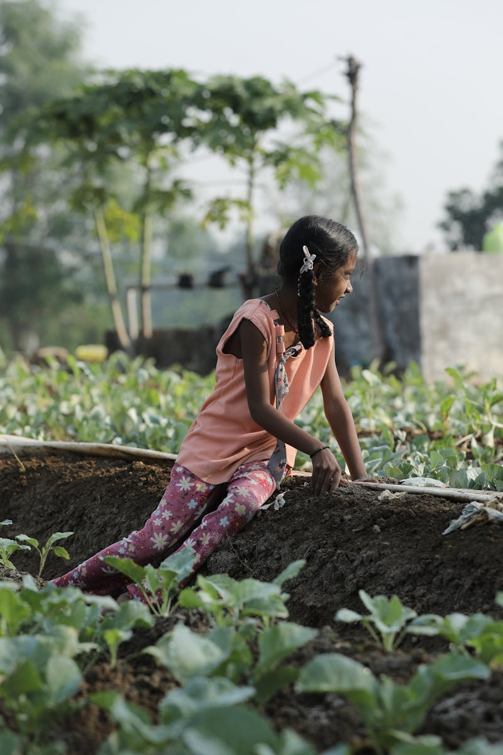
Embark on Community Farming
1.
Contact Information
Reach out to Go by Green Foundation via email or phone to discuss community farming investment options and get personalized advice.
2.
Next Steps Overview
After initial contact, review investment details with our team to start your journey in sustainable community farming initiatives.
3.
Investment Process
Learn about the simple steps to invest in community farming, including funding options and partnerships offered by Go by Green Foundation.
Photo by Pexels

Slide 18
Embark on Community Farming
4.
Benefits of Participation
Experience community growth, environmental benefits, and financial returns through Go by Green Foundation's farming investment programs.
5.
Success Stories
Hear from participants who have thrived in community farming investments with Go by Green Foundation, achieving sustainable and profitable outcomes.
6.
Support Resources
Access educational materials and ongoing support from Go by Green Foundation to ensure your community farming investment succeeds long-term.

