Slide 1
Rebuilding the Mammoth Step: A Journey into the Past
Exploring the ecological impact and potential of Place to Scene Park

Slide 2
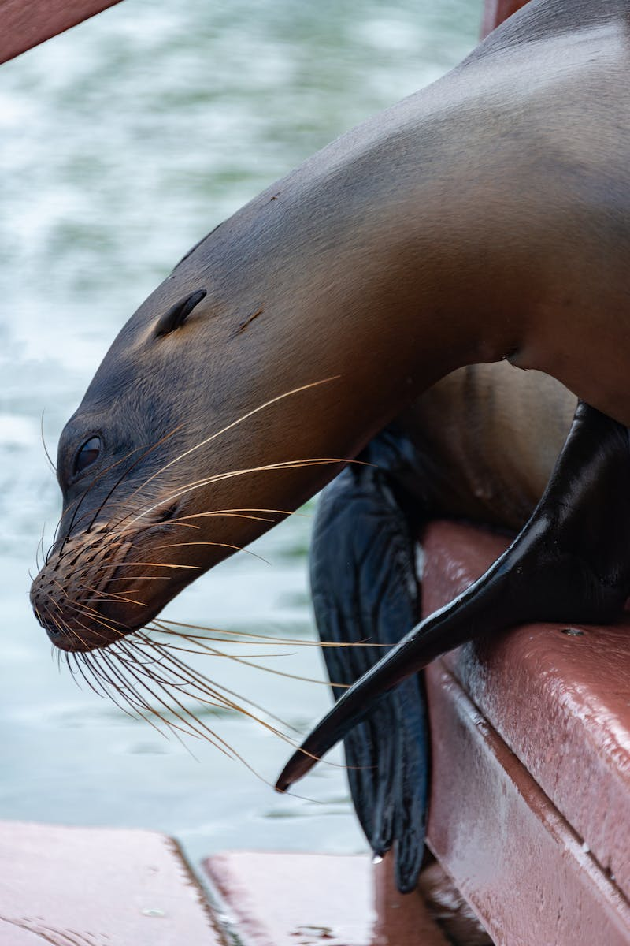
Introduction
• Twenty five thousand years ago, the Earth experienced a new ice age.
• The mammoth step, a vast bio, dominated the landscape.
• This bio supported a diverse animal community mirroring Africa's savannah.
• The mammoth step covered approximately 10% of Earth's land area.
• Fifteen thousand years ago, the mammoth step began to disappear.
• Scientists are now working on bringing back the mammoth step for ecological restoration.
• Understanding the cause of its disappearance is crucial for this restoration project.
Photo by Pexels

Slide 3
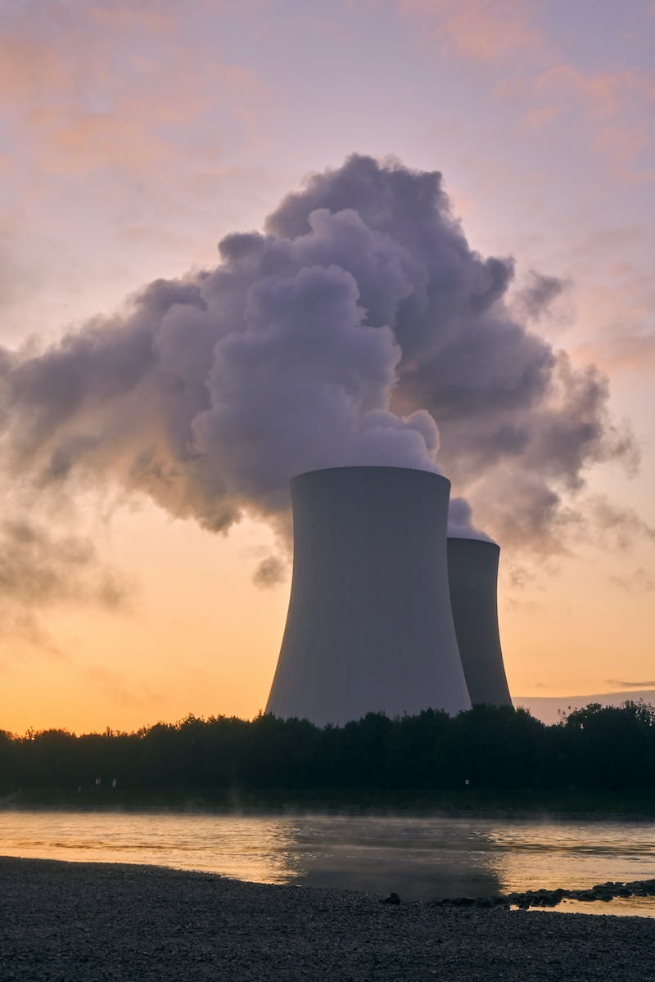
Climate Change Hypothesis
• The climate change hypothesis suggests that rising temperatures transformed the mammoth step.
• As global temperatures increased, forests replaced grasslands, reducing grazing grounds.
• This created a domino effect, leading to the extinction of many species.
• However, this hypothesis has flaws and does not explain why the mammoth step disappeared suddenly.
Photo by Pexels

Slide 4
Hunting Hypothesis
• The hunting hypothesis proposes that humans played a significant role in the extinction of the mammoth step.
• As humans migrated across the planet, they encountered the naive megafauna of the mammoth step.
• Unaware of the danger humans posed, megafauna populations declined due to hunting.
• This led to an imbalance in the ecosystem, allowing forests to encroach on grasslands.
Photo by Pexels

Slide 5
Evidence of Human Impact
• Observations from different regions support the hunting hypothesis.
• In Africa, the arrival of humans led to a gradual decline in megafauna populations.
• Similar patterns of population crash were observed in regions like Australia and North America.
• The expansion of humans was likely the catalyst for the extinction of megafauna.
Photo by Pexels

Slide 6
Introducing Place to Scene Park
• Place to Scene Park aims to restore the diversity and productivity of the mammoth step.
• Reintroducing large grazing animals is key to recreating this ecosystem.
• The park began with the introduction of horses, followed by musk ox, European bison, and other species.
• The presence of these animals has already begun to transform the landscape.
Photo by Pexels

Slide 7
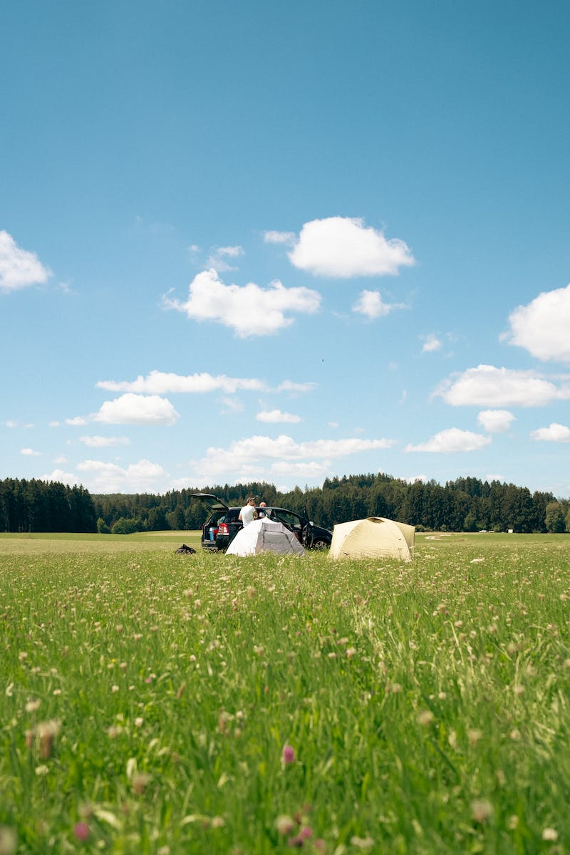
Impact on Climate Change
• The Mammoth Step has the potential to combat climate change.
• Grasslands act as effective carbon sinks, storing carbon in the soil.
• Expanding the step bio across northern Eurasia can increase carbon sequestration.
• This restoration project can help mitigate the effects of climate change.
Photo by Pexels

Slide 8
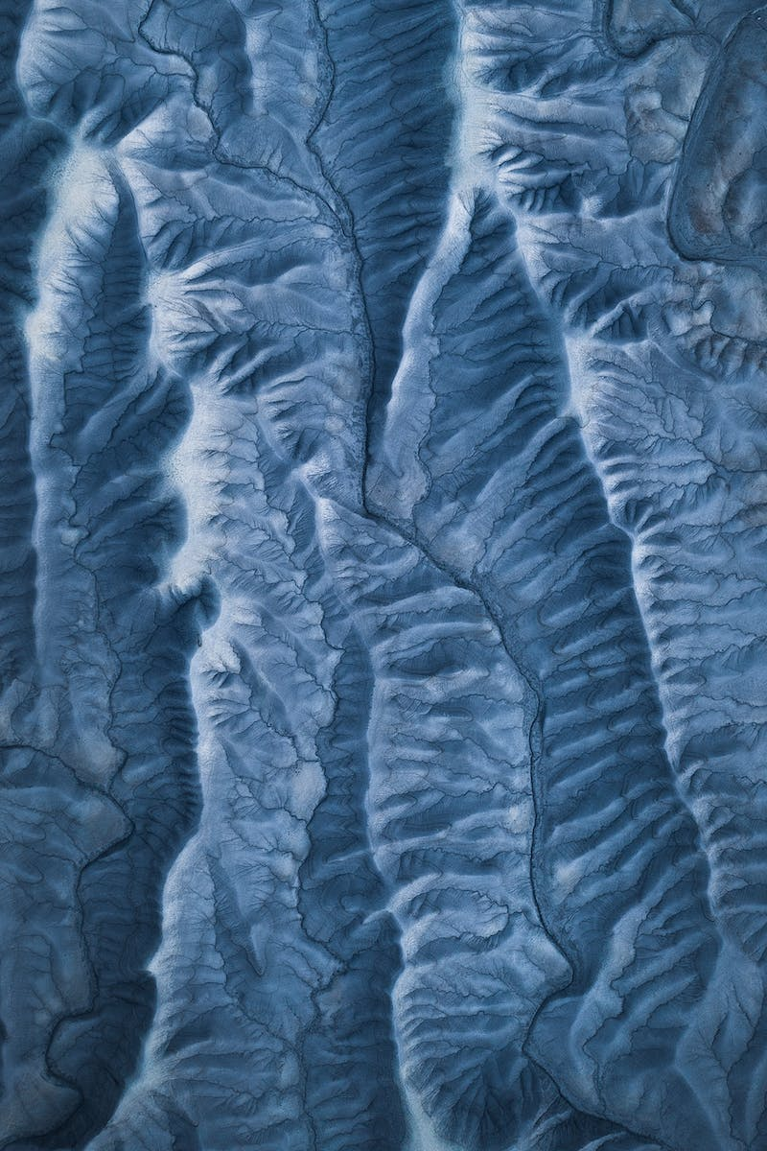
Protecting Frozen Perm
• The project also aims to protect frozen perm deposits in the arctic.
• Warming temperatures threaten to release methane, a potent greenhouse gas, from these deposits.
• The presence of animals in the park helps maintain the stability of perm by tramming the snow.
• This prevents the penetration of warm air and reduces the risk of methane release.
Photo by Pexels

