Slide 1
First State Management for Snake Bite
Reassuring, Immobilizing, and Getting to Hospital

Slide 2
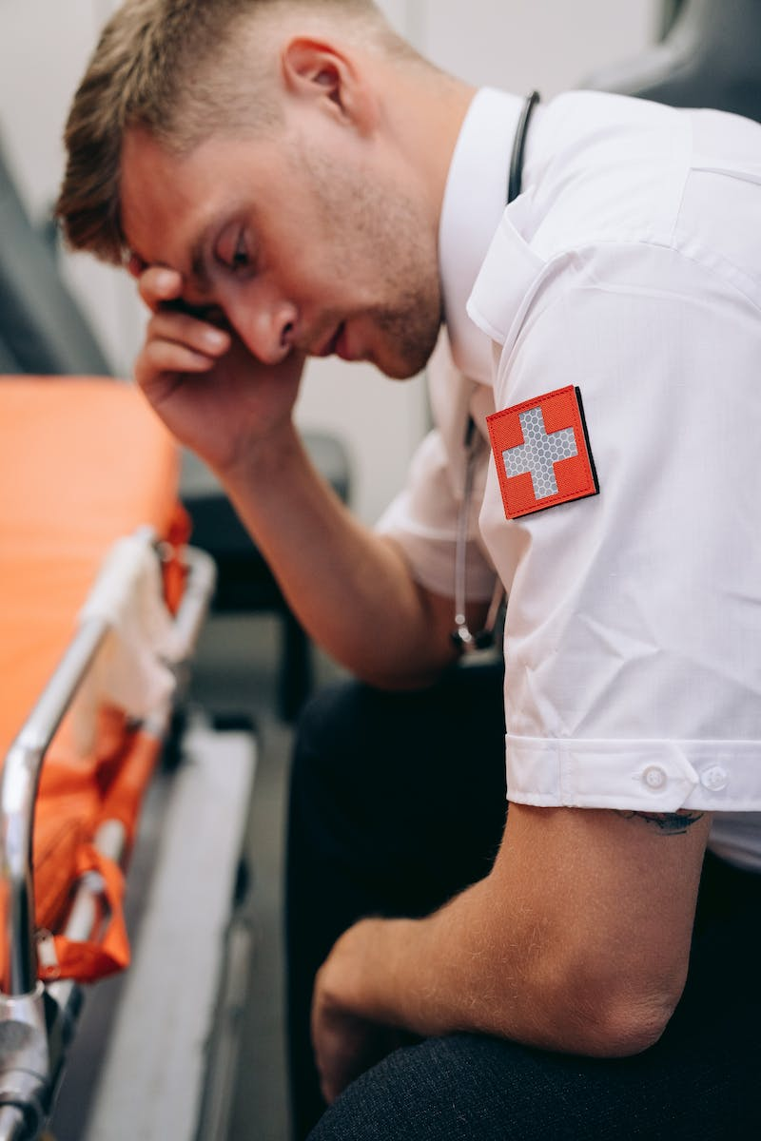
Introduction
• Snake bite management requires prompt action
• First state management is crucial for patient safety
• Two scenarios: site and hospital
• Follow mnemonic 'Do it Right'
Photo by Pexels

Slide 3
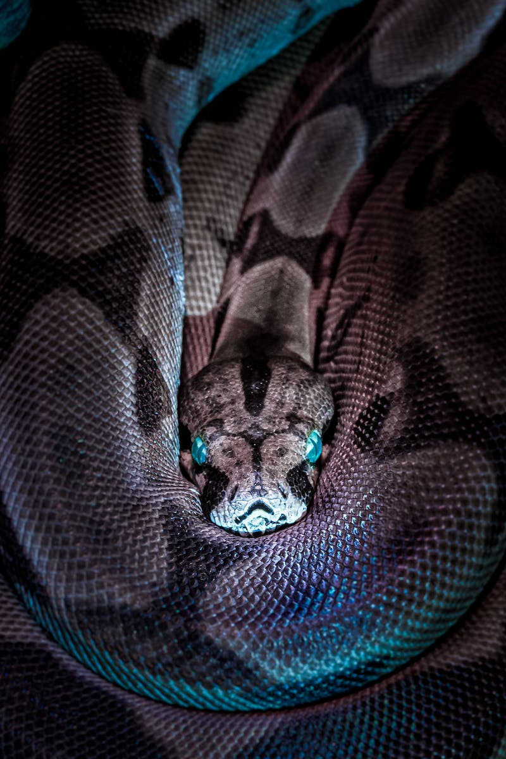
Reassuring the Victim
• Priority is to reassure the victim
• Ensure them that everything will be fine
• Stress that they will be taken to a hospital with snakebite facilities
• Provide reassurance and comfort
Photo by Pexels

Slide 4
Immobilizing the Bitterness
• Immobilize the bitten limb to prevent further venom spread
• Apply a splint or wooden board if available
• Use a crepe bandage or clothing to secure the limb
• Bandage should be tight enough to occlude initial lymphatics
Photo by Pexels

Slide 5
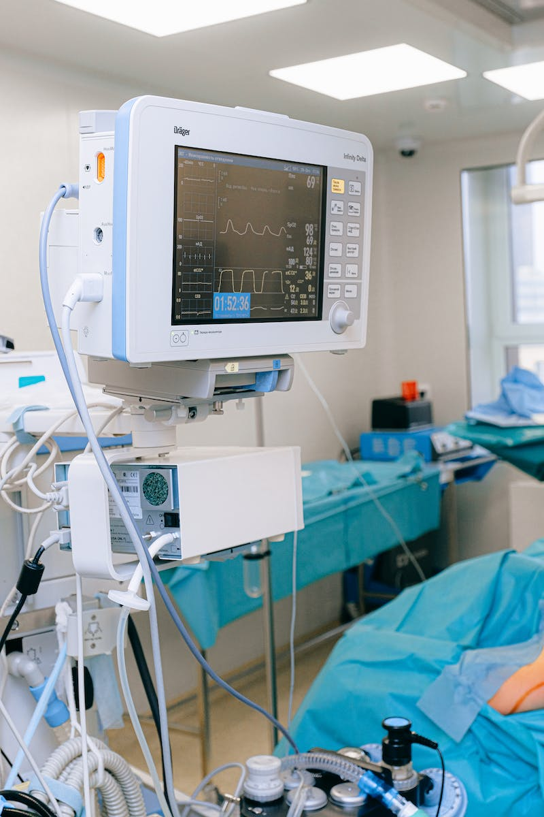
Getting to the Hospital
• Transport the victim immediately to a hospital with snakebite treatment facilities
• Ensure availability of antivenom at the hospital
• Inform the doctor about the signs and symptoms observed
• Prompt transfer is vital for timely treatment
Photo by Pexels

Slide 6
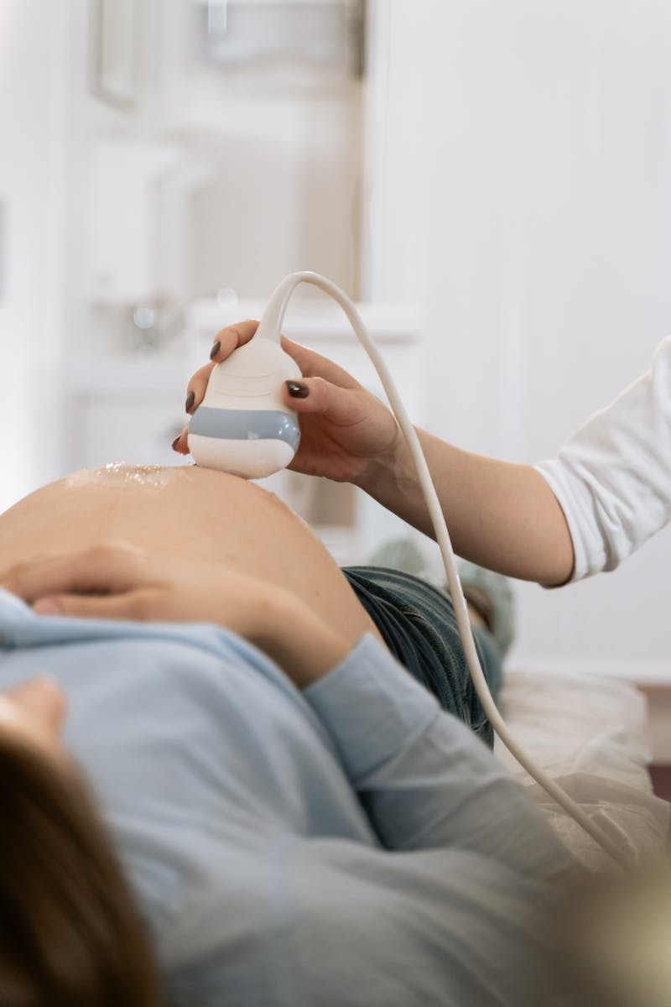
Local Examination
• Look for fang marks or scratch marks as signs of snake bite
• Check for blister formation and swelling at the bite site
• Inspect for localized lymphadenopathy near the bite area
• Measure circumference of the limb for monitoring swelling
Photo by Pexels

Slide 7
Systemic Examination
• Neurotoxic envenomation: look for diplopia and ptosis
• Hemotoxic envenomation: check for conjunctival hemorrhage and bleeding
• Monitor respiratory parameters and single breath count
• Assess for signs of impending respiratory failure
Photo by Pexels

Slide 8
Investigations
• Perform 20 minutes whole blood clotting time test
• Consider point-of-care PT/INR testing if available
• Additional investigations: complete blood count, urine routine, renal function
• Assess for coagulation abnormalities and kidney injury
Photo by Pexels

Slide 9
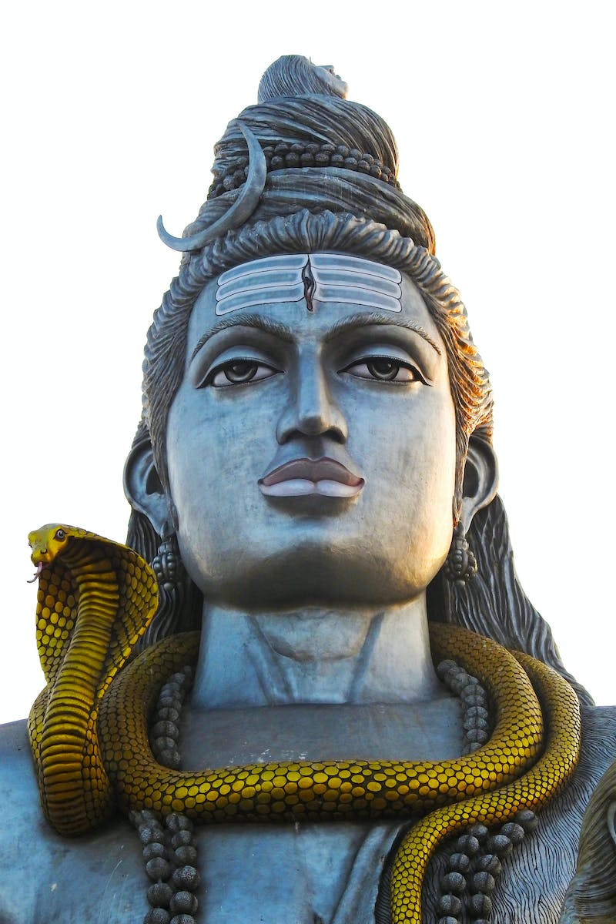
Indications for Antivenom
• Systemic indications: respiratory symptoms, bleeding, rapidly increasing swelling
• Positive 20 minutes whole blood clotting time or abnormal PT/INR
• Local indications: rapidly increasing swelling, lymphadenopathy
• Start antivenom with 6-10 vials at 1-2 ml per minute
Photo by Pexels

Slide 10
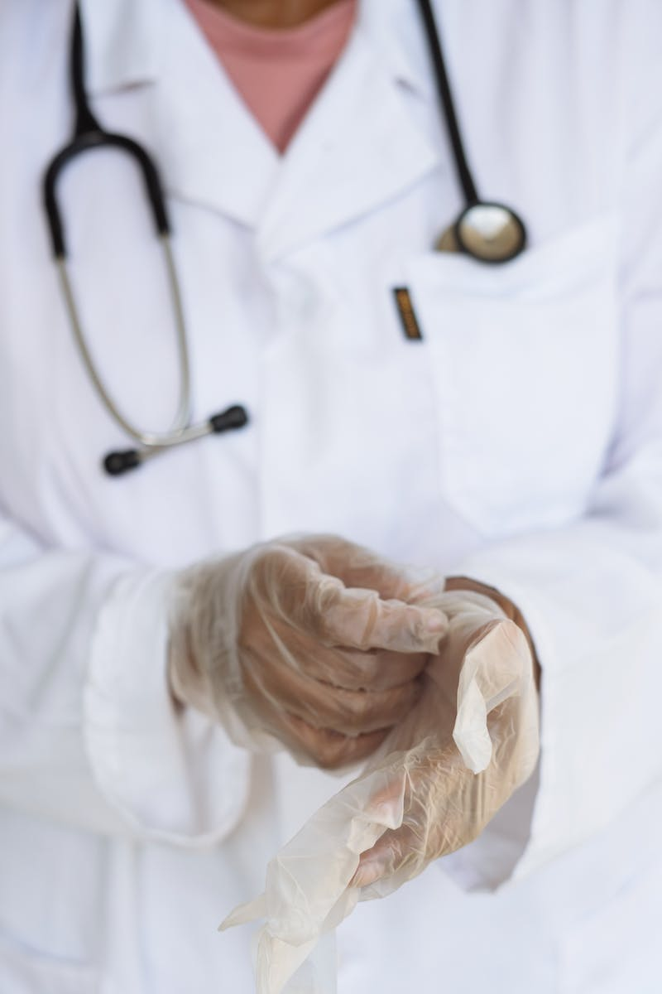
Management in the Hospital
• Ensure airway, breathing, and circulation
• Monitor vital signs and respiratory parameters
• Repeat single breath count every 15-20 minutes
• Administer anti-allergic medication if needed
Photo by Pexels

Slide 11
Additional Management
• Administer tetanus prophylaxis to all snake bite patients
• Prescribe antibiotics for coverage against gram-positive bacteria
• Observe patients for a minimum of 24 hours
• Address complications like compartment syndrome and renal failure
Photo by Pexels

Slide 12
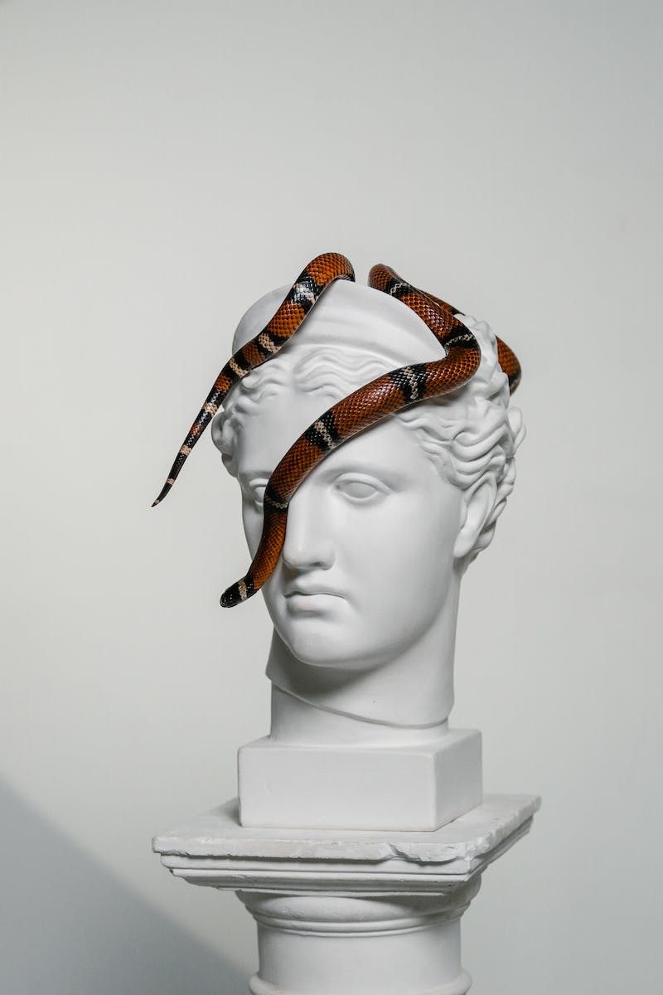
Conclusion
• First state management is vital for snake bite patients
• Reassure and immobilize the victim, get to hospital
• Conduct thorough local and systemic examinations
• Initiate antivenom and monitor closely in hospital
Photo by Pexels

