Slide 1
The Market for Instagram Verification Badges
Understanding the Demand and Business Tactics

Slide 2
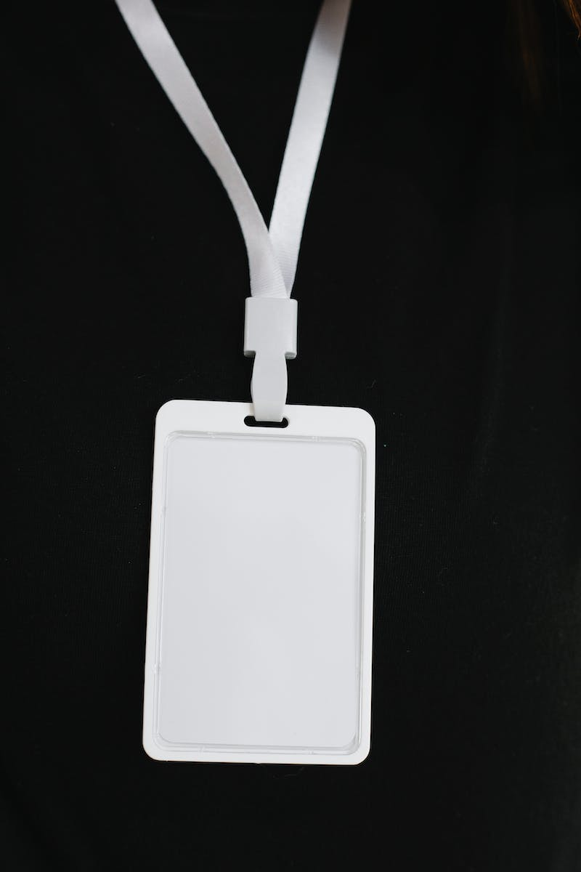
Introduction
• Instagram verification badges have become a symbol of social status and credibility on the platform.
• In the past, verification badges were mostly reserved for celebrities and public figures.
• However, the landscape has changed, and now even random individuals can obtain verification badges.
• But how did they acquire these badges? Let's find out.
• In this presentation, we'll explore the market for Instagram verification badges.
Photo by Pexels

Slide 3
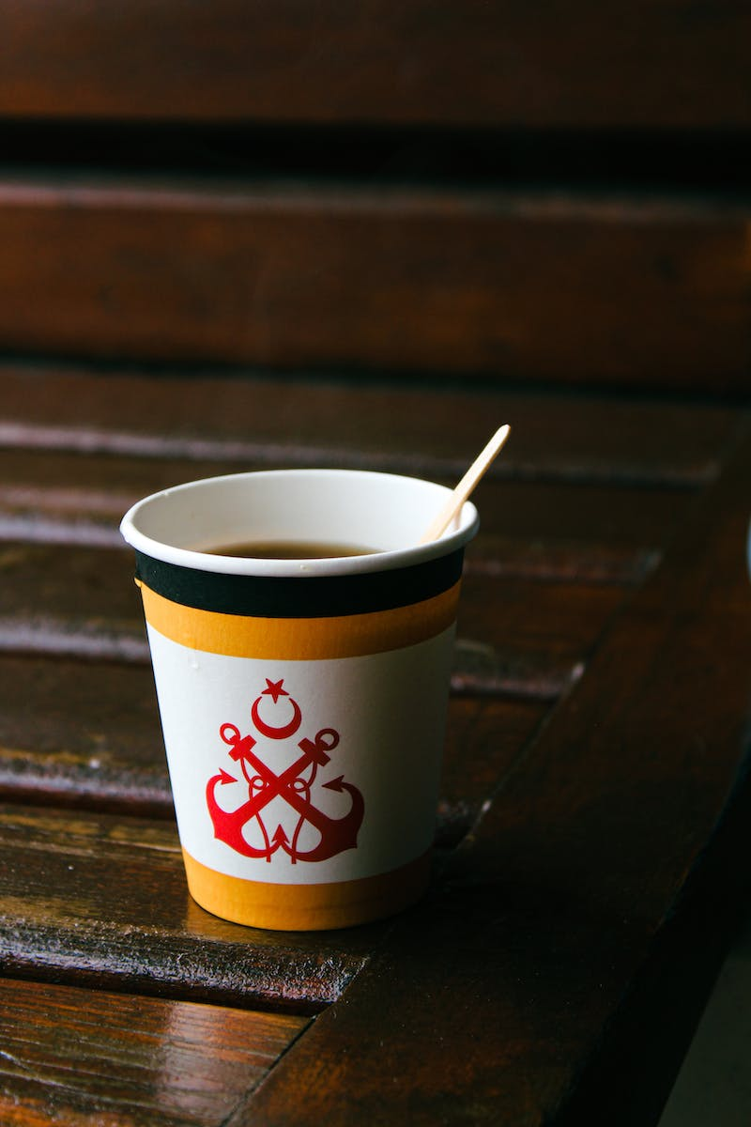
The Evolution of Verification Badges
• Verification badges were once seen as a status symbol of the elite and famous.
• Previously, only well-known individuals were invited to star-studded events and attracted major advertisers.
• However, the landscape has changed significantly.
• Now, anyone can become a verified account holder, regardless of their follower count or fame.
Photo by Pexels

Slide 4
The Business of Verification Badges
• Several services and contractors have emerged to help individuals acquire Instagram verification badges.
• However, these services come at a hefty price, ranging from $120 to $300,000.
• The activities of these contractors involve granting access to a monthly subscription that ultimately helps users get verified.
• The market for verification badges is thriving, with demand coming from various individuals and industries.
• In this presentation, we will explore how to independently acquire a verification badge.
Photo by Pexels

Slide 5
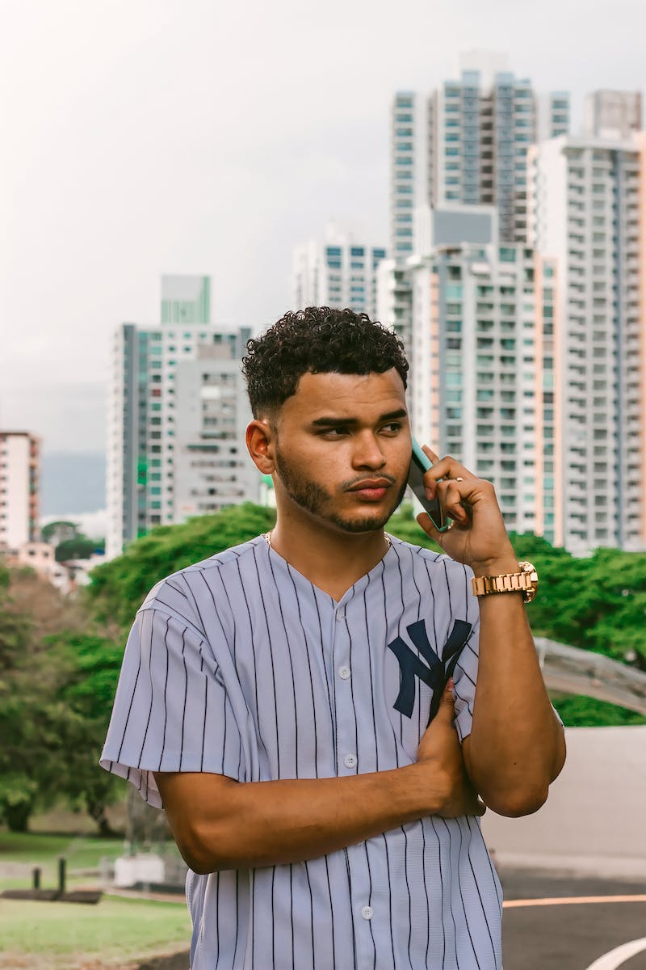
Methods of Obtaining Verification Badges
• One method to obtain a verification badge is through a 'drop' in a country where the feature is already available.
• This involves entrusting your account to someone in that country for a period of 3-14 days.
• Alternatively, it is possible to gain access to the verification badge feature by constantly using a VPN while being connected to Instagram.
• However, this method does not guarantee success for all accounts.
• These methods have their limitations and may not be feasible for everyone.
Photo by Pexels

Slide 6
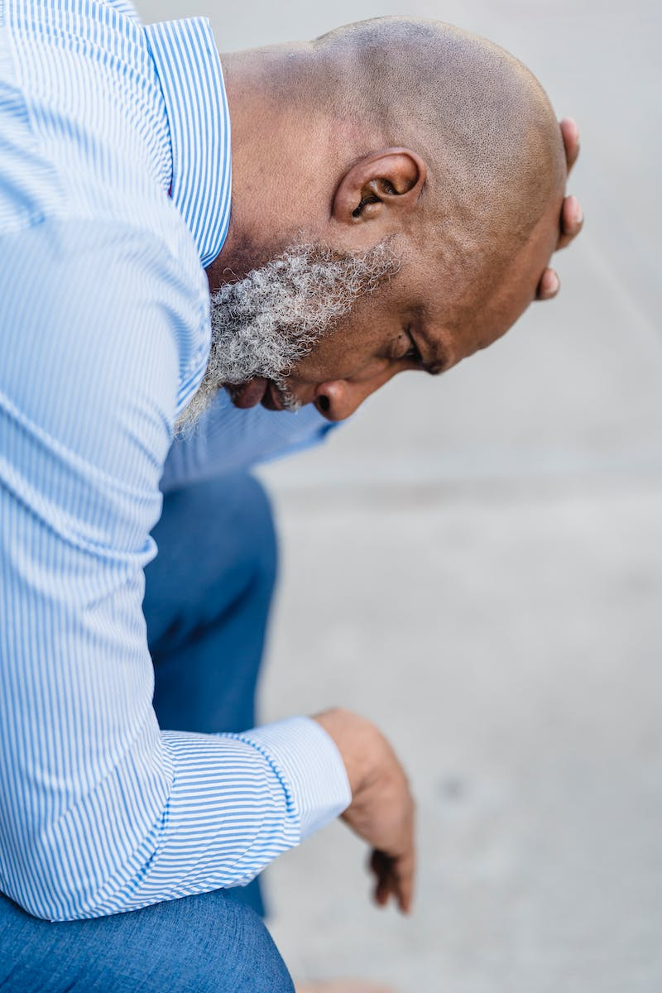
The Market for Verification Badges
• The market for verification badges is not as lucrative as it may seem.
• Despite the high prices charged by some sellers, the demand is relatively low.
• Most influencers and bloggers are not willing to pay exorbitant amounts for a verification badge.
• Several attempts to sell the badges were met with negative or uninterested responses.
• Ultimately, the market for verification badges may not be as profitable as anticipated.
Photo by Pexels

Slide 7
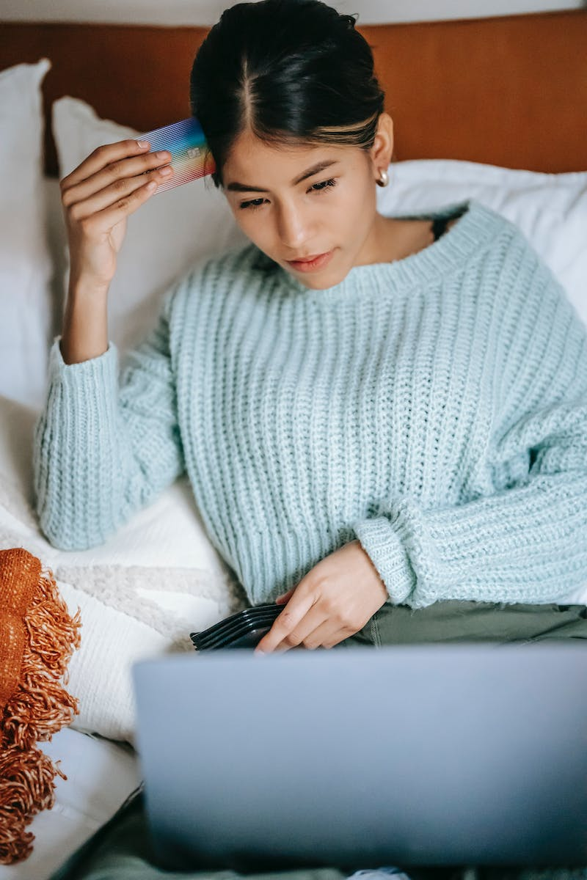
Conclusion
• Obtaining Instagram verification badges has become more accessible but is still relatively expensive.
• While there is demand for verification badges, the market may not be as lucrative as expected.
• It is important to spend money wisely and invest in useful and beneficial things.
• Additionally, there are alternative ways to spend money smartly, such as maximizing credit card benefits.
• In conclusion, the market for verification badges may not offer significant returns.
Photo by Pexels

