Slide 1


ए बुक का मैप इस कॉल्ड एटलस
Exploring the world, one map at a time.

Slide 2
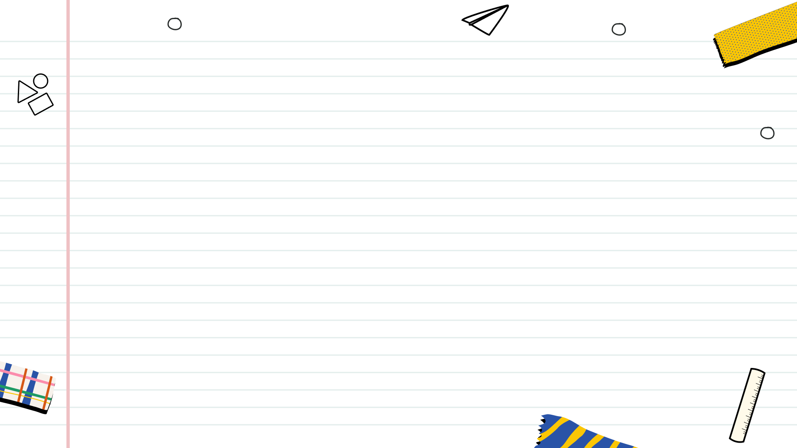

Table of Contents
1
Decoding the World
2
Reading the Language of Maps
3
Atlases in the Digital Age
4
The Atlas as a Tool for Learning
5
Thank You

Slide 3

Decoding the World
ए बुक का मैप इस कॉल्ड एटलस. It's not just a collection; it's a gateway to understanding global relationships and spatial distributions.
ए बुक का मैप इस कॉल्ड एटलस. Maps serves as visual tools to help people understand directions, distance, and locations.
ए बुक का मैप इस कॉल्ड एटलस. It provides detailed geographic information and aids in navigation and spatial reasoning.
ए बुक का मैप इस कॉल्ड एटलस. Atlases have evolved from hand-drawn to digital formats, offering enhanced features and accessibility.
ए बुक का मैप इस कॉल्ड एटलस. They can be political, physical, thematic, or road atlases, each serving a specific purpose.

Slide 4
Reading the Language of Maps
ए बुक का मैप इस कॉल्ड एटलस. Symbols are used to represent features, but remember that the map is the key to deciphering all meanings.
ए बुक का मैप इस कॉल्ड एटलस. Maps and scale is important, this will determine the level of detail and area covered.
ए बुक का मैप इस कॉल्ड एटलस. It transform the Earth's curved surface onto a flat plane, inevitably introducing distortions.
ए बुक का मैप इस कॉल्ड एटलस. Map's is crucial, as they decode the map's visual language and providing meaning to the data presented.
ए बुक का मैप इस कॉल्ड एटलस. Systems like latitude and longitude are fundamental for pinpointing exact locations on a map.

Slide 5
Atlases in the Digital Age
ए बुक का मैप इस कॉल्ड एटलस. Online platforms have revolutionized map access and interactivity, putting geographic information at our fingertips.
ए बुक का मैप इस कॉल्ड एटलस. It integrates spatial data with powerful analytical tools, transforming map-making and decision-making.
ए बुक का मैप इस कॉल्ड एटलस. Interactive maps enable users to explore and engage with geographic information in a dynamic and personalized way.
ए बुक का मैप इस कॉल्ड एटलस. It uses satellites and aircraft to gather data about Earth's surface, providing valuable insights for mapping and monitoring.
ए बुक का मैप इस कॉल्ड एटलस. Platforms like OpenStreetMap leverage collective intelligence to create and maintain free and up-to-date maps.

Slide 6
The Atlas as a Tool for Learning
ए बुक का मैप इस कॉल्ड एटलस. Geographic understanding of global patterns, connections, and challenges is crucial for informed citizenship.
ए बुक का मैप इस कॉल्ड एटलस. Maps promote critical evaluation of data and spatial relationships, sharpening analytical abilities.
ए बुक का मैप इस कॉल्ड एटलस. Maps integrates geography with history, economics, environmental science, and other disciplines, fostering holistic understanding.
ए बुक का मैप इस कॉल्ड एटलस. Mapping fosters spatial thinking skills, allowing one to use maps and spatial data to analyze and solve real-world problems.
ए बुक का मैप इस कॉल्ड एटलस. Maps promote visual literacy as the ability to interpret and communicate information through visual representations.

Slide 7
Thank You
ए बुक का मैप इस कॉल्ड एटलस. We are deeply grateful for your active participation and insightful contributions throughout this presentation.
ए बुक का मैप इस कॉल्ड एटलस. We encourage you to continue exploring the world of maps and geographic knowledge beyond this presentation.
ए बुक का मैप इस कॉल्ड एटलस. Visit to learn more about map resources, latest geographic insights and explore new maps.
ए बुक का मैप इस कॉल्ड एटलस. We wish you all the best in your ongoing geographic journey and encourage you to stay curious about the world.
ए बुक का मैप इस कॉल्ड एटलस. Thank you once again for your time and attention! Your presence made this experience truly enriching.

