Slide 1

Unlocking the Healing Power of Hilot
A Comprehensive 12-Day Journey into Filipino Traditional Healing Arts

Slide 2

Table of Contents
1
Welcome to Hilot Training: Your Journey Begins!
5
Hilot Ready: Client & Safety First
2
Hilot: Ancient Filipino Healing
6
Unlocking Hilot: Foundations
3
Hilot Ethics: Guiding Touch
7
Ancient Wisdom: Filipino Diagnostics
4
Hilot's Anatomical Compass
8
Hilot: Personalized Healing

Slide 3
9
Closing the Loop: Post-Service Excellence
10
Mastery & Celebration: Your Hilot Journey Concludes!

Slide 4
Welcome to Hilot Training: Your Journey Begins!
Define your aspirations for the training program and establish clear objectives for personal growth in Hilot.
Foster collaboration, respect, and understanding among participants to create a supportive learning environment for everyone.
Clarify the program's requirements, ethical guidelines, and performance standards to ensure everyone is aligned.
Embrace the hands-on, experiential nature of the 12-day program for deep skill development in Hilot.

Slide 5

Pre-Colonial Era
✓
Hilot: Ancient Filipino Healing
Origins Emerge
Hilot's origins are deeply embedded in pre-colonial Filipino culture. Passed down through generations, it served as a primary form of healthcare, addressing physical ailments and promoting overall well-being within communities through ancestral wisdom.
Exploring Hilot's deep history and philosophical roots.
Honoring the traditional Filipino healing heritage.
✓
16th Century
Spanish Influence
The arrival of the Spanish colonizers marked a period of suppression for many indigenous practices, including Hilot. Despite facing challenges, Hilot persevered, practiced discreetly within families and communities, safeguarding its unique techniques and knowledge from extinction.
20th Century
✓
Revival Dawns
The 20th century witnessed a resurgence of interest in traditional Filipino healing arts. Efforts to document, preserve, and promote Hilot gained momentum, driven by a desire to reclaim cultural heritage and offer alternative healthcare options deeply rooted in Filipino values.

Slide 6
21st Century
✓
Hilot: Ancient Filipino Healing
Global Recognition
Hilot is increasingly recognized globally for its holistic approach to healing. Practitioners are sharing their knowledge and skills, contributing to a growing appreciation for its therapeutic benefits and its significance as a valuable aspect of Filipino cultural identity. It’s finding its place in modern wellness.
Exploring Hilot's deep history and philosophical roots.
Honoring the traditional Filipino healing heritage.
✓
Future
Continued Evolution
The future of Hilot involves ongoing research, standardization of practices, and integration with modern healthcare. Embracing innovation while remaining true to its ancestral roots ensures Hilot will continue to thrive as a powerful and relevant healing modality for generations to come, both locally and globally.

Slide 7



Hilot Ethics: Guiding Touch
Uplifting Practice
Potential Pitfalls
Builds strong client trust and fosters long-term relationships based on mutual respect and understanding of boundaries.
Enhances the reputation of Hilot as a healing modality through consistent, ethical, and responsible practice.
Promotes a safe and comfortable environment for clients, encouraging openness and participation in the healing process.
Requires ongoing self-reflection and commitment to ethical principles; difficult to maintain without continuous effort.
May involve difficult conversations and boundary setting with clients, which can be challenging to navigate effectively.
Enforcement can be subjective and may require external oversight to ensure fairness and consistency in application.

Slide 8
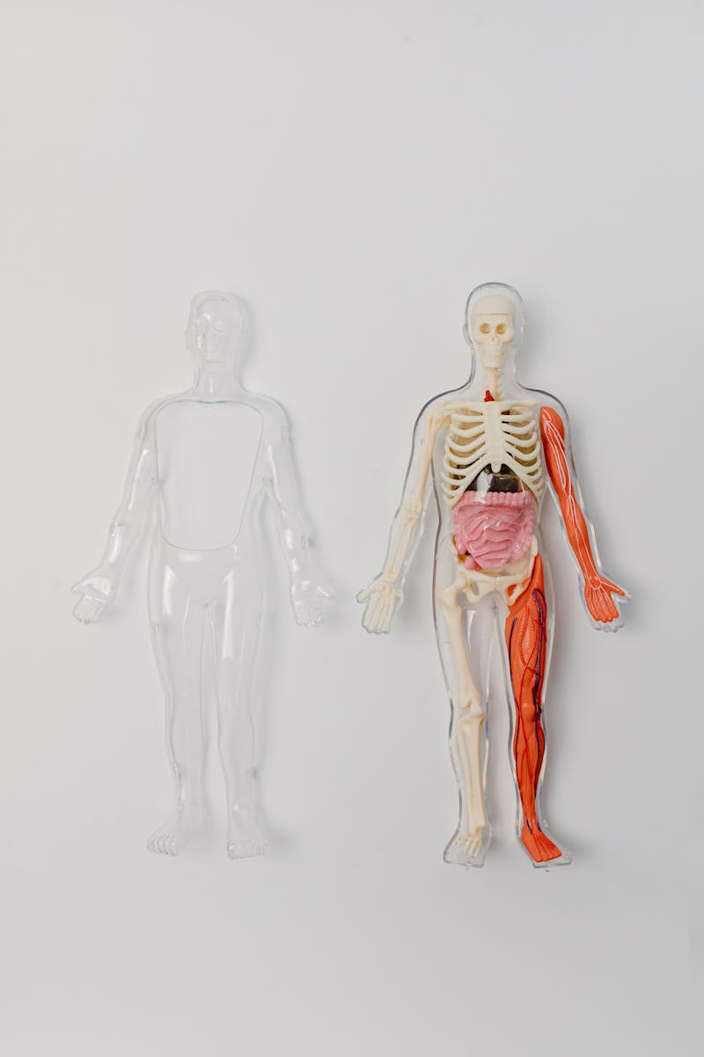
Hilot's Anatomical Compass
Muscle structure, function, and common imbalances are explored, providing a basis for targeted Hilot techniques and muscle release.
Bones, joints, and posture are examined, revealing connections to pain patterns and the impact of skeletal alignment on well-being.
Blood flow, circulation pathways, and the role of blood in healing are analyzed, informing Hilot's impact on vital energy.
Nerve pathways, sensory receptors, and the body's communication network are studied, enhancing sensitivity in Hilot assessments.
Photo by Pexels

Slide 9
Hilot Ready: Client & Safety First
Streamlining client onboarding, collecting essential information, and building rapport before the Hilot session begins smoothly.
Learning to identify potential health risks and contraindications to ensure client safety during Hilot treatment.
Implementing essential safety protocols to protect both the client and the Hilot practitioner during each session.
Creating a comfortable and safe environment for clients to relax and fully benefit from the Hilot therapy session.

Slide 10
Unlocking Hilot: Foundations
Hilot is an art of touch, a traditional healing practice passed down through generations.
Master core massage strokes: gliding, kneading, friction. Build a foundation for effective healing.
Proper posture and movement are key to preventing injury and maximizing your leverage as a healer.
Learn how to apply Hilot techniques in a smooth, fluid manner, maximizing patient comfort.

Slide 11
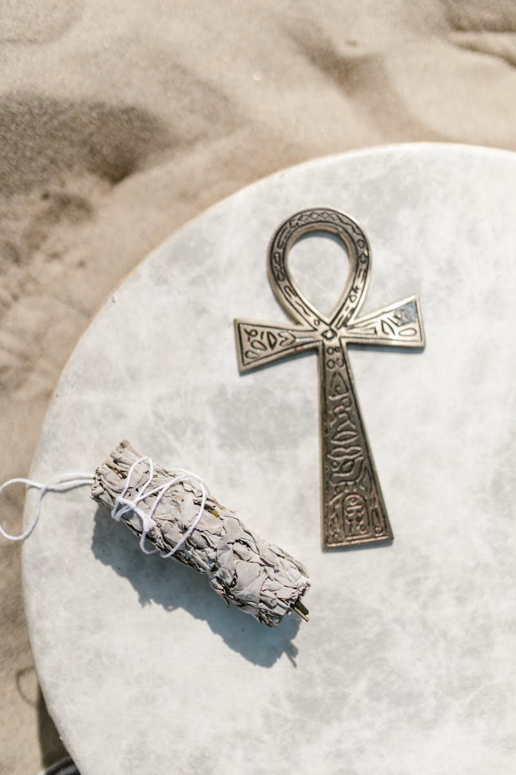
Ancient Wisdom: Filipino Diagnostics
Traditional diagnostics seek to identify root imbalances causing discomfort, going beyond surface-level symptoms for holistic healing.
'Lamig' refers to a condition caused by cold exposure, leading to muscle stiffness and joint pain addressed with warmth.
'Pilay' signifies sprains or strains, often treated with massage, herbal applications, and immobilization for proper recovery.
Medicinal plants play a vital role, offering natural solutions to alleviate pain, reduce inflammation, and restore balance in the body.
Photo by Pexels

Slide 12

Hilot: Personalized Healing
1.Customized Touch
2.Individualized Plans
Tailoring Hilot massage techniques to address the client's specific needs and promote optimal well-being.
Developing personalized Hilot wellness programs that align with individual goals and lifestyle for lasting results.
3.Confidence Building
4.Holistic Approach
Empowering practitioners with the skills and knowledge to confidently deliver effective Hilot treatments and build trust.
Focusing on the interconnectedness of mind, body, and spirit in the Hilot healing process for complete wellness.

Slide 13
Closing the Loop: Post-Service Excellence
Key Benefits
Potential Hurdles
Improved client outcomes through consistent application of post-care advice, fostering long-term well-being and satisfaction.
Enhanced communication between providers based on accurate SOAP notes, facilitating informed decision-making and targeted interventions.
Seamless continuity of care prevents service gaps by proactively managing follow-ups, adapting to client needs, and ensuring client progress.
Time constraints and workload pressures can hinder thorough documentation and detailed post-care planning, affecting care quality.
Maintaining consistent documentation standards across different staff members and departments requires ongoing training and standardization efforts.
Clients might not fully adhere to post-care recommendations, diminishing the benefits of the service and potentially affecting client progress.

Slide 14

Mastery & Celebration: Your Hilot Journey Concludes!
Skills Demonstrated
100%
Feedback Received
5/5
Knowledge Retention
95%
Technique Accuracy
98%

