Slide 1
Competition and Monopoly: Unveiling the Illusions
Why competition may not be as valuable as we think

Slide 2
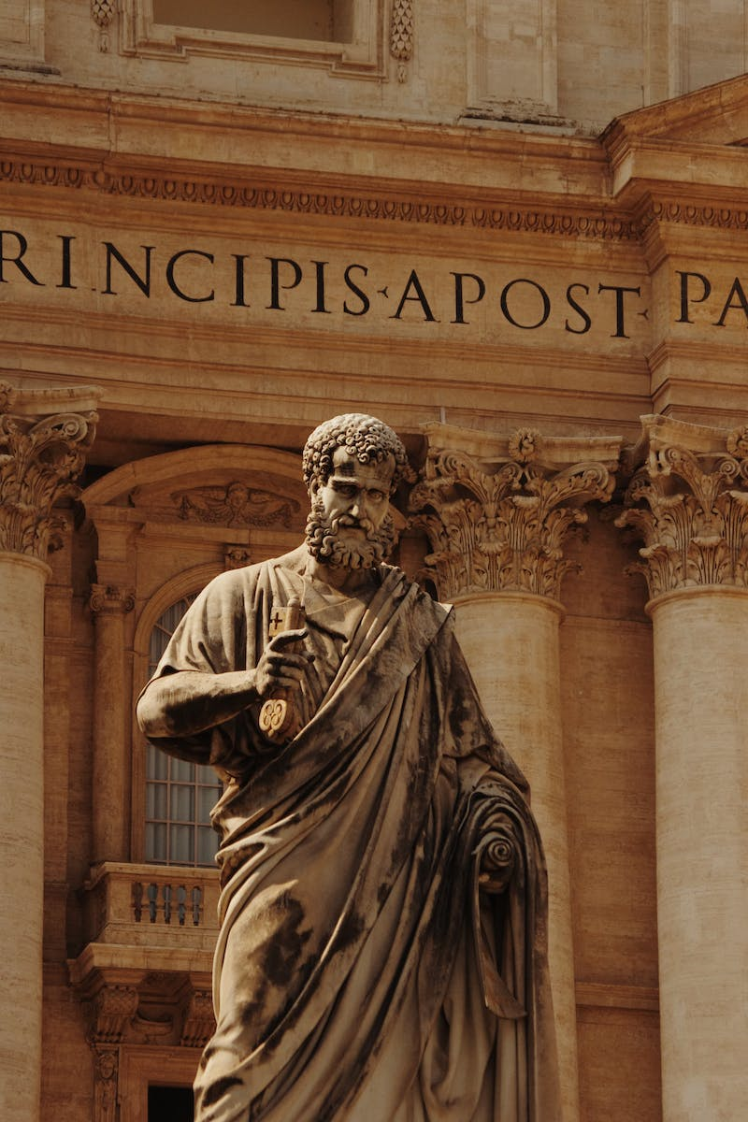
Introduction
• Peter Till, founder of PayPal and Palantir, discusses strategy and competition
• Highlights the importance of creating value and capturing a fraction of it
• Explains the misconception around the value of competition
• Introduces the concept of monopoly as a desirable goal
Photo by Pexels

Slide 3
The Value of a Business
• A valuable company creates x dollars of value for the world
• Value is determined by both creating something of value (x) and capturing a fraction of that value (y)
• X and y are independent variables, indicating the potential for large x with a small y
• Illustration of the airline industry vs. Google as an example of different valuations
Photo by Pexels

Slide 4
Perfect Competition vs. Monopoly
• Perfect competition is often seen as efficient and desirable
• Monopoly, on the other hand, is viewed as stable and valuable
• Contrasts the characteristics and outcomes of perfect competition and monopoly
• Highlights the dichotomy between these two types of businesses
Photo by Pexels

Slide 5
Lies about Business Types
• Businesses often lie about their nature to fit the desired image
• Monopolies pretend to be highly competitive to avoid regulation
• Non-monopolies claim uniqueness to differentiate themselves
• Explains the deceptive narratives told by businesses
Photo by Pexels

Slide 6
Building a Monopoly
• Starting with small markets and expanding is key to monopoly
• Many successful companies in Silicon Valley followed this model
• Examples include Amazon, eBay, and Facebook
• Focus on creating a monopoly by offering something unique
Photo by Pexels

Slide 7
Characteristics of a Monopoly
• Monopoly businesses often have proprietary technology
• Network effects and economies of scale contribute to their dominance
• Branding also plays a role in creating monopoly power
• Software businesses are particularly good at achieving monopoly-like status
Photo by Pexels

Slide 8
Last Mover Advantage
• Being the last company in a category is valuable
• Most of the value in companies exists in the future
• Learning from historical examples like Microsoft and Google
• Emphasizes the importance of long-term durability
Photo by Pexels

Slide 9
Science and Technology: Capturing Value
• Science and technology innovations don't always lead to capturing value
• Scientists rarely make money from their inventions
• Examples of valuable innovations without significant financial rewards
• Highlighting the structure of industries and the role of competition
Photo by Pexels

Slide 10
Competition as an Illusion
• Reevaluating the perception of competition as valuable
• Human nature's inclination towards imitation and validation through competition
• Questioning the wisdom of crowded competition
• The importance of thinking critically about the value of competition
Photo by Pexels

Slide 11
Conclusion
• Recap of the main points discussed
• Emphasizing the need to think beyond traditional views of competition
• Encouragement to consider the role of monopoly and value creation
• Closing remarks and invitation for further discussion
Photo by Pexels

