Slide 1
The Power of Artificial Intelligence in Healthcare
Transforming the Future of Medicine

Slide 2
Introduction
• Overview of Artificial intelligence (AI) in healthcare
• Benefits of AI in improving diagnosis and treatment
• Current challenges in healthcare industry
• How AI can revolutionize healthcare
Photo by Pexels

Slide 3
AI in Medical Imaging
• Enhancing accuracy and efficiency of medical image analysis
• Detecting early signs of diseases
• Improving patient outcomes
• Challenges in implementing AI in medical imaging
Photo by Pexels

Slide 4
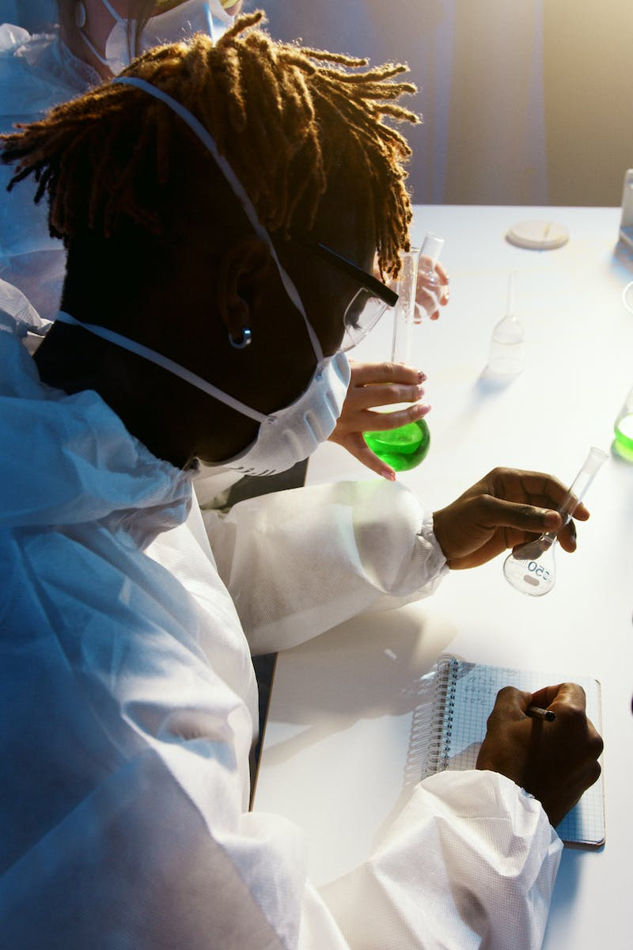
AI-Powered Virtual Assistants
• Improving patient satisfaction and experience
• Enhancing communication between healthcare providers and patients
• Personalized healthcare recommendations and reminders
• Security and privacy concerns
Photo by Pexels

Slide 5
Predictive Analytics in Healthcare
• Utilizing AI to predict disease outbreaks
• Identifying high-risk patients and prioritizing interventions
• Optimizing resource allocation in healthcare facilities
• Ethical considerations in predictive analytics
Photo by Pexels

Slide 6
AI in Drug Discovery and Development
• Accelerating drug discovery process
• Identifying potential drug candidates
• Reducing time and cost of clinical trials
• Ethical implications of AI in drug development
Photo by Pexels

Slide 7
Conclusion and Future Directions
• Summary of the key points discussed
• Potential future applications of AI in healthcare
• Challenges and considerations for widespread adoption of AI in healthcare
• Call to action for embracing AI in healthcare
Photo by Pexels

