Slide 1
How to Embrace Misery and Live a Miserable Life
Cutting Through Happiness and Finding True Misery

Slide 2
Introduction
• In a world obsessed with happiness, let's uncover the secrets of true misery.
• Learn how to embrace a miserable life and avoid any hint of joy or fulfillment.
• Discover the power of negativity and self-sabotage in everyday activities.
• Join us on this journey to absolute despair and dissatisfaction.
Photo by Pexels

Slide 3
Step 1: Diet
• The impact of diet on your mood and well-being.
• Avoid healthy foods and indulge in processed junk.
• Say no to vegetables and whole foods.
• Stick to affordable, poor quality processed foods.
Photo by Pexels

Slide 4
Step 2: Materialism
• Buying unnecessary and wasteful items to perpetuate dissatisfaction.
• Avoid investing in useful products or experiences.
• Upgrade your phone frequently without utilizing its capabilities.
• Prioritize instant gratification over long-term fulfillment.
Photo by Pexels

Slide 5
Step 3: Avoid Challenges
• Resisting difficult tasks to preserve misery.
• Engage in mindless distractions instead of facing challenges.
• Prioritize frivolous activities like social media or pornography.
• Deliberately avoid personal growth and development.
Photo by Pexels

Slide 6
Step 4: Abandon Ambition
• Reject setting goals or taking proactive steps towards success.
• Maintain a lack of ambition to sustain a miserable existence.
• Avoid progress and the possibility of finding fulfillment.
• Stay within your comfort zone and settle for mediocrity.
Photo by Pexels

Slide 7
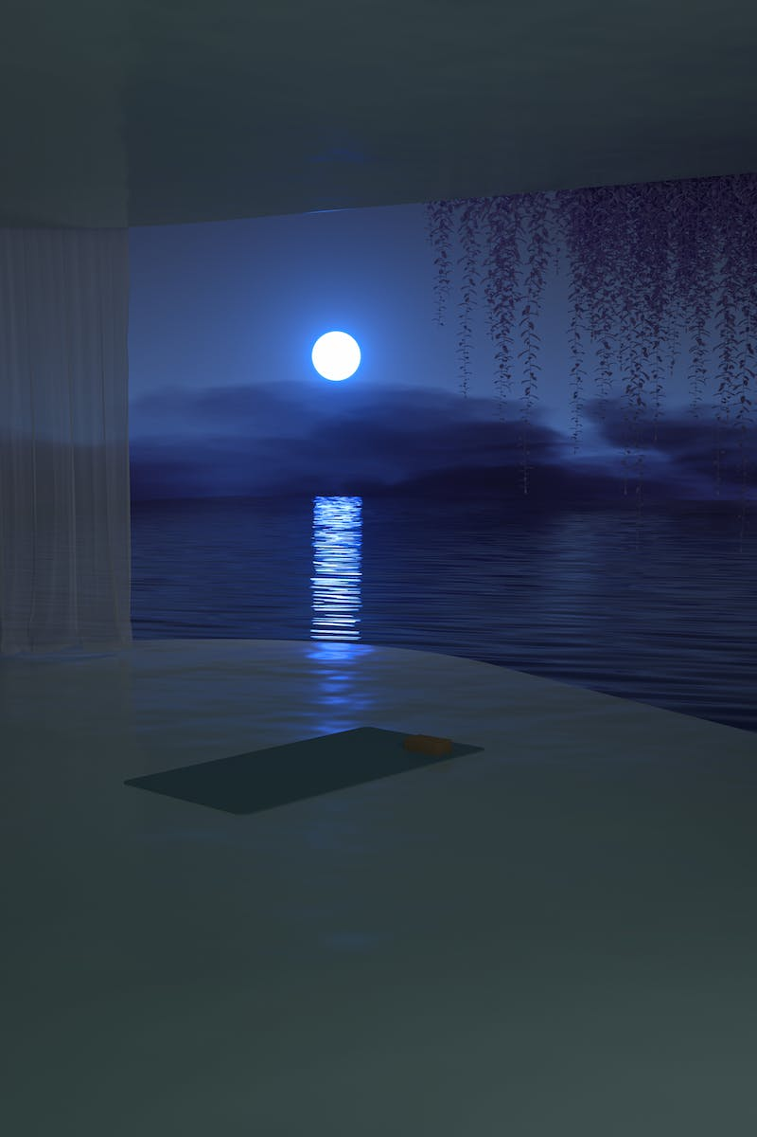
Step 5: Surroundings
• Create a disorganized and uninspiring living space.
• Eliminate any signs of organization or beauty in your environment.
• Avoid natural elements and sources of inspiration.
• Maintain a dull and oppressive living environment.
Photo by Pexels

Slide 8
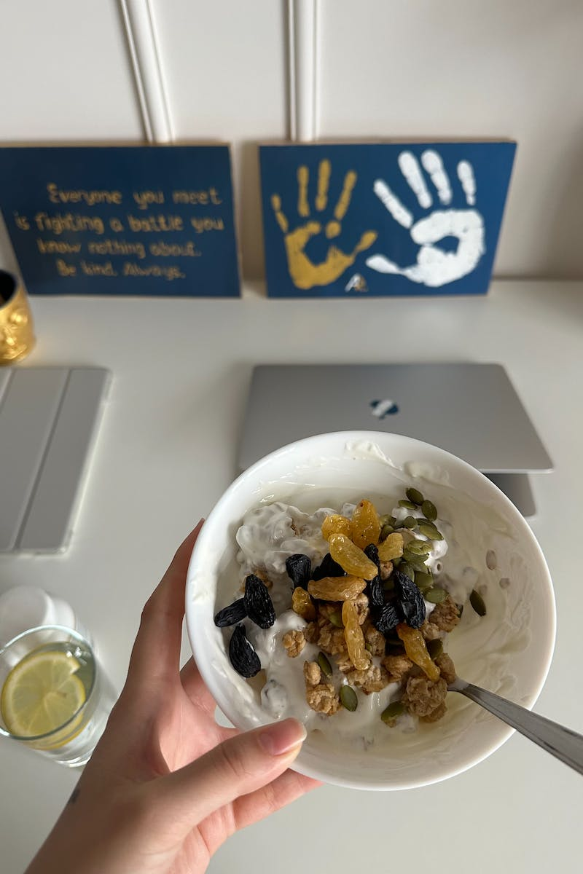
Step 6: Reject Creativity
• Deny yourself any creative outlets or artistic pursuits.
• Suppress any activities that promote mental health and relaxation.
• Curb opportunities for self-expression and personal growth.
• Discourage engagement with the arts and creative endeavors.
Photo by Pexels

Slide 9
Step 7: Embrace Pessimism
• Adopt a perpetual negative outlook on life.
• Expect the worst in every situation, regardless of reality.
• Disregard any advice that promotes positive thinking.
• Assume the role of a victim and wallow in self-pity.
Photo by Pexels

Slide 10
Step 8: Isolate Yourself
• Avoid meaningful connections and isolate yourself from others.
• Limit social interactions to maintain misery.
• Stay away from positive environments and nature.
• Disregard personal responsibility and blame others for your unhappiness.
Photo by Pexels

Slide 11
Step 9: Neglect Physical Health
• Ignore the importance of physical exercise and well-being.
• Avoid activities that promote physical fitness and improve mood.
• Choose a sedentary lifestyle devoid of any physical exertion.
• Associate discomfort with personal growth and fulfillment.
Photo by Pexels

Slide 12
Step 10: Fear Uncertainty
• Shy away from embracing uncertainty and taking risks.
• Avoid stepping out of your comfort zone for fear of positive outcomes.
• Choose stability and predictability above all else.
• Dismiss the potential for growth and fulfillment through uncertain situations.
Photo by Pexels

Slide 13
Conclusion
• Recap the ten steps to living a miserable life.
• Highlight the importance of embracing misery and avoiding happiness.
• Encourage the audience to continue living a miserable existence.
• Thank the audience for their time and dedication to misery.
Photo by Pexels

