Slide 1

Unlocking the Digital World: Computer Networking
An In-Depth Exploration of Networks and Their Impact on Modern Life.

Slide 2

Table of Contents
1
Unlocking Connectivity: The Power of Networks
5
Network Essentials: Key Devices
2
The Power of Connection: Network Objectives
6
OSI vs. TCP/IP: Communication Models
3
Network Spectrum Unveiled
7
Data's Digital Pathways
4
Network Topologies: The Blueprint
8
Decoding IP Addresses

Slide 3
9
Networking: Global Digital Evolution

Slide 4
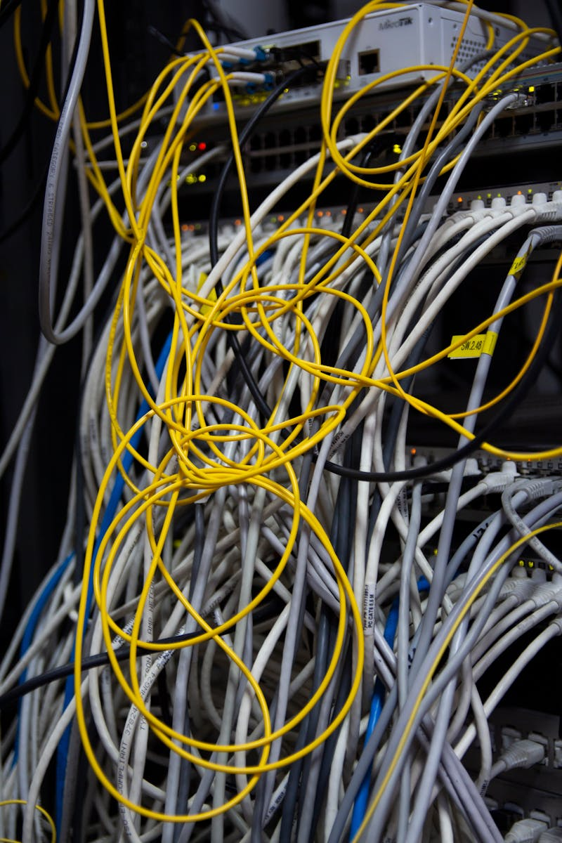
Unlocking Connectivity: The Power of Networks
Networks allow devices to exchange data and resources, enhancing collaboration and innovation in various fields and practices daily.
Email, video conferencing, and instant messaging all rely on computer networks for efficient and reliable communication worldwide now.
Networks enable access to cloud-based services, offering scalable storage, processing power, and software applications globally to companies.
Computer networks connect a wide range of devices, from personal computers to mobile phones and IoT devices for global access.
Photo by Pexels

Slide 5

The Power of Connection: Network Objectives
1.Seamless Communication
2.Efficient Sharing
Networking facilitates instant data transfer and interaction, fostering better collaboration and quicker decision-making within organizations.
Networked systems enable easy access and sharing of resources like printers, software, and storage, reducing costs and redundancy.
3.Centralized Management
4.Improved Security
Networking allows for centralized data and application management, simplifying administration and improving operational efficiency significantly.
Networked environments, with proper security measures, offer enhanced data protection through controlled access and threat monitoring protocols.

Slide 6
Network Spectrum Unveiled
PANs connect devices in a small personal area, like a phone to wireless headphones, providing localized connectivity.
LANs connect devices within a limited area, such as a home, office, or school, enabling resource sharing.
MANs connect devices across a city or metropolitan area, larger than a LAN but smaller than a WAN.
WANs connect devices over a broad geographical area, spanning countries or even continents, enabling global communication.

Slide 7

Network Topologies: The Blueprint
Device arrangement profoundly affects network speed, reliability, and cost. Strategic design is crucial for optimal performance.
A single cable connects all devices. It's simple but susceptible to failures and performance bottlenecks as demand increases.
All devices connect to a central hub, offering better fault tolerance but reliant on the hub's reliability.
Devices connect in a closed loop, with data passing sequentially. Failure in one node can disrupt the entire network.
Photo by Pexels

Slide 8
Network Essentials: Key Devices
Essential hardware for connecting devices and facilitating data exchange in any network setup.
Network Interface Cards (NICs) enable devices to connect to and communicate over a network.
Hubs act as central connection points, broadcasting data to all connected devices.
Switches intelligently forward data only to the intended recipient, enhancing network efficiency.

Slide 9



OSI vs. TCP/IP: Communication Models
OSI Advantages
TCP/IP Drawbacks
Conceptual clarity through distinct layers, aiding in understanding network functions and troubleshooting complex communication issues effectively.
Standardized framework promotes interoperability, ensuring devices from various vendors can communicate seamlessly within a network environment.
Provides a comprehensive, layered approach, making it easier to isolate and address network problems, improving overall network reliability.
Complex implementation due to its seven-layer structure, making it harder to put into practice in real-world networking scenarios.
Slower processing speed compared to TCP/IP because of the overhead involved in processing each of the seven layers individually.
Not widely adopted in its entirety, limiting its practical application in many modern networking environments and architectures.

Slide 10
Data's Digital Pathways
Twisted pair, coaxial, and fiber optic cables offer different speeds and costs for data transmission.
Radio waves and microwaves enable wireless communication, offering flexibility but potential for interference.
Data zips across varied media, each uniquely balancing speed, cost, and reliability factors.
Transmission speeds vary greatly depending on the media type utilized for data's journey.

Slide 11
Decoding IP Addresses
IP addresses act as unique identifiers, distinguishing each device connected to a network.
Both IPv4 and IPv6 serve the same purpose, but IPv6 offers a vastly larger address space.
Subnetting divides larger networks, improving performance and security through logical groupings.
Effective subnetting allows for streamlined network administration and resource allocation within networks.

Slide 12

1969
✓
Networking: Global Digital Evolution
ARPANET's Birth
The Advanced Research Projects Agency Network (ARPANET) is established, marking a pivotal moment in networking history. This pioneering network laid the groundwork for the internet, connecting research institutions and enabling early data exchange.
Networking fuels modern digital systems. It enables faster communication, efficient resource sharing, and streamlined business operations worldwide.
✓
1983
TCP/IP Standardized
The Transmission Control Protocol/Internet Protocol (TCP/IP) becomes the standard protocol suite for ARPANET. This standardization was crucial, allowing different networks to communicate seamlessly and fostering the internet's rapid growth and expansion.
1990
✓
WWW Emerges
Tim Berners-Lee invents the World Wide Web (WWW), revolutionizing information access. The WWW introduced a user-friendly interface to the internet, enabling widespread adoption and transforming how people share and consume content globally.

Slide 13
2007
✓
Networking: Global Digital Evolution
Mobile Revolution
The introduction of the iPhone sparks the mobile revolution. Smartphones become ubiquitous, extending network access to billions and fostering a new era of mobile applications, social networking, and on-the-go connectivity worldwide.
Networking fuels modern digital systems. It enables faster communication, efficient resource sharing, and streamlined business operations worldwide.
✓
2020
5G Connectivity
The rollout of 5G networks begins, promising significantly faster speeds and lower latency. This advancement unlocks new possibilities for applications like IoT, autonomous vehicles, and augmented reality, further enhancing digital connectivity.

