Slide 1
Exploring Bolivia: Land of Diversity
Unveiling the Wonders of Bolivia

Slide 2
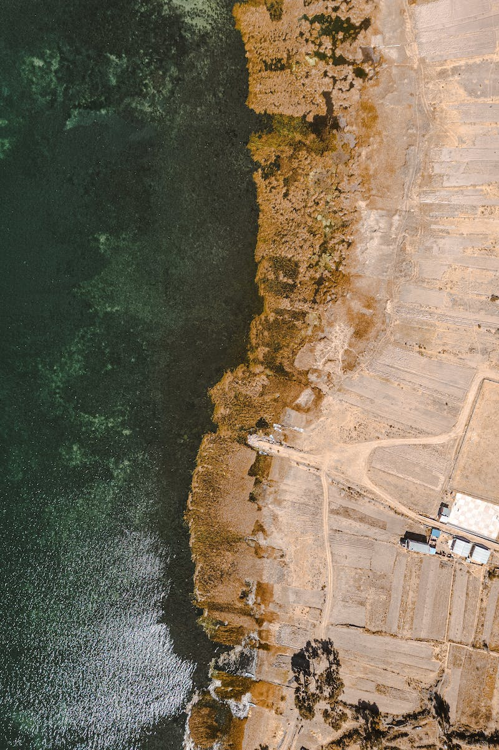
Introduction to Bolivia
• Bolivia is the highest and most isolated country in South America.
• It became independent from Spain on August 6, 1820.
• Bolivia is one of the few places in the world where mining is widespread.
• Jiwanaku, an archaeological site in Bolivia, is among South America's most intriguing.
Photo by Pexels

Slide 3
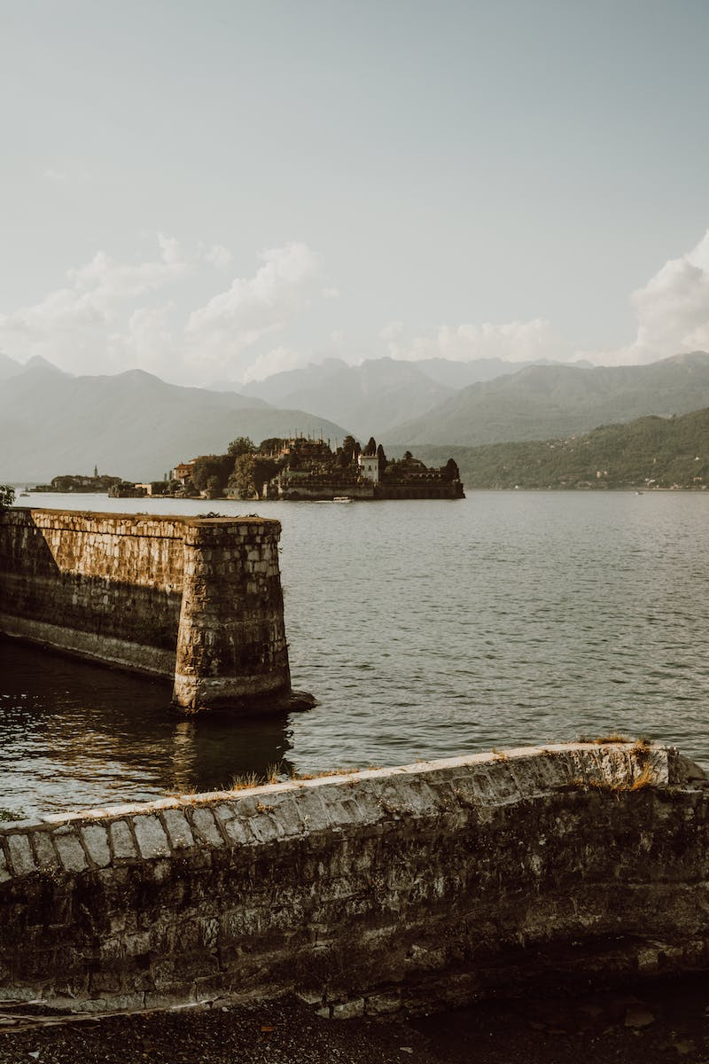
Bolivia's Natural Wonders
• The Bolivia Lake, straddling the border between Peru and Bolivia, is the world's highest navigable lake.
• Bolivia has an annual rainfall of over five meters, making it one of the wettest countries on the planet.
• The Llama, a native animal, serves as a valuable resource for meat, wool, leather, and fuel.
• Avocado is used as a source of food and fuel, with dried dung commonly used in rural communities.
Photo by Pexels

Slide 4
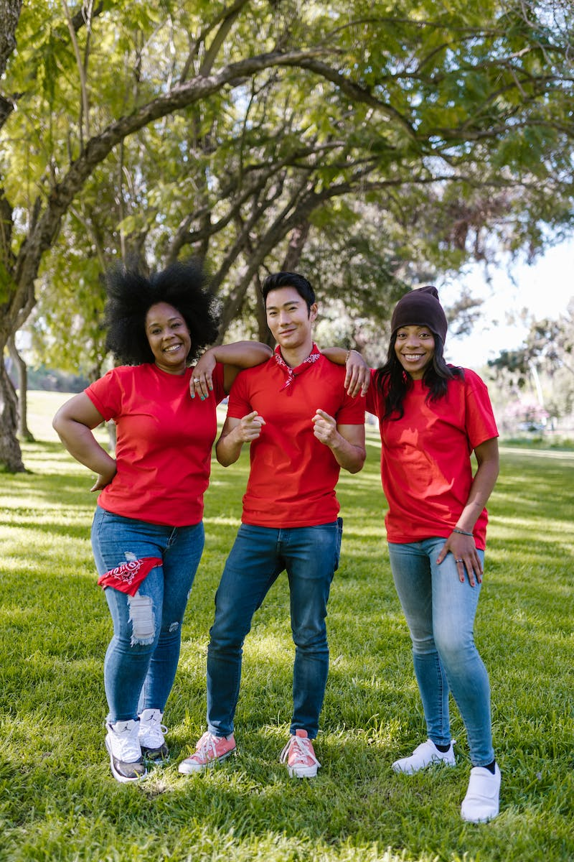
Language and Culture
• Bolivia has over thirty official languages, including Quechua and Aymara.
• Spanish is the most widely spoken language in the country.
• The indigenous languages reflect Bolivia's diverse cultural heritage.
• The fusion of indigenous traditions and Spanish influences creates a unique cultural tapestry.
Photo by Pexels

Slide 5
Obligatory Military Service
• Military service is obligatory in Bolivia for all men between the ages of eighteen and twenty-two.
• This requirement aims to ensure the country's defense and strengthen national identity.
• It provides young men with training and discipline, fostering a sense of patriotism.
• The military service plays a vital role in Bolivia's national security.
Photo by Pexels

Slide 6
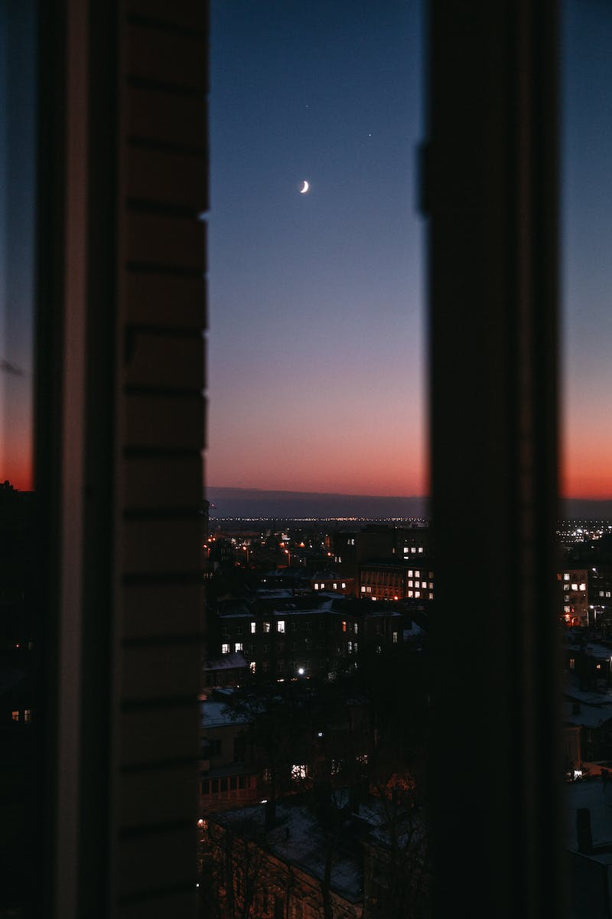
Conclusion
• Bolivia is a land of diverse landscapes, rich cultural heritage, and unique traditions.
• From its highest navigable lake to its intriguing archaeological sites, Bolivia offers unparalleled natural and historical wonders.
• The fusion of indigenous cultures with Spanish influences creates a vibrant and captivating cultural tapestry.
• Explore Bolivia to witness its breathtaking beauty and immerse yourself in its vibrant traditions and warm hospitality.
Photo by Pexels

