Slide 1

DC Measurement Mastery: Accurate Results Guaranteed!
Unlocking Precision: A Step-by-Step Guide to Flawless DC Measurement Techniques

Slide 2

Table of Contents
1
DC Measurement Basics
5
Voltage Unveiled: Parallel Connection
2
DC Circuit Essentials
6
Measuring Current: A Step-by-Step Guide
3
Power Up: Circuit Foundations
7
Precision Readings: Mastering Meter Selection
4
Multimeter Mastery: Step 2
8
Multimeter Accuracy Over Time

Slide 3
9
Data Mastery: Analysis & Best Practices

Slide 4
DC Measurement Basics
Direct current flows in one direction, maintaining constant polarity and magnitude over time.
DC measurements help analyze circuit behavior, troubleshoot issues, and verify design specifications effectively.
Understanding DC characteristics is crucial for comprehending overall electronic circuit functionality and performance standards.
DC measurement is essential in power supplies, battery testing, and many other electronic applications practically.

Slide 5



DC Circuit Essentials
Key Advantages
Potential Drawbacks
Multimeters offer versatile measurements of voltage, current, and resistance, crucial for circuit analysis and troubleshooting.
Power supplies provide stable and adjustable DC voltage, ensuring consistent circuit operation during experimentation and development.
Breadboards enable rapid prototyping and circuit construction without soldering, facilitating experimentation and design iterations.
Initial investment in quality tools and equipment can be significant, especially for comprehensive testing and advanced projects.
Learning to use measurement tools effectively requires time and practice to avoid errors and ensure accurate readings.
Breadboards are not suitable for high-frequency or high-power circuits due to limited current capacity and parasitic effects.

Slide 6
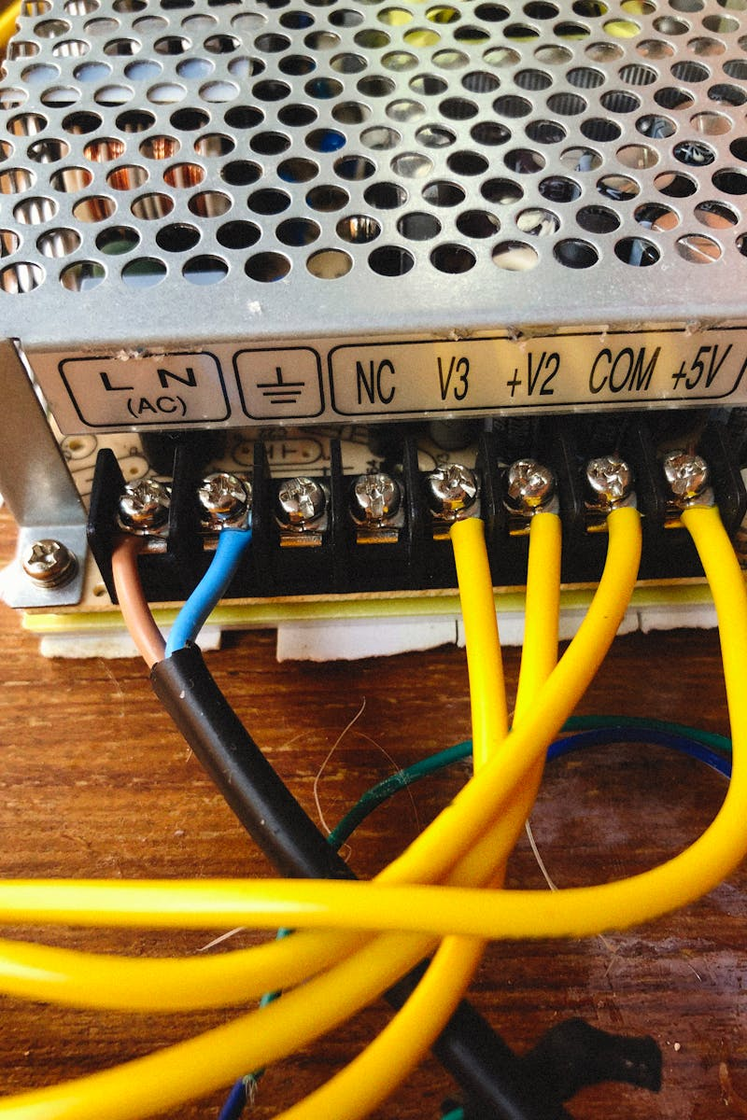
Power Up: Circuit Foundations
Understand breadboard connectivity to effectively prototype. Rows and columns create pathways for component interaction.
Strategic component placement ensures optimal circuit layout. Minimize wire lengths for better signal integrity.
Precise wiring is paramount for a functional circuit. Double-check connections to prevent shorts and open circuits.
Connect the DC power supply with correct polarity. Confirm voltage level before powering the entire circuit.
Photo by Pexels

Slide 7
Multimeter Mastery: Step 2
Choose DC voltage or current on your multimeter. This aligns with the target measurement.
Your desired parameter (voltage/current) dictates the mode. Precision starts with correct selection.
Confirm the DC setting. Alternating current measurements require a different setting altogether.
Incorrect mode leads to faulty readings. Double check before probing any circuit elements.

Slide 8
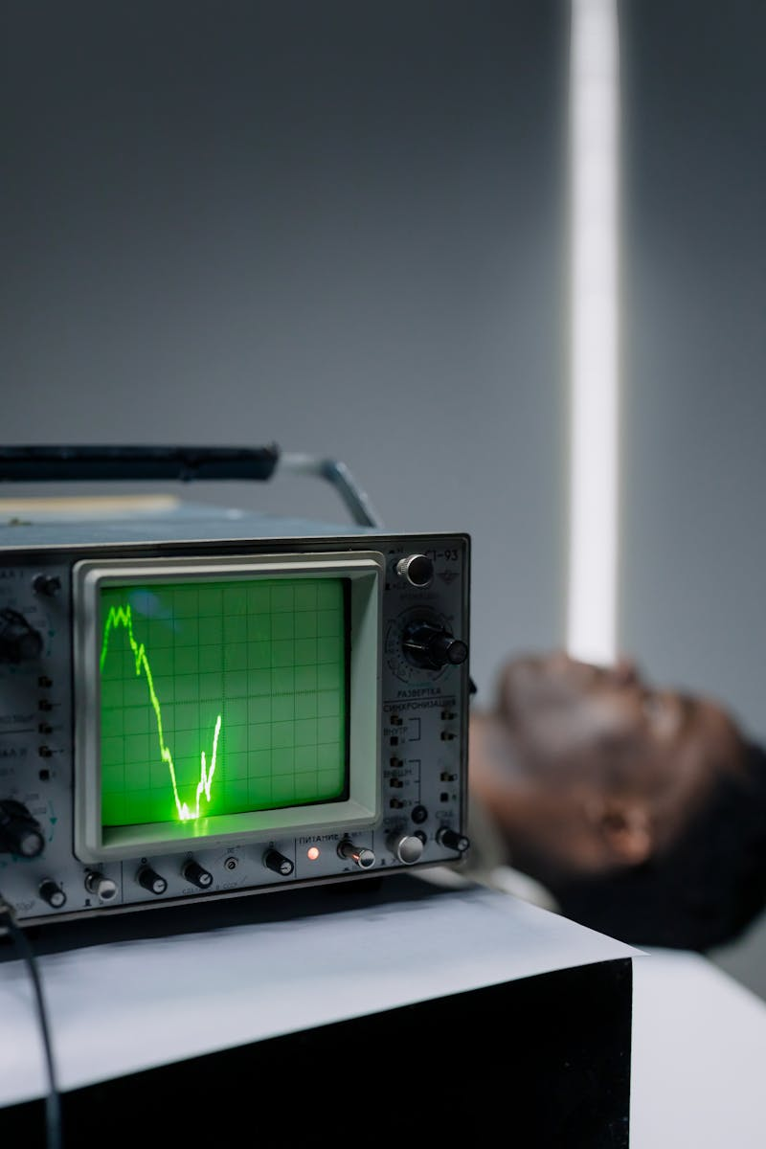
Voltage Unveiled: Parallel Connection
Connecting in parallel ensures the multimeter experiences the same voltage drop as the component being tested for accuracy.
Configure your multimeter to the DC or AC voltage range, depending on the circuit's voltage type. Select carefully.
Place the multimeter probes across the component's terminals, ensuring proper polarity if measuring DC voltage levels.
Observe the multimeter display to read the voltage value across the component. Note down the voltage readings carefully.
Photo by Pexels

Slide 9

Measuring Current: A Step-by-Step Guide
Current Reading
0.5A
Voltage Drop
2.1V
Resistance Load
4.2Ω
Measurement Error
0.1%

Slide 10
Precision Readings: Mastering Meter Selection
Range Accuracy
99.9%
Error Margin
±0.5%
Resolution Level
1mV
Reading Stability
98%

Slide 11

1920
✓
Multimeter Accuracy Over Time
Early Concepts
The fundamental principles of electrical measurement were being explored, laying the groundwork for future multimeter development. Early instruments focused on basic voltage and current readings with limited accuracy.
Maintaining accuracy is crucial for reliable measurements.
Regular calibration and verification are essential practices.
✓
1950
Analog Advancements
Analog multimeters gained popularity, relying on needle deflection to indicate readings. Calibration involved adjusting potentiometers and zero points to ensure accurate measurements against known standards, a meticulous and time-consuming process.
1980
✓
Digital Revolution
Digital multimeters (DMMs) emerged, offering improved precision and easier readability. Calibration procedures shifted to using digital references and automated adjustments, enhancing both accuracy and efficiency of verification processes.

Slide 12
2010
✓
Multimeter Accuracy Over Time
Automated Verification
Automated calibration systems became commonplace, allowing for rapid and comprehensive testing of multimeter accuracy. These systems utilize precise voltage and current sources, analyzing deviations and generating calibration reports to meet traceability requirements.
Maintaining accuracy is crucial for reliable measurements.
Regular calibration and verification are essential practices.
✓
2024
Continuous Monitoring
Modern multimeters now feature capabilities for self-calibration and continuous monitoring. These features alert users to potential accuracy drifts, enabling proactive maintenance and ensuring consistently reliable measurements. Cloud connectivity assists with calibration scheduling.

Slide 13

Data Mastery: Analysis & Best Practices
1.Data Interpretation
2.Meticulous Records
Carefully analyze measurement data to identify trends, patterns, and potential anomalies. Accuracy is key to drawing valid conclusions.
Maintain comprehensive and organized records of all measurements, observations, and experimental conditions. Documentation ensures reproducibility and traceability.
3.Safety First
4.Result Validation
Adhere strictly to all established safety procedures throughout the measurement and analysis process. Prioritize personal and environmental well-being.
Validate interpreted results using statistical methods and cross-referencing with existing knowledge. Confirm accuracy and identify possible errors.

