Slide 1
Contemporary Philippine Arts from the Regions, Lesson Five
Composition, Content, and Context

Slide 2
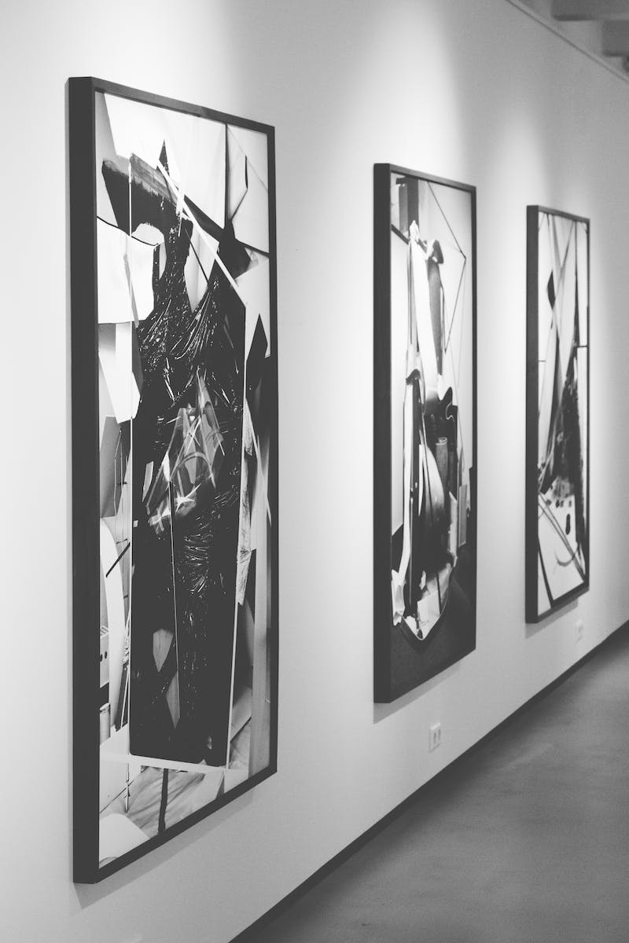
Introduction
• Welcome to Contemporary Philippine Arts from the Regions, Lesson Five
• Our lesson for today is Composition, Content, and Context
• The three basic properties of a work of art are subject, composition, and content
• If any of these three elements are missing, it wouldn't be considered an artwork
Photo by Pexels

Slide 3
Subject
• Subject refers to what the artwork is about
• It includes big ideas, themes, subject matter, and point of view
• Literary sources and visual sources can also be the subject of an artwork
• Art can also intersect with music, film, theater, and dance
Photo by Pexels

Slide 4
Composition
• Composition refers to the elements and principles of art
• Size and scale, media material, process, and skill are also part of composition
• A carefully chosen size and scale can give meaning and importance to an artwork
• Different materials and processes can be used to create unique effects
Photo by Pexels

Slide 5
Content
• Content refers to the context in which the artwork exists
• Context includes answers to questions like when, where, who, and why
• The significance and relevance of an artwork can also be part of its content
• Art can have personal, social, cultural, historical, artistic, educational, political, expert, or environmental significance
Photo by Pexels

Slide 6
Examples of Subject
• Minors in the Sierra by Charles Christian and August Sw oath
• Natural Beach by Robert Roger Brown
• Kim bay twenty eighteen installation artwork
Photo by Pexels

Slide 7
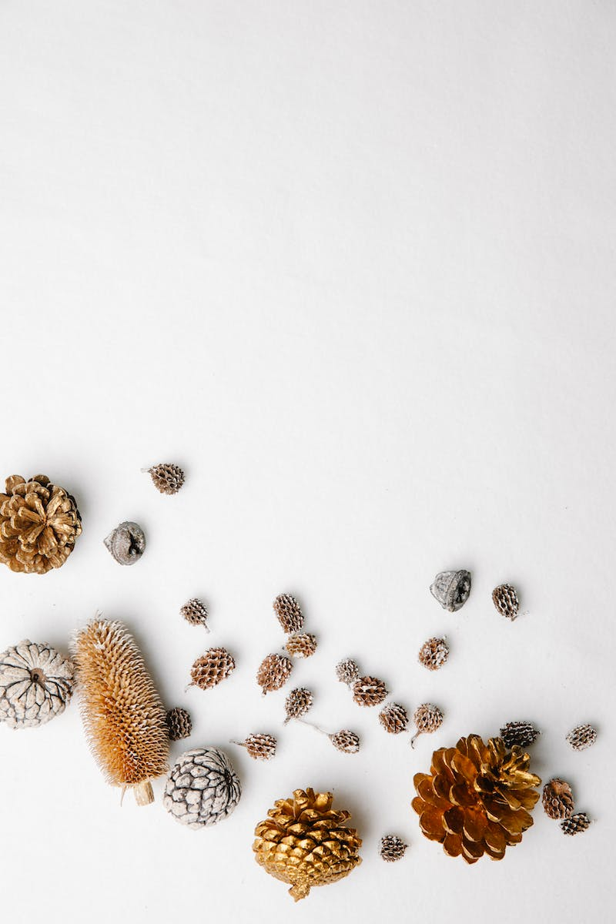
Size and Scale Examples
• Hyper-realistic sculptures by Ron Mueck
• Hans Haacke's artwork 'The Imaginary Museum'
Photo by Pexels

Slide 8
Media Material Examples
• Wee Teng Boon's self-portrait made with real teeth, fingernails, and hair
• Michael Heizer's artwork 'Levitated Mass' made with a giant boulder
Photo by Pexels

Slide 9
Process and Method Examples
• John Sa Sa's artwork created using toxic sludge from abandoned coal mines
• Gustav Klimt's portrait of Adele Bloch-Bauer
Photo by Pexels

Slide 10
Significance and Relevance
• Personal, social, cultural, historical, artistic, educational, political, expert, and environmental significance
• The importance of the content and context in understanding the meaning of an artwork
Photo by Pexels

Slide 11
Conclusion
• Composition, content, and context are essential aspects of contemporary Philippine arts
• Understanding these properties helps in analyzing and appreciating artworks
• Art reflects the subject, composition, and content of the artist's intention
• Thank you for joining us in this lesson on Composition, Content, and Context
Photo by Pexels

