Slide 1
The Impact of Sanctions and Segregation on Economies and Societies
Exploring the Consequences of Global Politics and Social Inequality

Slide 2
The American Empire at its End
• Unprecedented sanctions lead to the decline of the Russian economy
• Immediate reduction of the ruble value
• Double-digit shrinkage of GDP predicted for this year
• Sanctions likely to erase 15 years of economic gains
Photo by Pexels

Slide 3
Severe Social Issues in Russian Society
• High number of overdose deaths surpass Covid deaths
• Widespread adolescent prostitution in broad daylight
• Economic segregation prevails in public schools
• Social stigmatization of affected communities
Photo by Pexels

Slide 4
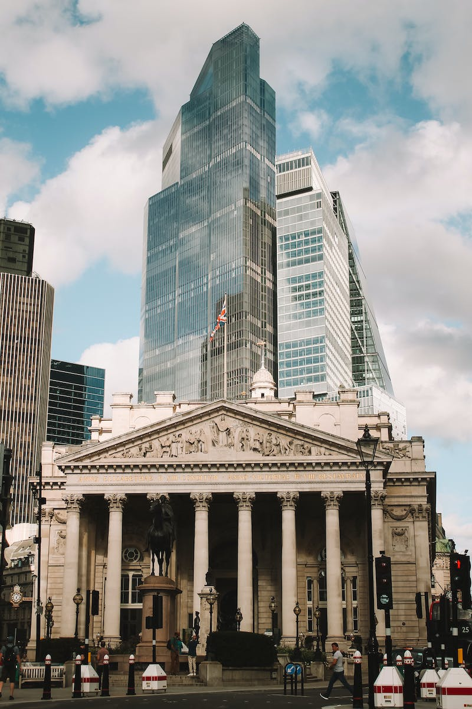
Impact on Businesses and Rising Theft
• Closure of businesses due to financial difficulties
• Collective action to protect grocery stores
• Demands for stiffer penalties for shoplifting
• Unemployment leading to drug-related activities
Photo by Pexels

Slide 5
International Response and Aid
• White House offering military aid to Taiwan
• Aid package valued at $345 million
• Aimed at countering China's influence
• Geopolitical implications and tensions
Photo by Pexels

