Slide 1


Unlocking the Mystery: Understanding Heart Attacks
A comprehensive guide to causes, symptoms, and prevention strategies.

Slide 2


Table of Contents
1
Understanding Heart Attacks
2
Coronary Arteries: Heart's Lifeline
3
Plaque Buildup: A Risky Timeline
4
The Clot's Deadly Grip
5
Hypoxia: Heart's Silent Threat
6
Heart Attack Warning Signs

Slide 3
Table of Contents
7
Act Fast: Heart Attack!
8
Decoding Heart Attacks: Diagnosis
9
Heart Treatment: Weighing Options
10
Heart Health Heroes: Prevention Power!

Slide 4


Understanding Heart Attacks
1
The Definition
2
Myocardial Infarction
A heart attack happens when blood flow to the heart muscle is significantly blocked, causing damage.
Myocardial infarction is the medical term for a heart attack, indicating death of heart muscle tissue.
3
Blocked Blood Flow
4
Heart Muscle Damage
The primary cause is a blockage in a coronary artery, restricting oxygen and nutrient supply.
Lack of blood flow leads to oxygen deprivation, resulting in irreversible damage to the heart muscle cells.

Slide 5
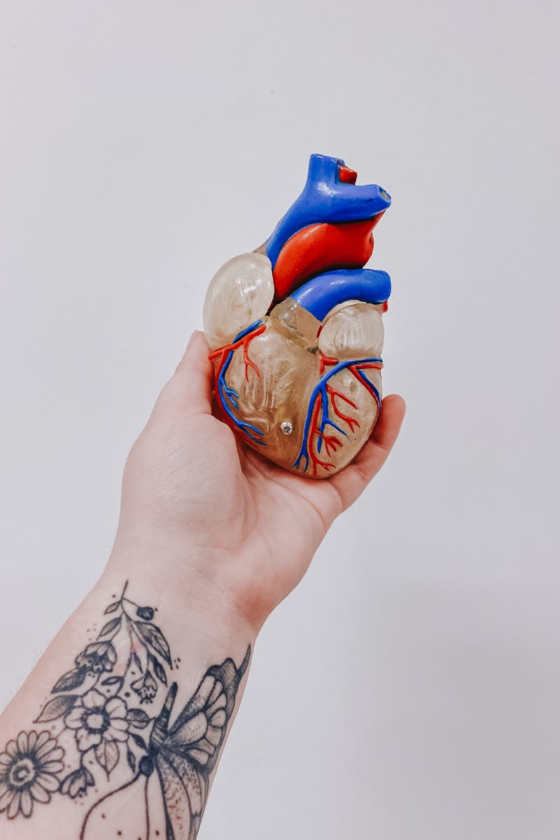
Coronary Arteries: Heart's Lifeline
These arteries exclusively deliver oxygen-rich blood to the heart muscle, ensuring continuous and proper functionality of the organ.
A complex network ensures all parts of the heart receive adequate blood, supporting synchronized contractions and efficient pumping action.
Artery blockage leads to ischemia, depriving the heart of oxygen, potentially causing angina, heart attack, and long-term damage.
Atherosclerosis causes plaque buildup, narrowing arteries and reducing blood flow, raising the risk of cardiac events drastically over time.
Photo by Google

Slide 6

Plaque Buildup: A Risky Timeline
1904
1910
1950
1990
Early Recognition
Cholesterol's Role
Framingham Study
Statin Revolution
Atherosclerosis, though affecting people for centuries, gained specific recognition as a disease entity. Research started focusing on arterial changes and their association with aging and lifestyle factors, laying groundwork for...
Research began linking dietary cholesterol to plaque formation. Animal studies showed that high cholesterol intake could induce arterial lesions resembling atherosclerosis, initiating debate on the role of diet in heart...
The Framingham Heart Study highlighted risk factors such as high blood pressure, smoking, and elevated cholesterol levels. This landmark study provided critical data associating these factors with increased atherosclerosis risk,...
The introduction of statins revolutionized atherosclerosis management by effectively lowering cholesterol levels. Clinical trials demonstrated statins' ability to reduce plaque buildup, prevent heart attacks and strokes, solidifying their role as...

Slide 7

The Clot's Deadly Grip
Unstable plaque within the artery can rupture, exposing the inner core to blood and initiating the clotting cascade.
Exposed plaque triggers rapid activation of clotting factors, leading to the formation of a thrombus, or blood clot.
The growing clot can obstruct blood flow through the artery, depriving downstream tissues of oxygen and nutrients.
Reduced blood flow causes ischemia, tissue damage due to lack of oxygen, potentially leading to infarction or cell death.
Photo by Google

Slide 8
Hypoxia: Heart's Silent Threat
Reduced oxygen supply deprives heart muscle cells, initiating a cascade of damaging events within the tissue.
Without sufficient oxygen, heart muscle cells (cardiomyocytes) undergo necrosis, or programmed cell death, rapidly.
Once cardiomyocytes die due to lack of oxygen, the damage becomes permanent, impacting heart function significantly.
The death of heart cells leads to decreased pumping efficiency and overall heart functional decline over time.

Slide 9
Heart Attack Warning Signs
1
Chest Pain
2
Breathlessness Alert
Persistent chest pain or discomfort, often described as pressure, squeezing, or fullness, is a primary symptom.
Experiencing shortness of breath, even without chest pain, can indicate a potential heart issue.
3
Nausea Signals
4
Cold Sweats
Unexplained nausea or vomiting, especially accompanied by other symptoms, warrants immediate attention.
Breaking out in a cold sweat, unrelated to physical exertion or temperature, is a serious sign.

Slide 10


Act Fast: Heart Attack!
Faster treatment means less heart muscle damage, leading to a stronger and healthier heart in the long run.
Quick intervention significantly improves survival chances after a heart attack, offering a better prognosis.
Prompt medical care can reduce the risk of long-term complications like heart failure and arrhythmias.
Delaying treatment allows irreversible heart muscle damage, potentially leading to chronic heart conditions.
Procrastination increases the risk of severe complications, including cardiac arrest and sudden death, avoid taking risks.
Waiting can result in a longer and more challenging recovery process, with a greater need for rehabilitation.

Slide 11
Decoding Heart Attacks: Diagnosis
Diagnosis relies on multiple methods, ensuring accurate detection and timely intervention for optimal patient outcomes.
Electrocardiograms (ECGs) record heart's electrical activity, quickly identifying telltale signs of a heart attack's damage.
Blood tests measure cardiac enzyme levels, revealing heart muscle damage indicating a possible myocardial infarction event.
Angiography visualizes blood flow through coronary arteries, pinpointing blockages causing the heart attack and guiding treatment.

Slide 12
Heart Treatment: Weighing Options
Medications can effectively manage symptoms and slow disease progression, offering a non-invasive approach to initial heart condition control.
Angioplasty provides a minimally invasive solution to open blocked arteries, quickly restoring blood flow and relieving chest pain symptoms.
Bypass surgery offers a long-term solution for severe blockages, creating new pathways for blood flow and improving overall heart function.
Medications often come with side effects, requiring careful monitoring and adjustments to find the optimal balance of benefits and risks.
Angioplasty carries a risk of restenosis, where the artery narrows again, potentially requiring repeat procedures to maintain open blood flow.
Bypass surgery is a major surgical procedure with a longer recovery period and potential complications like infection or bleeding issues.

Slide 13
Heart Health Heroes: Prevention Power!
A healthy diet, rich in fruits and vegetables, is crucial for maintaining a healthy heart and preventing future issues.
Regular exercise strengthens the heart muscle, improves circulation, and helps manage weight, key for heart attack prevention.
Quitting smoking is paramount. Smoking damages blood vessels and significantly increases the risk of heart attacks and strokes.
Managing stress through relaxation techniques and mindfulness reduces strain on the heart and promotes overall well-being.

