Slide 1
Presenting Containers: Understanding Present Simple and Present Continuous
Exploring the usage and differences between present simple and present continuous tenses

Slide 2
Introduction to Present Simple and Present Continuous
• Present containers refer to the present simple and present continuous tenses in English
• These tenses are used to describe actions happening in the present
• They have different forms and are used in specific contexts
• Understanding their differences is important for effective communication
Photo by Pexels

Slide 3
Present Simple: Actions and Habits
• The present simple tense is used to describe general actions and habits
• It is used for repeated actions, routines, and facts
• The verb form remains the same for all subjects
• Examples: I drink coffee every day, She speaks English fluently
Photo by Pexels

Slide 4
Present Continuous: Actions in Progress
• The present continuous tense is used to describe actions happening at the moment of speaking
• It is used for actions that are in progress and temporary
• The verb form includes 'be' verb + 'verb+ing' form
• Examples: I am drinking coffee now, They are building a house
Photo by Pexels

Slide 5
Present Simple vs Present Continuous: Usage Differences
• Present simple is used for general facts, routines, and habits
• Present continuous is used for actions happening now or in the near future
• Present simple: I eat pizza every day, Present continuous: I'm reading a book now
• It's important to use the correct tense to convey the intended meaning
Photo by Pexels

Slide 6
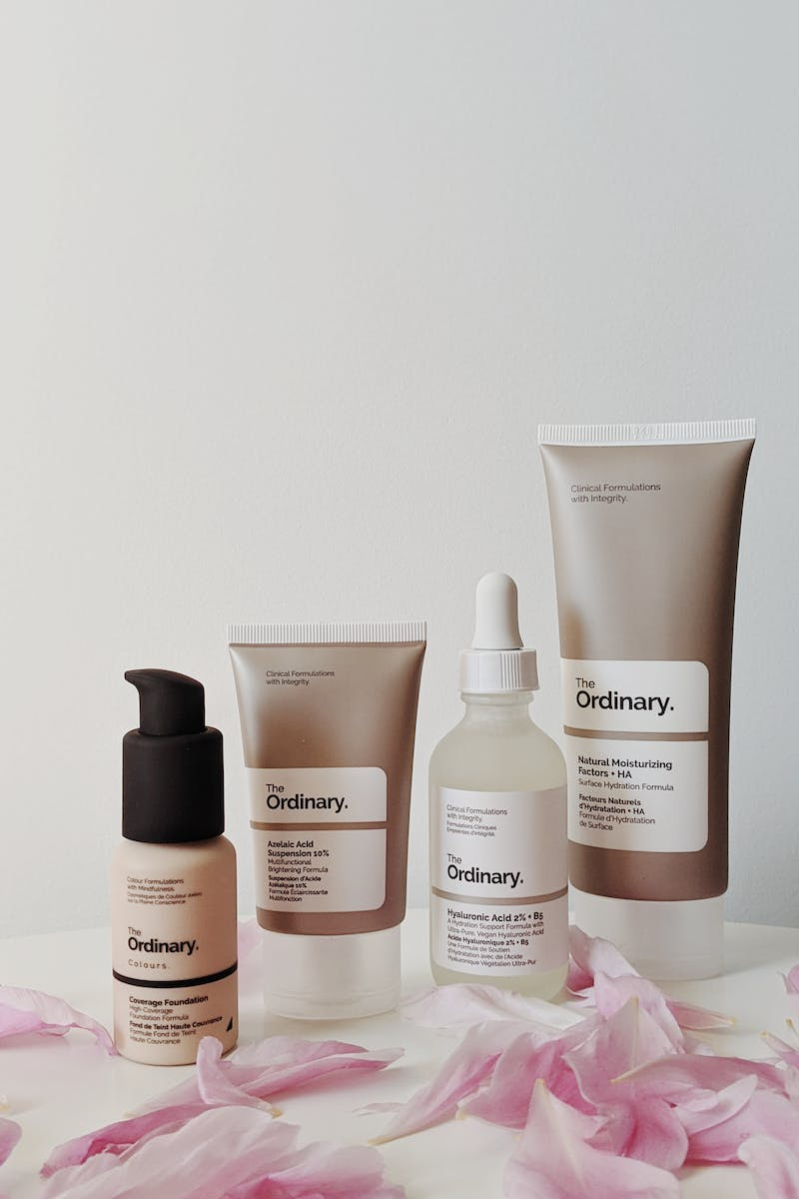
Examples of Present Containers in Everyday Language
• We use present containers in everyday language without realizing it
• Examples: It's raining now, The film starts at 8 PM tonight
• They help us communicate about current situations and scheduled events
• Understanding present containers enhances our language skills
Photo by Pexels

Slide 7
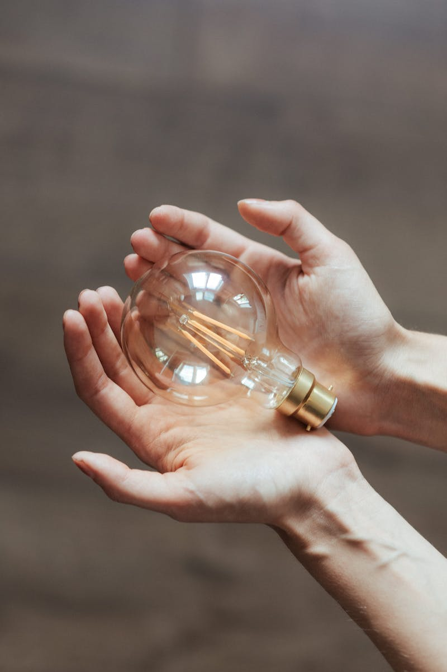
Conclusion
• Present simple and present continuous tenses are essential for accurate and meaningful communication
• Mastering the usage of present containers improves language skills
• Continue practicing and observing present containers in conversations and texts
• Thank you for watching and see you in the next video!
Photo by Pexels

