Slide 1
Exploring the Unique Houses and Architecture in Shanghai
A Journey through Modern and Traditional Designs

Slide 2
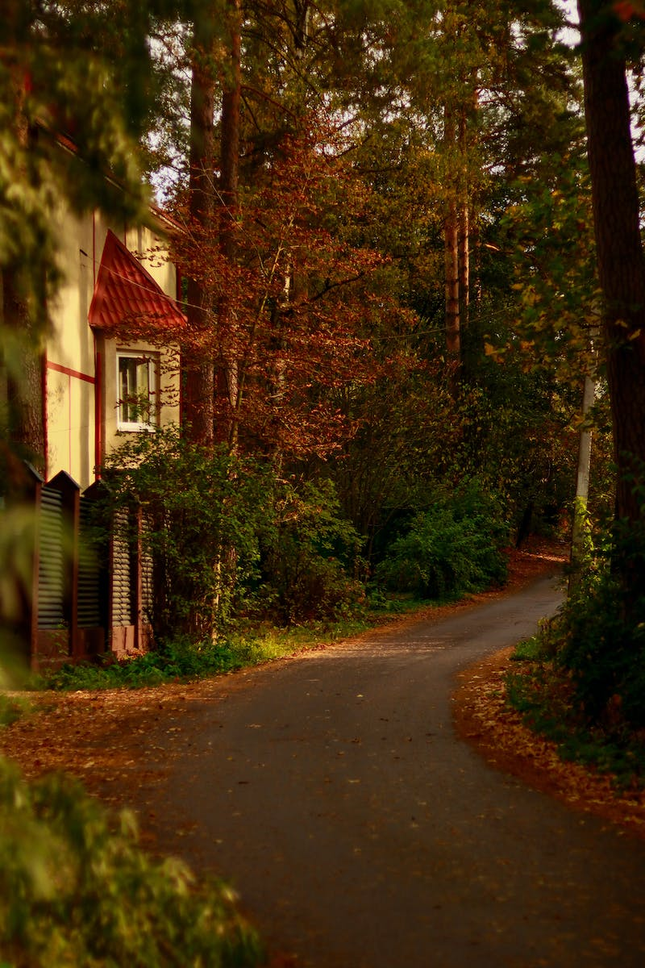
Introduction
• Shanghai is home to a variety of unique houses
• Explore the blend of modern and traditional architecture
• Discover the fascinating design elements in each house
• Uncover the stories behind these remarkable structures
Photo by Pexels

Slide 3
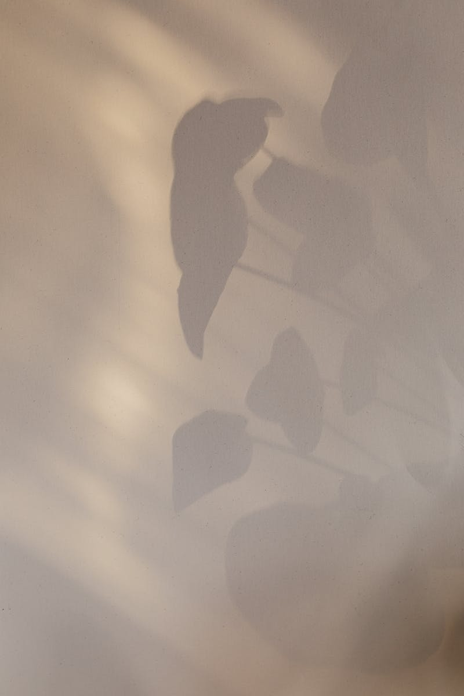
House Design in Shanghai
• Incredible variety of house designs in Shanghai
• Mix of traditional Chinese, Western, and futuristic styles
• Influence of international designers and architects
• Houses designed to cater to different lifestyles and preferences
Photo by Pexels

Slide 4
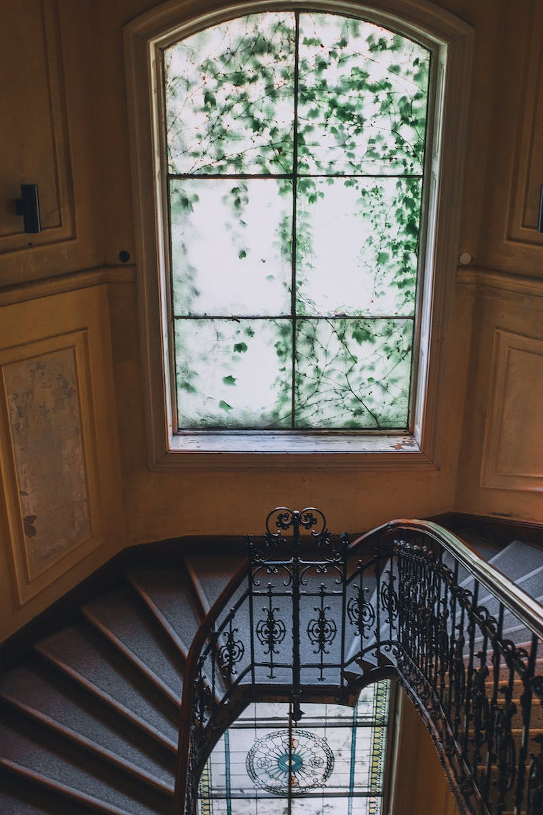
Modern Luxury Mansions
• Explore the grandeur of modern luxury mansions
• Impeccable design and finest quality materials
• State-of-the-art amenities and luxurious features
• Mansions designed for a lavish and comfortable lifestyle
Photo by Pexels

Slide 5
Preservation of Traditional Architecture
• Preservation of traditional Chinese architecture in Shanghai
• Historical houses with cultural significance
• Efforts to protect and restore traditional buildings
• Appreciation of the rich history and heritage
Photo by Pexels

Slide 6
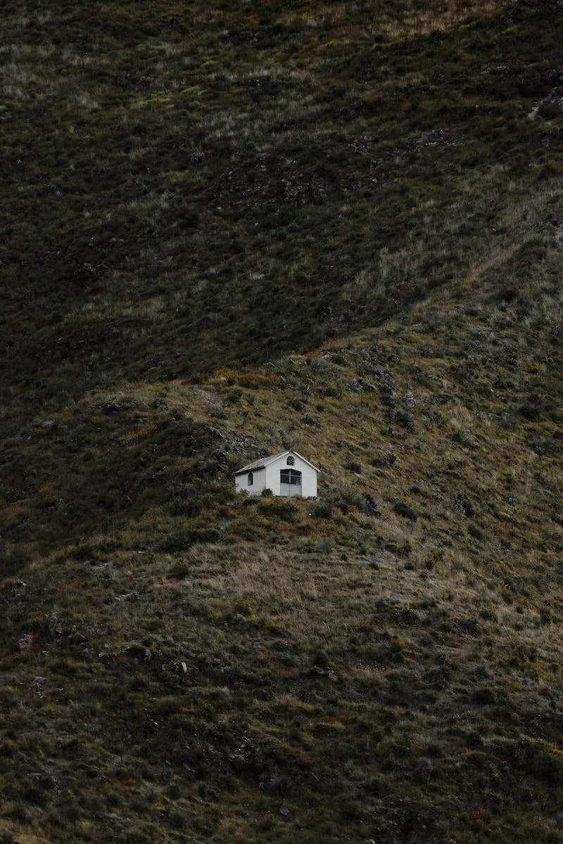
Innovative Green Houses
• Explore the concept of green houses in Shanghai
• Integration of sustainable and eco-friendly features
• Efficient use of renewable energy sources
• Promotion of environmental consciousness
Photo by Pexels

Slide 7
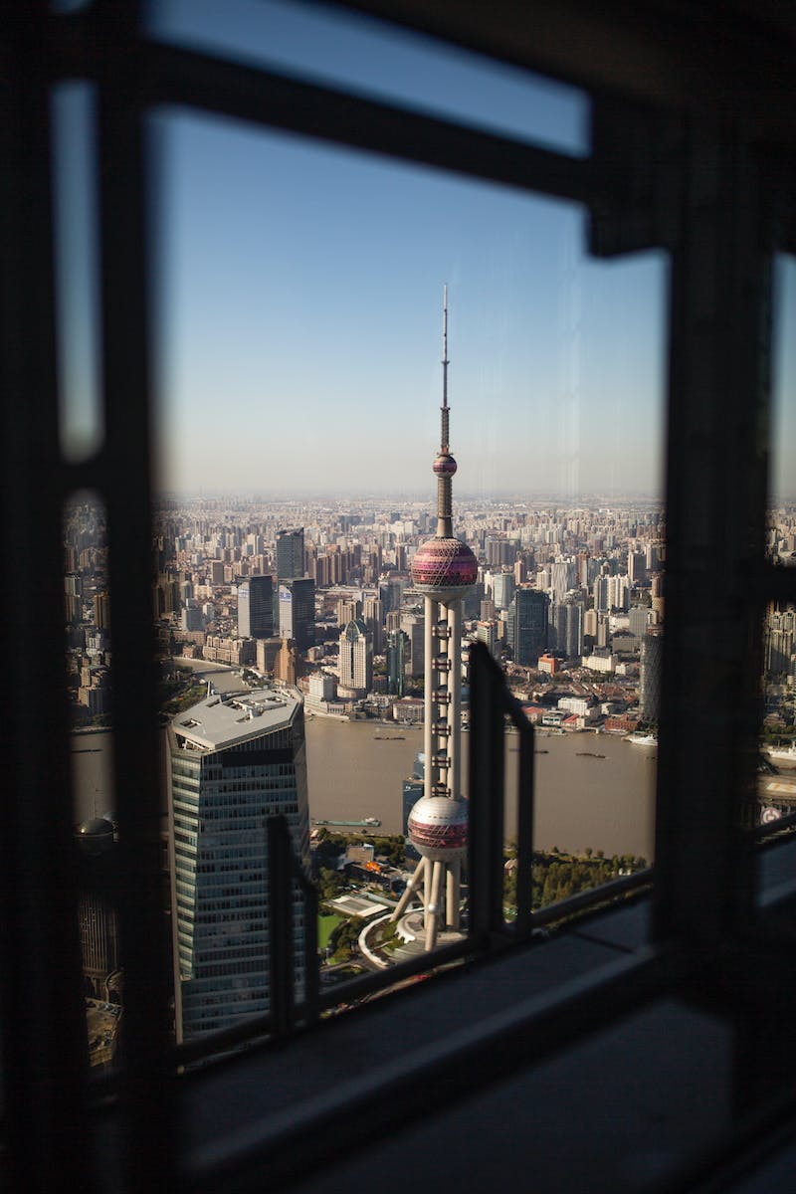
Conclusion
• Shanghai offers a diverse range of unique houses
• Blend of modern luxury, traditional architecture, and innovation
• Unique designs that cater to different preferences and values
• A city that truly exemplifies architectural excellence
Photo by Pexels

