Slide 1
The Future of Artificial Intelligence
Exploring the potential and challenges of AI in our society

Slide 2
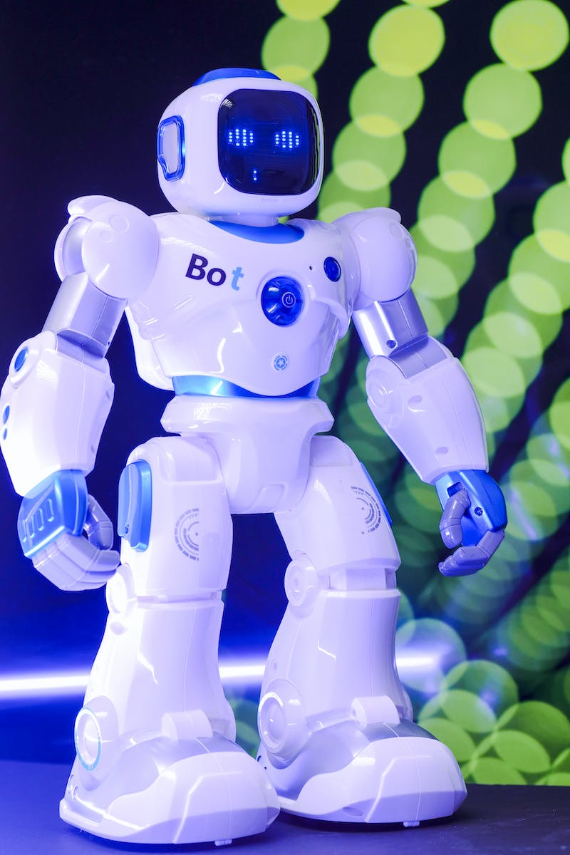
Introduction to Artificial Intelligence
• AI refers to the simulation of human intelligence in machines.
• It includes methods like machine learning, natural language processing, and computer vision.
• AI has the potential to revolutionize various industries and enhance our daily lives.
• AI can help automate tasks, improve efficiency, and make better decisions.
Photo by Pexels

Slide 3
Applications of Artificial Intelligence
• AI is already being used in various fields like healthcare, finance, and transportation.
• In healthcare, AI can assist in diagnosing diseases and developing personalized treatments.
• In finance, AI algorithms can analyze large volumes of data to make accurate predictions.
• In transportation, AI is used in self-driving cars to enhance safety and efficiency.
Photo by Pexels

Slide 4
Ethical Considerations of AI
• As AI becomes more powerful, ethical concerns arise.
• Issues like bias, privacy, and job displacement need to be addressed.
• Bias in AI algorithms can perpetuate unfairness and discrimination.
• Data privacy is crucial as AI systems collect and analyze large amounts of personal information.
Photo by Pexels

Slide 5
Future Trends in AI
• AI is expected to continue evolving in the coming years.
• Advancements in deep learning and reinforcement learning will enable more sophisticated AI systems.
• AI is likely to play a crucial role in solving complex problems and driving innovation.
• Areas like robotics, virtual assistants, and smart cities will benefit from AI advancements.
Photo by Pexels

Slide 6
Conclusion
• Artificial intelligence presents immense opportunities and challenges for our society.
• By understanding its potential and addressing ethical considerations, we can harness AI's power for the benefit of humanity.
• Continuous research, collaboration, and ethical guidelines will be crucial in shaping the future of AI.
Photo by Pexels

