Slide 1
The Influence of Soviet Cinema Propaganda
Exploring Soviet film propaganda and its impact on society

Slide 2
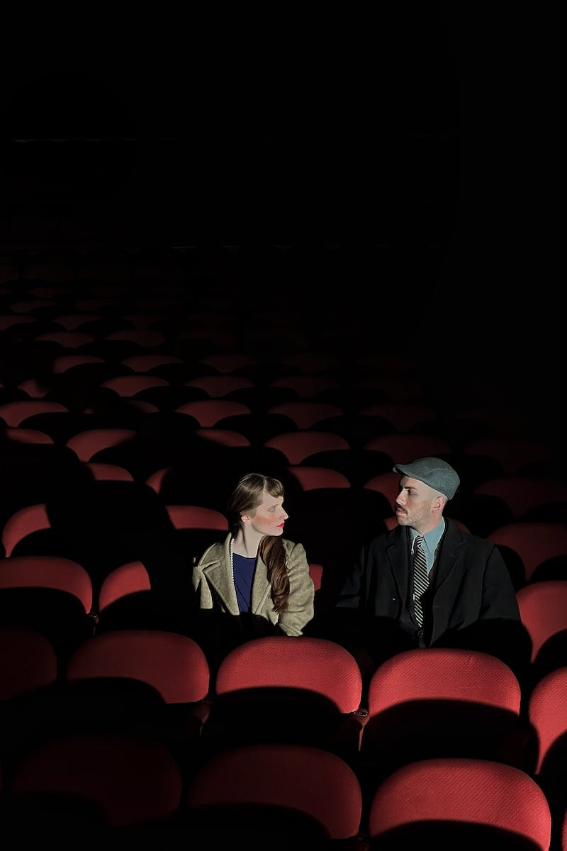
Introduction
• Soviet cinema propaganda as a tool of influence
• Contrasting reactions and impact on society
• Propaganda in various countries and eras
• Differentiating propaganda of ideas and ideologies
Photo by Pexels

Slide 3
Soviet Propaganda in War Films
• Memorable war films portraying Soviet heroes
• Exploring the scale of battles and human stories
• Examples: 'The Fate of a Man' and 'Ballad of a Soldier'
• Highlighting the soldiers' motivations and sacrifices
Photo by Pexels

Slide 4
Civil War and Red Army Films
• Portrayal of the Red Army and its impact
• Balancing the depiction of White Guards
• Examples: 'Chapayev' and 'Peter the First'
• Highlighting the courage and dedication of soldiers
Photo by Pexels

Slide 5
Historical Films and Soviet Culture
• Exploring biographical films of Russian leaders
• Examples: Suvorov, Kutuzov, Ushakov, and Nevsky
• Promoting Russian spirit and unity
• Adapting 'War and Peace' by Leo Tolstoy
Photo by Pexels

Slide 6
Satire and Critique in Soviet Comedies
• Highlighting societal issues through humor
• Examples: 'The Irony of Fate' and 'Gentlemen of Luck'
• Mocking specific lifestyles and corruption
• Addressing controversial topics like drunkenness
Photo by Pexels

Slide 7
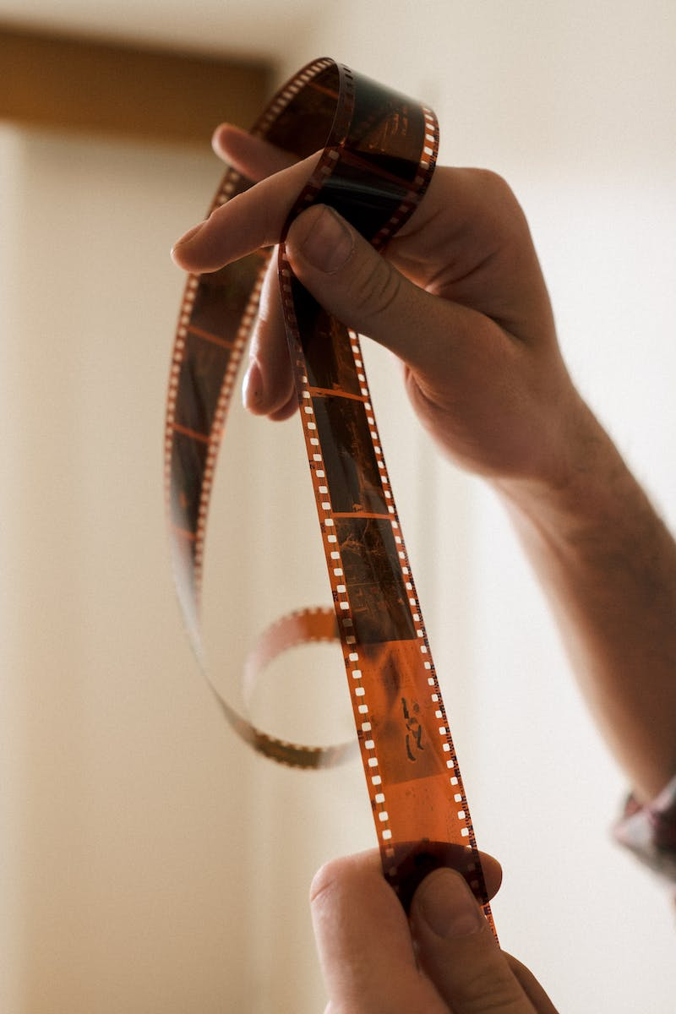
The Evolution of Soviet Cinema Propaganda
• Shift in approach during the Cold War era
• Influence of political changes like perestroika
• Examples: '7 Ultra Lies' and 'Russia We Lost'
• Questioning the narrative and historical accuracy
Photo by Pexels

Slide 8
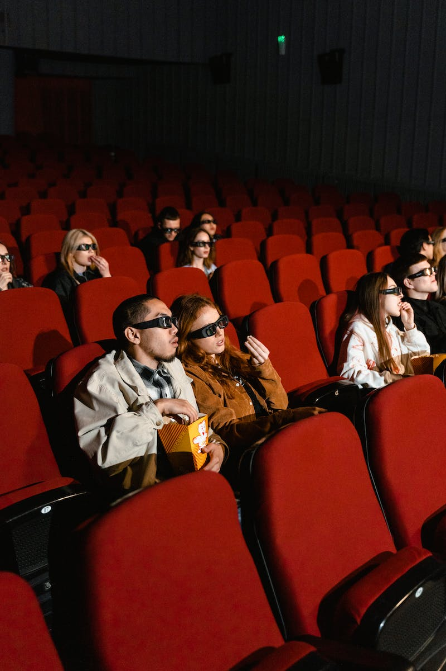
Impact and Analysis
• Cinema as an effective propaganda tool
• Creating visual representations of history
• Shaping societal attitudes and understanding
• The role of historical films in shaping identity
Photo by Pexels

Slide 9
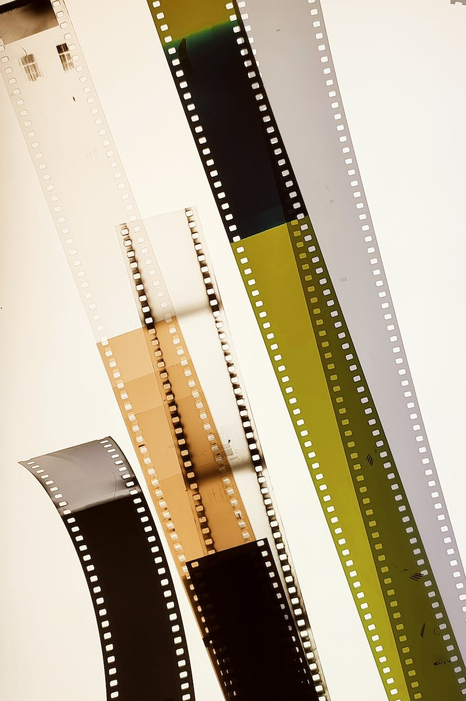
Conclusion
• Mixed reactions and themes in Soviet cinema propaganda
• Analysis of present-day Russian cinema
• Highlighting the importance of balanced propaganda
• Acknowledging the influence of Soviet cinema
Photo by Pexels

