Slide 1
The Story of Antiguanyin Tea
Uncovering the Origins and Benefits

Slide 2
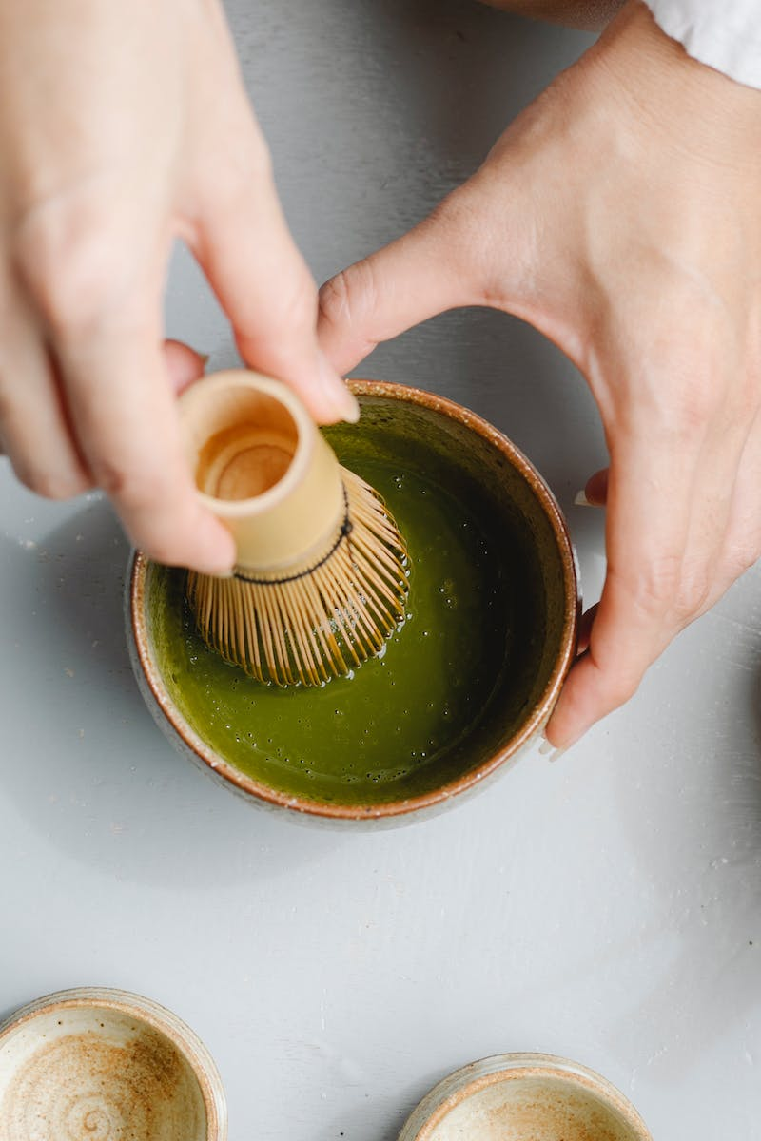
Introduction
• Antiguanyin: A popular Chinese tea
• Known for its calming and meditative effects
• Contains pleasant floral and fruity notes
• Rich in polyphenols, low in caffeine
Photo by Pexels

Slide 3
The Origins
• Grown in the Fujian province of China
• Made from young tea leaves
• Named after the iron statue of Guanyin
• Associated with tranquility and serenity
Photo by Pexels

Slide 4
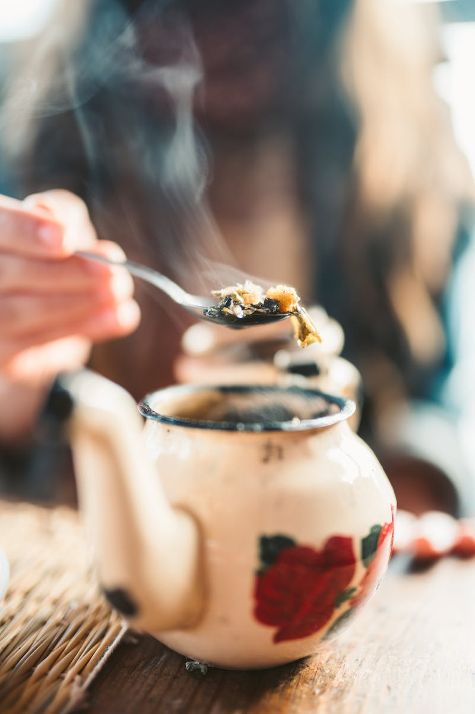
Flavor and Effects
• Delivers a smooth and pleasant taste
• Induces a meditative state
• Differentiates from other types of tea
• Provides a gentle and calming effect
Photo by Pexels

Slide 5
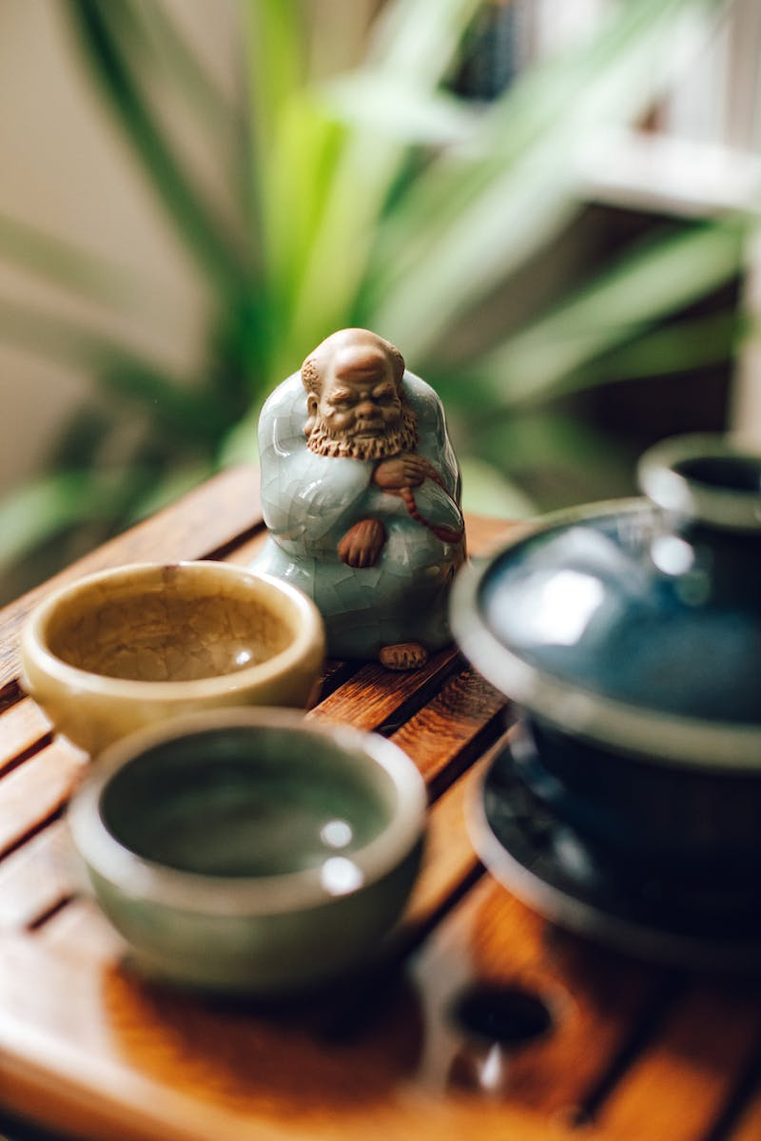
Brewing Antiguanyin Tea
• Use a gaiwan or porcelain teaware
• Recommended temperature: 90-95°C
• Perform initial rinsing of the tea leaves
• Follow quick infusions for optimal flavor
Photo by Pexels

Slide 6
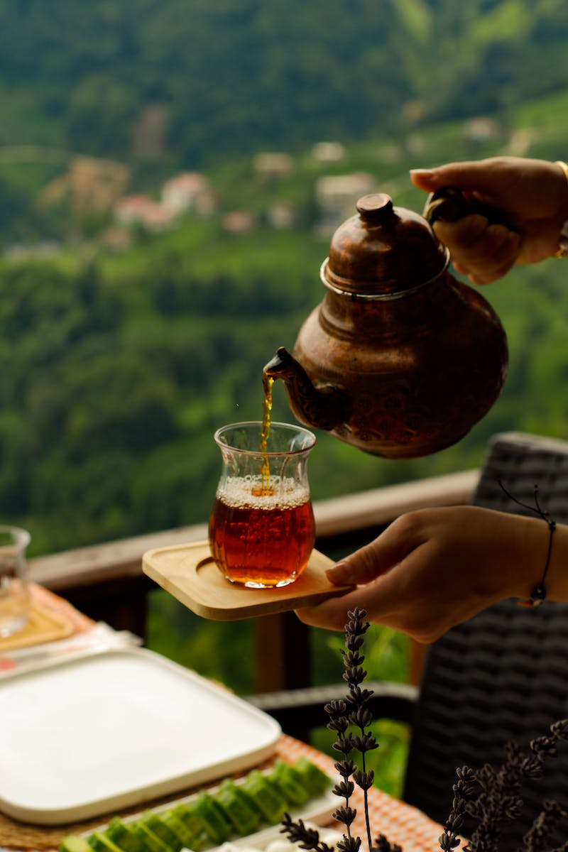
Varieties of Antiguanyin
• Five different varieties based on processing
• Polaris: Fresh aroma, strong flavor
• Guxiang: Fruity aroma
• Huasen: Floral aroma
• Cherenkami: Grape-like notes
Photo by Pexels

Slide 7
Conclusion
• Antiguanyin tea: A drink of quality and reflection
• Reflects the quality of the person brewing it
• Choose the right variety to suit personal taste
• Enjoy a calming and flavorful experience
Photo by Pexels

