Slide 1
Stalin: Debunking Myths and Revealing Truths
Separating fact from fiction in the life and legacy of Joseph Stalin

Slide 2
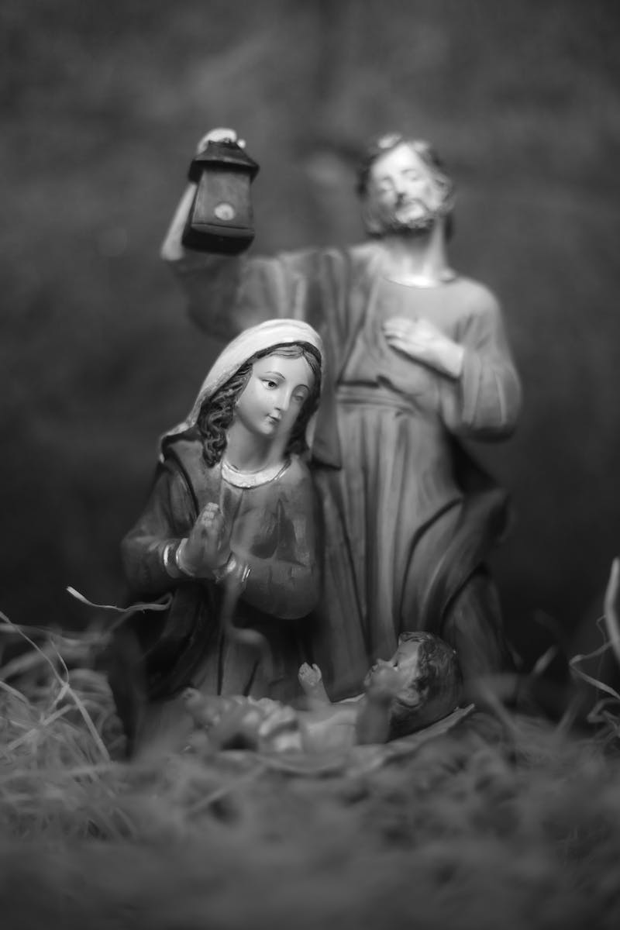
Myth 1: Wrong Birthday
• Stalin was born on December 21, 1879, in Gori, Russian Empire (now Georgia)
• Official celebrations held on December 21, but his actual birthdate is December 6
• Discrepancy remains unexplained
• Only coincidences between official and real date: 19th century, December
Photo by Pexels

Slide 3
Myth 2: The Wrong Father
• Stalin's father, Vissarion Dzhugashvili, was a working-class shoemaker
• Various legends emerged about his true parentage but were refuted
• External resemblance pointed to Vissarion as the true father
• Speculations included famous traveler Przhevalsky, but no evidence

Slide 4
Myth 3: He was Uneducated
• Stalin had no formal education, but was a voracious reader
• Expelled from seminary for promoting Marxism
• Educated himself extensively through reading
• Owned a personal library of 25,000 volumes across various subjects
Photo by Pexels

Slide 5
Myth 4: Stalin's Criminal Past
• Allegations of Stalin being a bank robber and bandit are unfounded
• Participated in revolutionary activities, organizing demonstrations and strikes
• Involved in expropriations, including the Tiflis robbery in 1907
• Focused primarily on revolutionary propagandist role
Photo by Pexels

Slide 6
Myth 5: Stalin as an Agent of the Secret Police
• Accusations of Stalin cooperating with the tsarist secret police were common during intra-party struggles
• Historians have refuted these claims as fabrication
• Stalin himself was repeatedly arrested, imprisoned, and sent into exile
• Collaboration with secret police debunked by historical evidence
Photo by Pexels

Slide 7
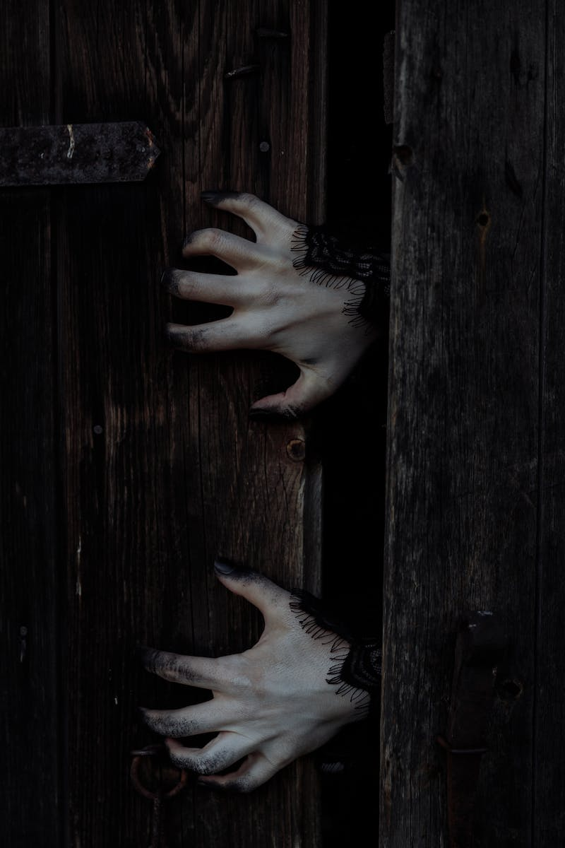
Myth 6: Stalin's Role in the October Revolution
• Stalin played an active role in the October Revolution of 1917
• Member of the Military Revolutionary Committee and Central Committee
• Participated in determining the structure of the new Soviet government
• One of the main leaders of the Bolshevik coup
Photo by Pexels

Slide 8
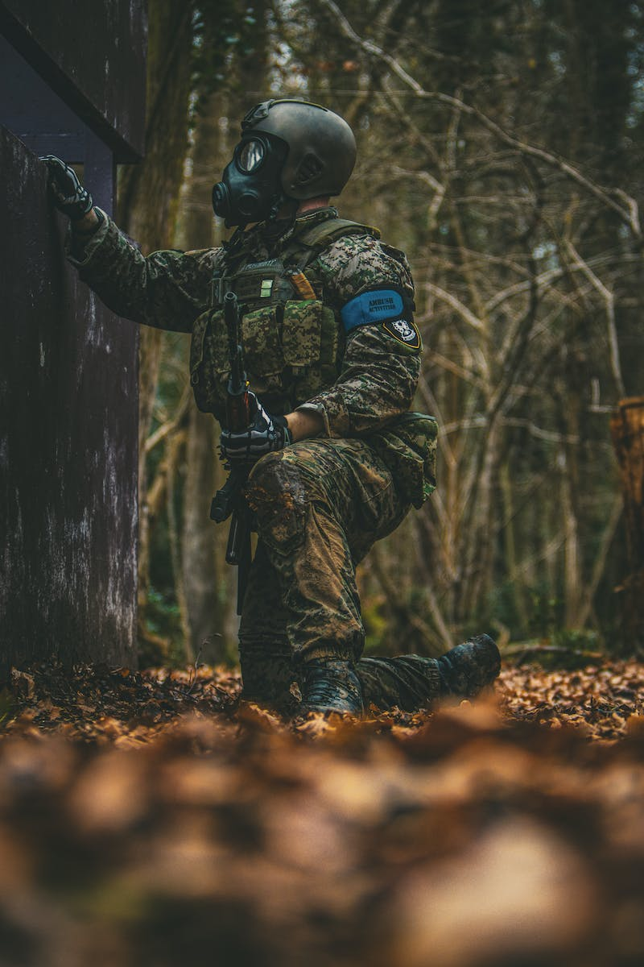
Myth 7: Stalin's Lack of Military Knowledge
• Stalin gained military leadership experience during the civil war
• Led large masses of troops and defended key cities and fronts
• Took part in military operations against Denikin, Wrangel, and Polish forces
• Accusations of hating military experts contradicted by his military achievements
Photo by Pexels

Slide 9
Myth 8: Lenin's Lack of Trust in Stalin
• Lenin entrusted Stalin with the position of General Secretary
• Stalin was seen as a member of the Leninist guard
• Lenin expressed concerns about Stalin's rudeness as General Secretary
• Stalin identified himself as a follower of Lenin
Photo by Pexels

Slide 10
Myth 9: Stalin vs. Trotsky: Personal Enmity or Strategic Differences
• Stalin's clash with Trotsky was based on strategic differences rather than personal enmity
• Trotsky criticized Stalin for poor defense of Tsaritsyn and considered him a mediocrity
• Trotsky's theories focused on worldwide revolution, while Stalin emphasized building socialism in one country
• Divergent strategies for the party and the country
Photo by Pexels

Slide 11
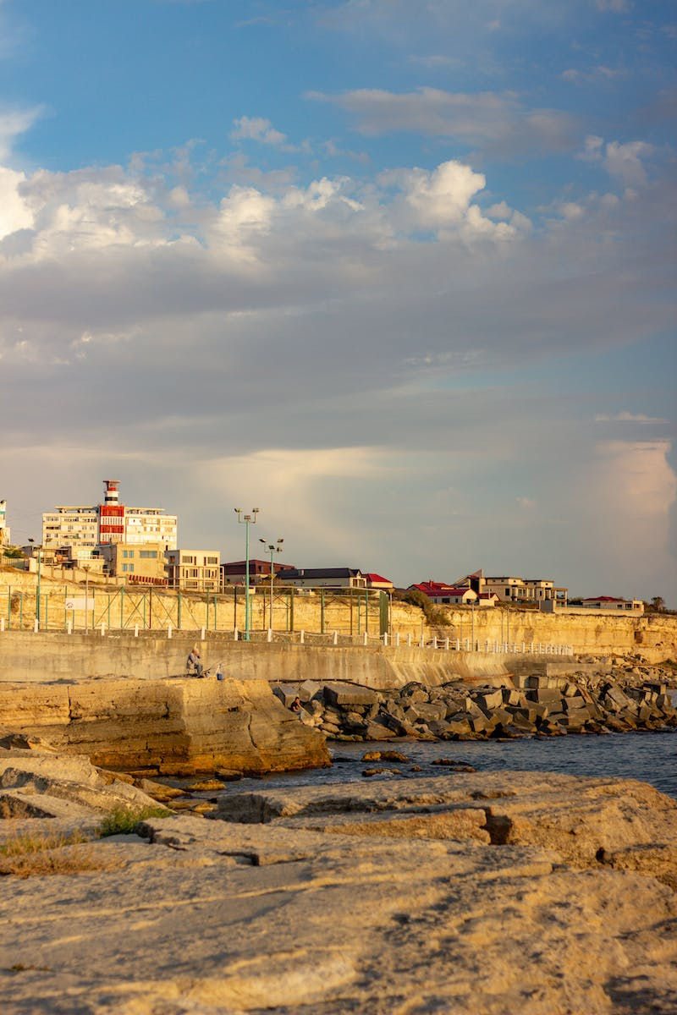
Myth 10: Stalin's Modernization as a Crime
• Stalin's industrialization and collectivization were necessary for the survival of the USSR
• Industrialization allowed the USSR to withstand external threats
• Famine caused by multiple factors, not solely collectivization
• Soviet Union's industrial output ranked second globally by 1941
Photo by Pexels

Slide 12
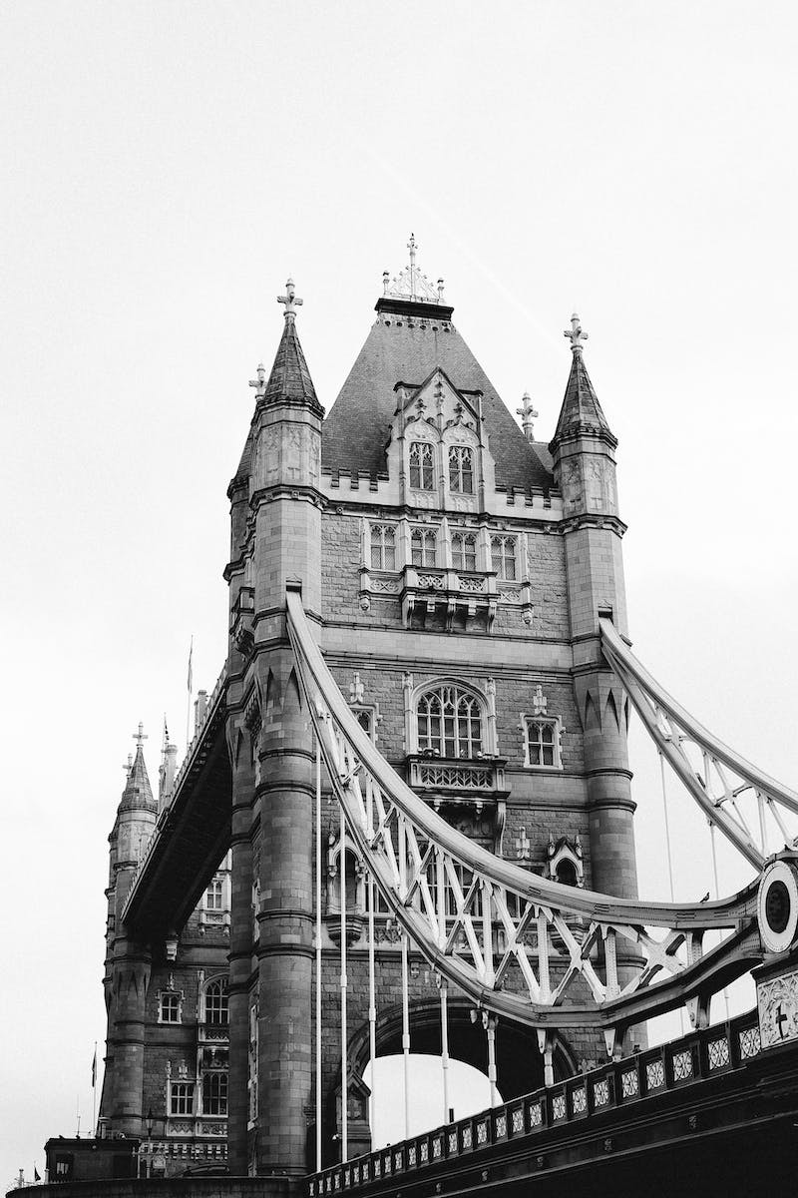
Myth 11: Stalin Alone Responsible for the Great Terror
• Stalin's role in the Great Terror should not be solely blamed
• Resolution of the Politburo initiated the mechanism of the Great Terror
• Widespread denunciations came from lower-level leaders
• Repressions a result of unfinished civil war and echoes of the NEP
Photo by Pexels

Slide 13
Myth 12: Stalin Destroyed the Leninist Guard
• Stalin's inner circle consisted of trusted Leninist colleagues
• Many members had extensive party experience dating back to the early days
• Stalin maintained and relied on the Leninist guard
• Narrative of destroying the Leninist guard lacks evidence
Photo by Pexels

Slide 14
Myth 13: Stalin and the Second World War
• Stalin cannot be equated with Hitler as a cause of the Second World War
• Munich Agreement of 1938 empowered Hitler, setting the stage for war
• USSR's agreement with Germany allowed territorial gains and enhanced defense
• Nazi Germany and appeasing powers bear primary responsibility for the war
Photo by Pexels

Slide 15
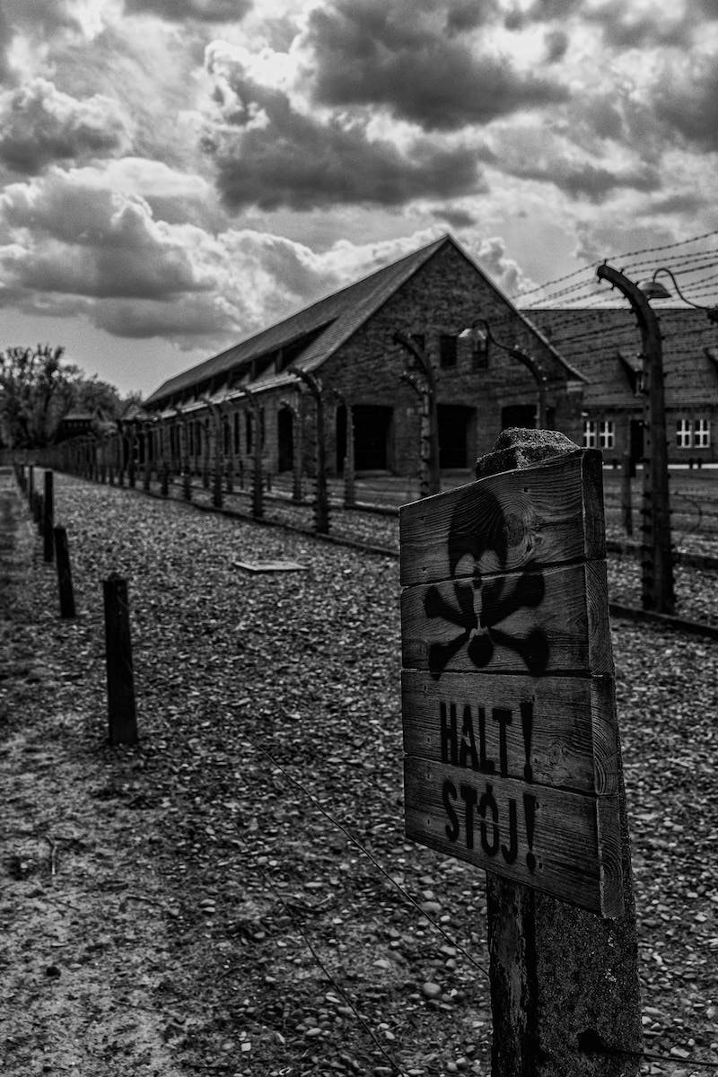
Myth 14: Stalin's Personal Struggles at the Beginning of the War
• Claims of Stalin falling into prostration at the start of the war lack evidence
• Stalin actively engaged in addressing the war through meetings and appeals
• Demonstrated strong leadership and instilled confidence in the population
• Contrary to claims, Stalin maintained control and command
Photo by Pexels

Slide 16
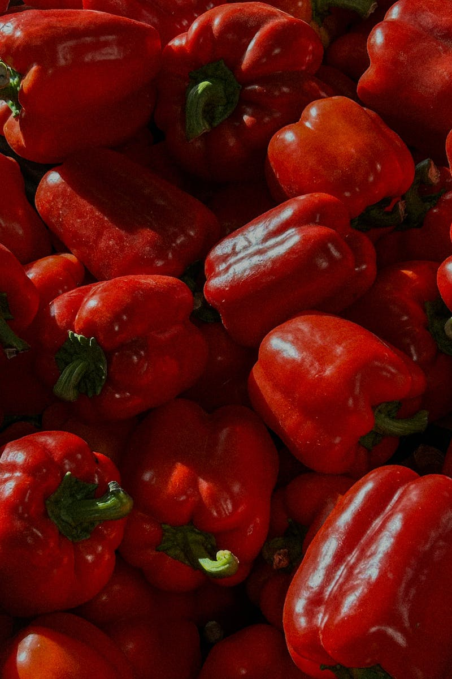
Myth 15: Blaming Marshals and Generals for Early Defeats
• Blaming marshals and generals for early defeats shifts responsibility away from Stalin
• Stalin shared the responsibility for failure at the start of the war
• His political system contributed to the failure
• Victory, as well as failures, attributable to Stalin's decisions
Photo by Pexels

Slide 17
Myth 16: Stalin's Use of a Globe to Plan Operations
• Claims of Stalin using a globe to plan operations lack credibility
• Attributed to Khrushchev's unsubstantiated statement
• Actual planning based on detailed maps and reports
• Manipulation of narrative to portray Stalin as militaryly incompetent
Photo by Pexels

Slide 18
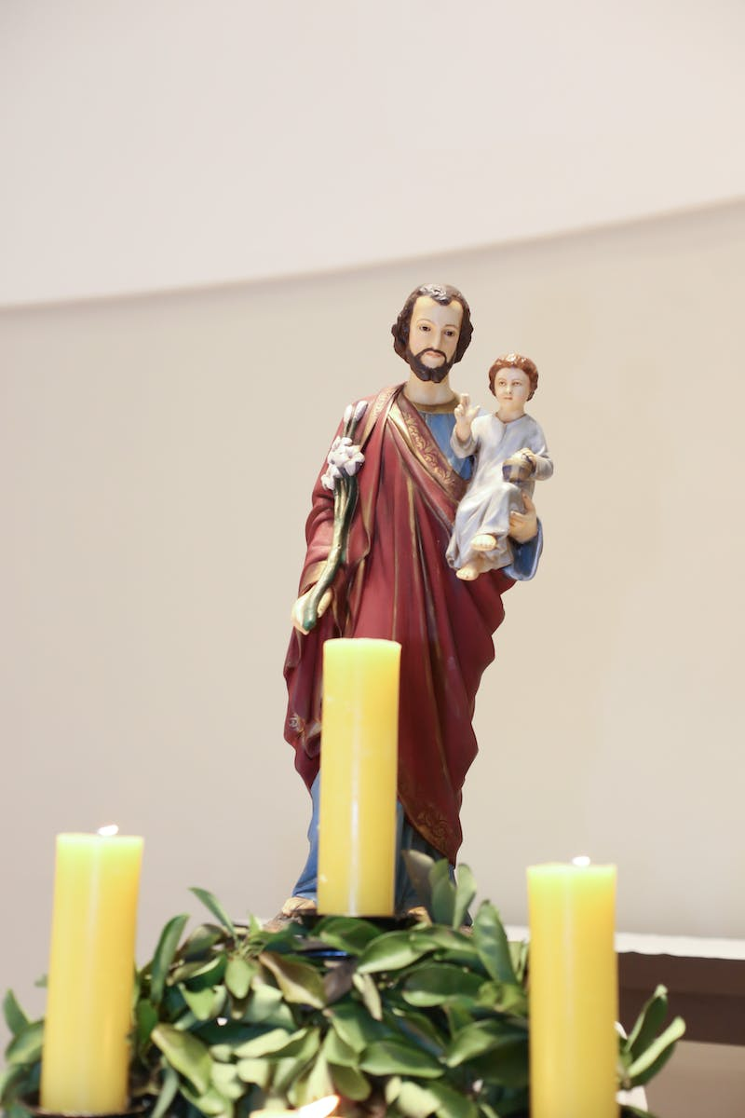
Myth 17: Stalin's Multiple Resignations
• Stalin submitted multiple resignation petitions throughout his leadership
• Exact number of petitions varies, but the intent was to gain power and test loyalty
• Each resignation met with rejection and increased power for Stalin
• Tactics to maintain control and raise the stakes
Photo by Pexels

Slide 19
Myth 18: Poisoning of Stalin
• Claims of Stalin being poisoned lack evidence
• Stalin's health was compromised by stress and exertion
• Suffered from strokes and deteriorating health
• Official cause of death attributed to stroke
Photo by Pexels

Slide 20
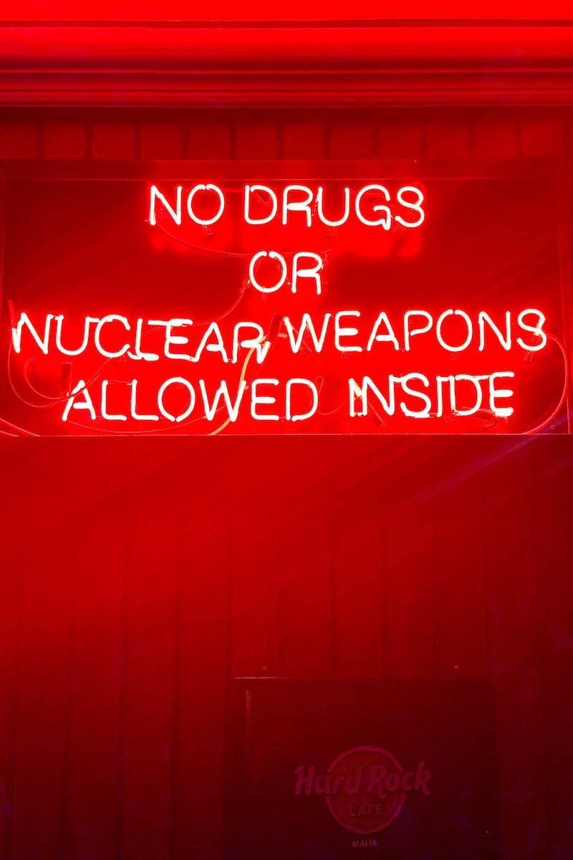
Myth 19: The Plow and the Bomb
• Stalin's policies grew the USSR, transitioning from agriculture to nuclear power
• Term attributed to Isaac Deutscher but often misattributed to Churchill
• Emphasizes the transformation of the USSR under Stalin's leadership
• Significant achievements in both industrial and nuclear sectors
Photo by Pexels

Slide 21
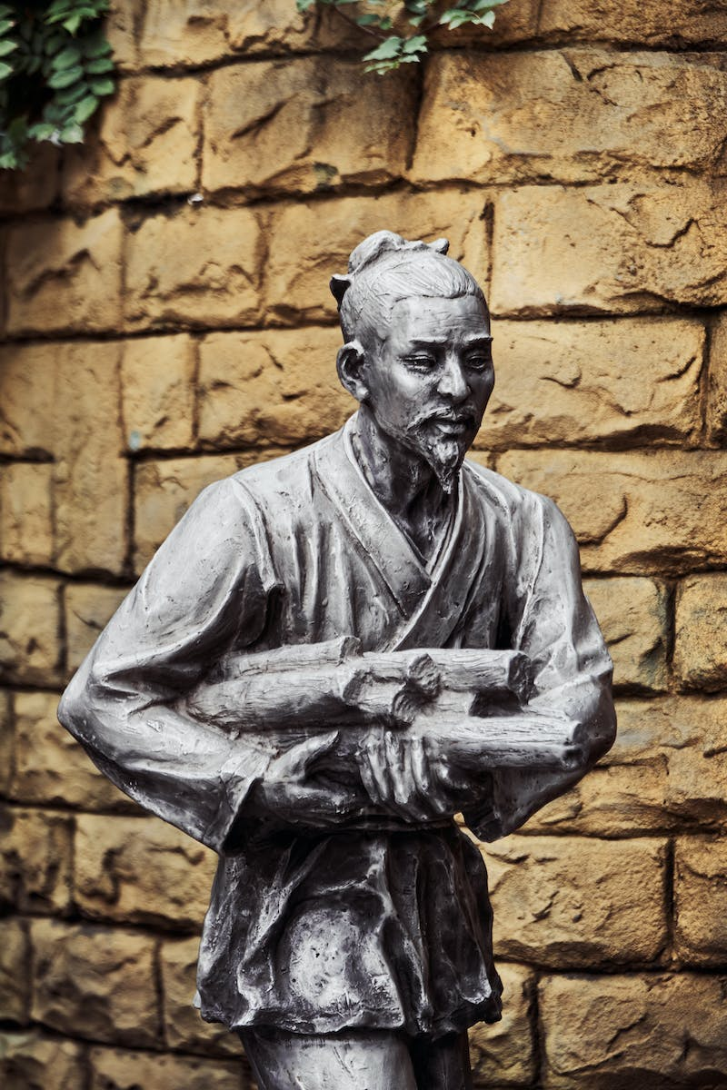
Myth 20: Stalin's Legacy
• Stalin left a complex and controversial legacy
• Critics condemn mass repression and poverty under his rule
• Recognize his role in Soviet industrialization and wartime victories
• Acknowledgement of historical context and consequences
Photo by Pexels

