Slide 1
Brain and Body Exercise
Improving Cognitive and Physical Health

Slide 2
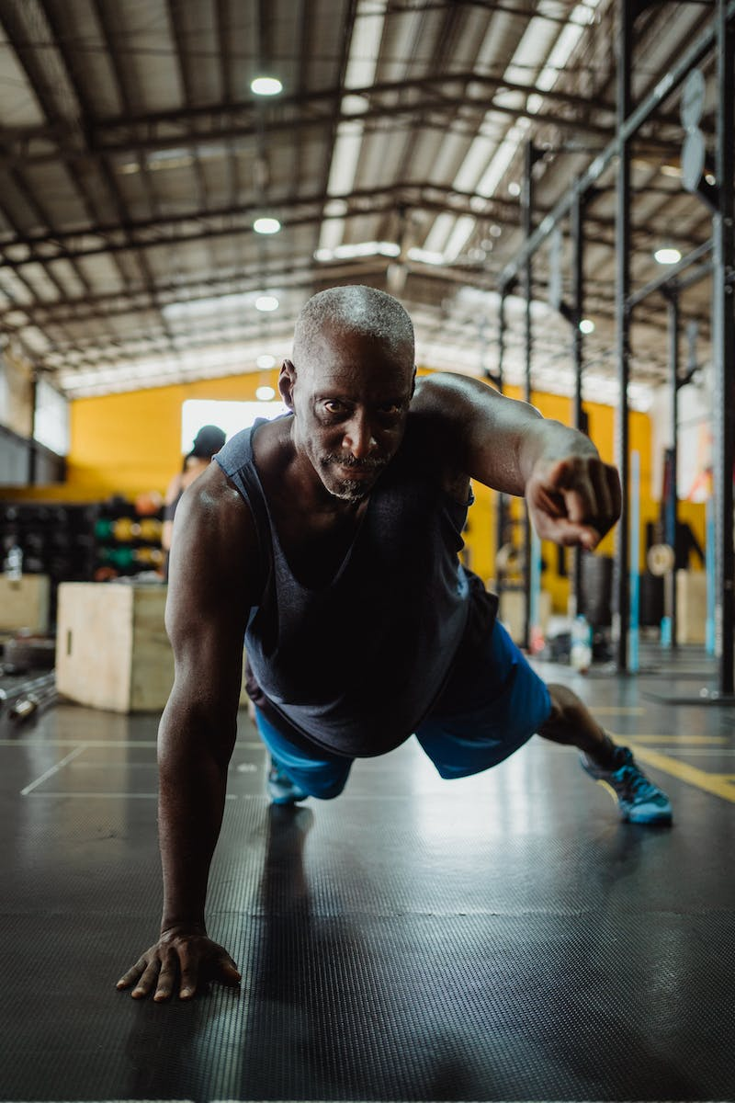
Introduction
• Give me five on the right.
• Give me five on the left.
• Chris cross and stretch.
• Do your very best.
• Use your brain and body.
Photo by Pexels

Slide 3
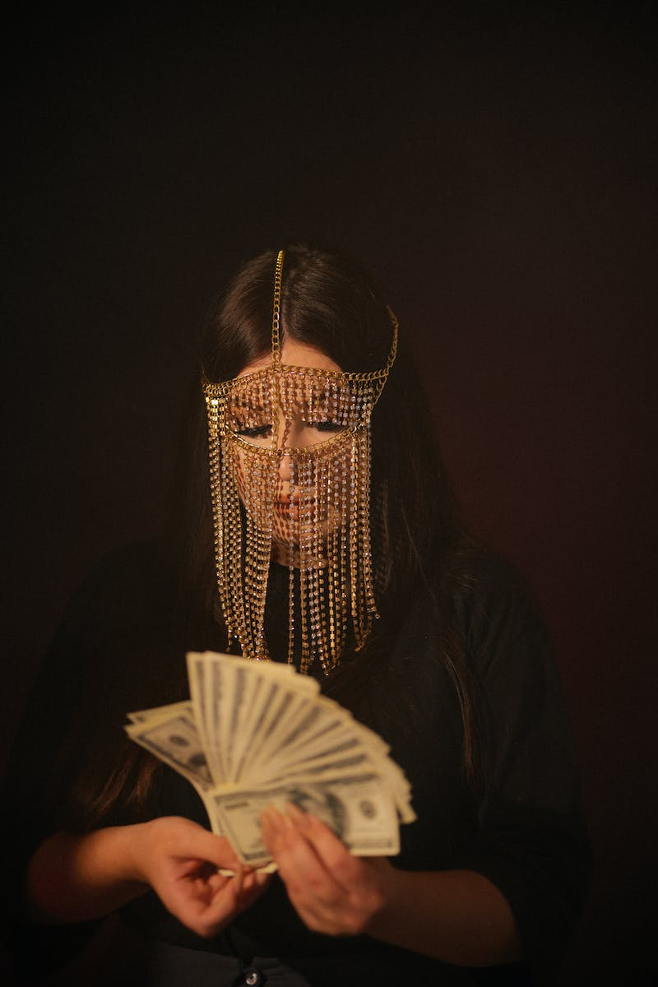
Counting and Scissors
• Count to one hundred twenty, five at a time.
• Chris cross your arms and do scissors.
• Five, ten, fifteen, twenty, twenty five, thirty, thirty five, forty, forty five, fifty, fifty five, sixty, sixty five, seventy, seventy five, eighty, eighty five, ninety, ninety five, one hundred.
• Two leg swaps from one hundred, one hundred five, one hundred ten, one hundred fifteen, one hundred twenty.
Photo by Pexels

Slide 4
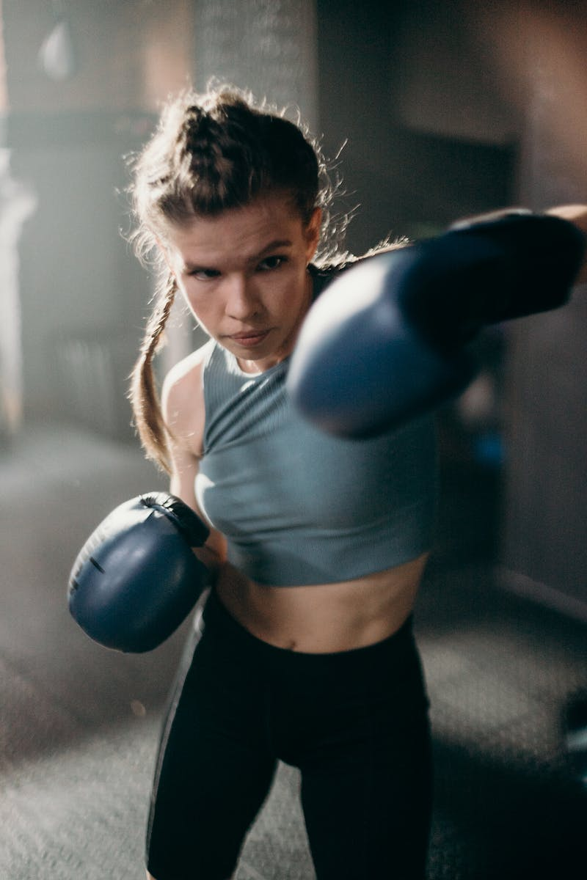
Leg Cross and Arm Curls
• Give me five on the right.
• Give me five on the left.
• Press call and stretch.
• Do your very best.
• Use your brain and body.
Photo by Pexels

Slide 5
Counting and Arm Swaps
• Count to one hundred twenty, five at a time.
• Chris cross your legs left and right.
• Five, ten, fifteen, twenty, twenty five, thirty, thirty five, forty, forty five, fifty, fifty five, sixty, sixty five, seventy, seventy five, eighty, eighty five, ninety, ninety five, one hundred.
• Two arm curls from one hundred, one hundred five, one hundred ten, one hundred fifteen, one hundred twenty.
Photo by Pexels

Slide 6
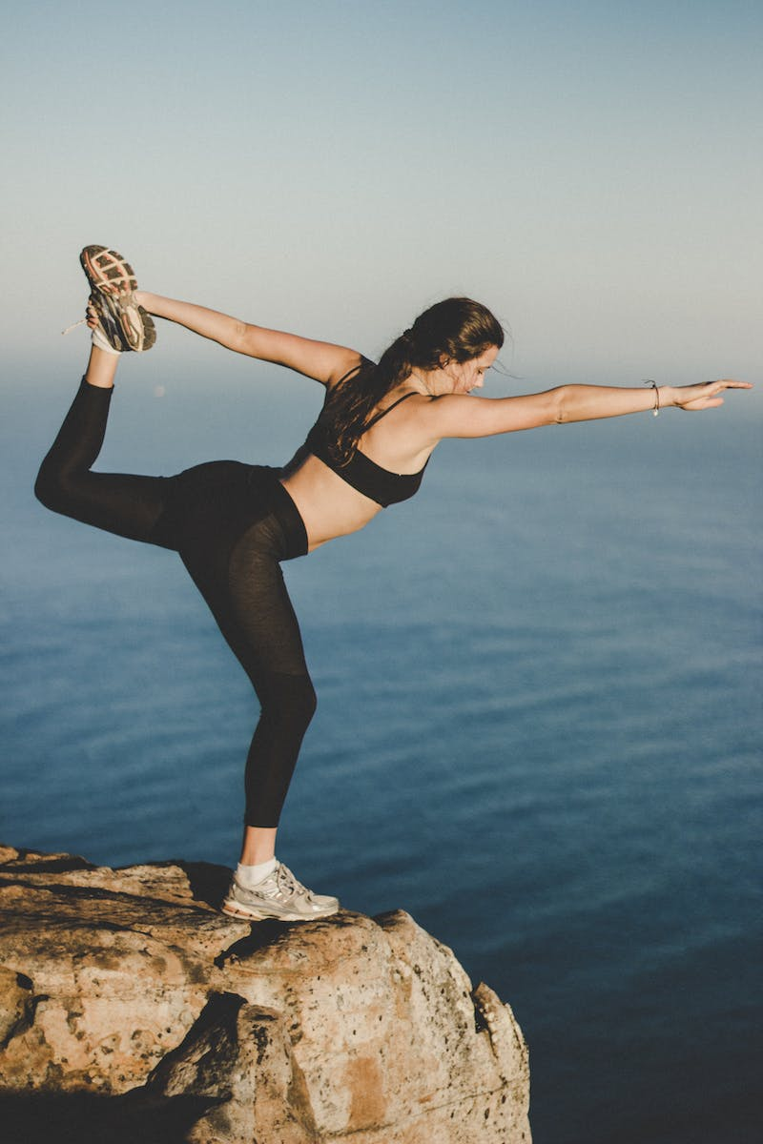
Conclusion
• Give me five on the right.
• Give me five on the left.
• Chris cross and stretch.
• Do your very best.
• Use your brain and body.
• Exercise regularly.
• Count to one hundred twenty.
Photo by Pexels

