Slide 1
The Power of Artificial Intelligence
Unleashing the Potential

Slide 2
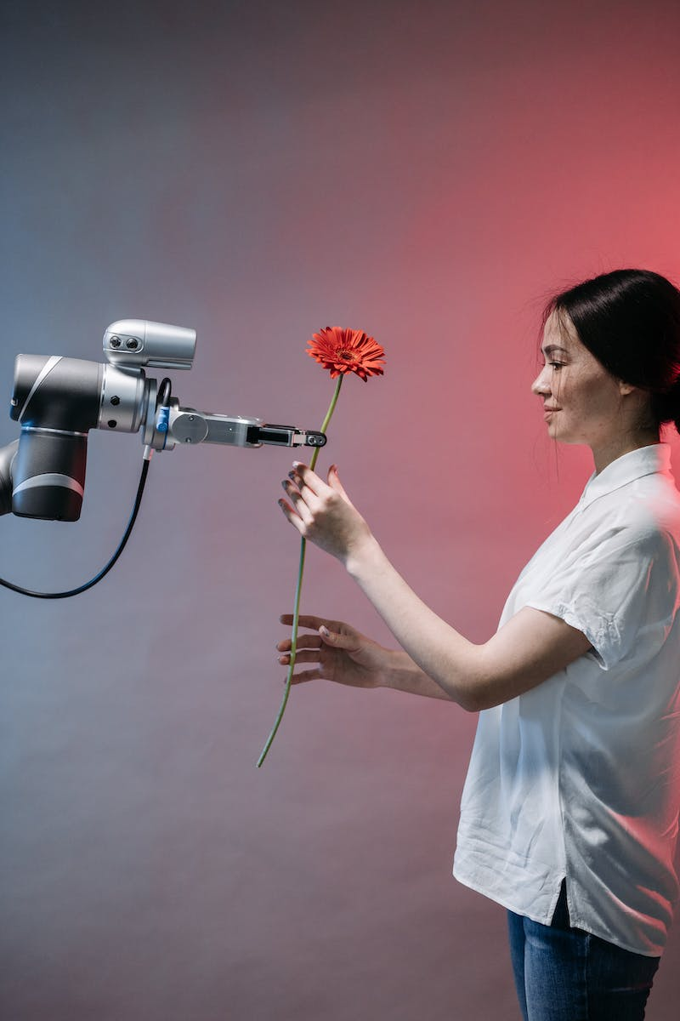
Introduction to Artificial Intelligence
• AI is a branch of computer science that focuses on creating intelligent machines.
• It involves the development of algorithms and models to simulate human cognitive abilities.
• AI can be categorized into narrow AI and general AI.
• Narrow AI is designed for specific tasks, while general AI aims to replicate human intelligence.
• AI has the potential to revolutionize various industries.
Photo by Pexels

Slide 3
Machine Learning: The Core of AI
• Machine learning is a subset of AI that focuses on enabling computers to learn and improve from experience.
• It involves the development of algorithms and statistical models to analyze and interpret data.
• Supervised learning, unsupervised learning, and reinforcement learning are the three main types of machine learning.
• Machine learning algorithms are used in various applications, such as image recognition, natural language processing, and predictive analytics.
Photo by Pexels

Slide 4
Deep Learning: Unlocking AI's Full Potential
• Deep learning is a subset of machine learning that focuses on training artificial neural networks.
• Neural networks are inspired by the structure of the human brain and consist of interconnected layers of artificial neurons.
• Deep learning enables complex pattern recognition and can be used for tasks such as image and speech recognition.
• It has achieved remarkable success in various domains, including healthcare, finance, and autonomous vehicles.
Photo by Pexels

Slide 5
Ethics and Challenges in AI
• As AI progresses, ethical considerations become increasingly important.
• Concerns regarding privacy, bias, and job displacement arise with the widespread adoption of AI.
• Ensuring AI systems are fair, transparent, and accountable is crucial.
• Collaboration between policymakers, researchers, and industry experts is necessary to address these challenges.
Photo by Pexels

Slide 6
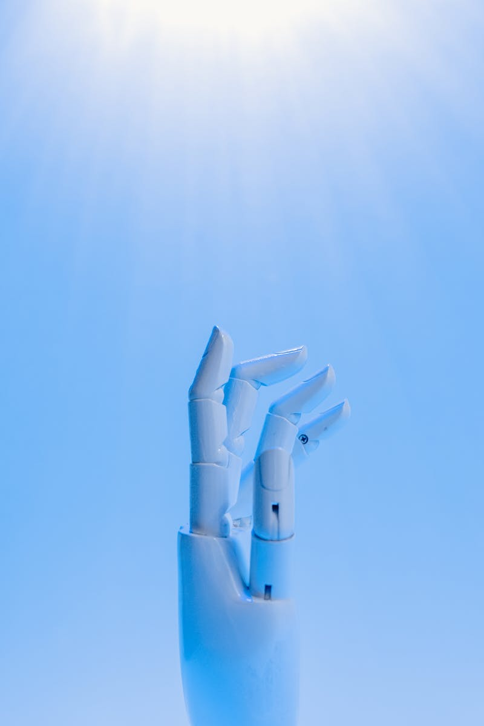
Future of AI: Opportunities and Challenges
• The future of AI holds immense potential and opportunities for innovation.
• AI can revolutionize industries, improve healthcare outcomes, and solve complex problems.
• However, challenges such as data privacy, security, and human-AI collaboration need to be addressed.
• The responsible development and deployment of AI will shape its future trajectory.
Photo by Pexels

