Slide 1
The Rise and Fall of Eduard Streltsov
From Football Legend to Prisoner

Slide 2
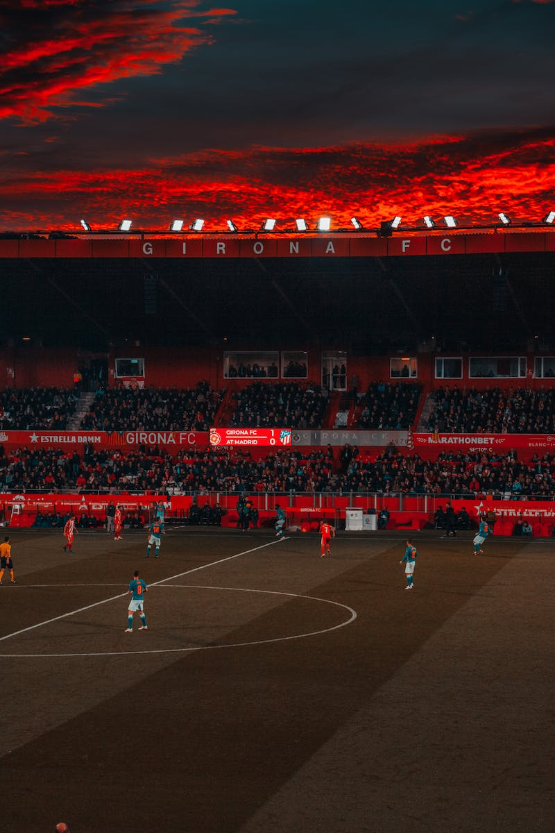
Introduction
• Eduard Streltsov was one of the greatest footballers in the history of the Soviet Union.
• His skill and technique made him a standout player, earning comparisons to the best in the world.
• However, his career took a tragic turn when he was arrested for a crime he didn't commit.
• In this presentation, we will explore the life and career of Eduard Streltsov.
Photo by Pexels

Slide 3
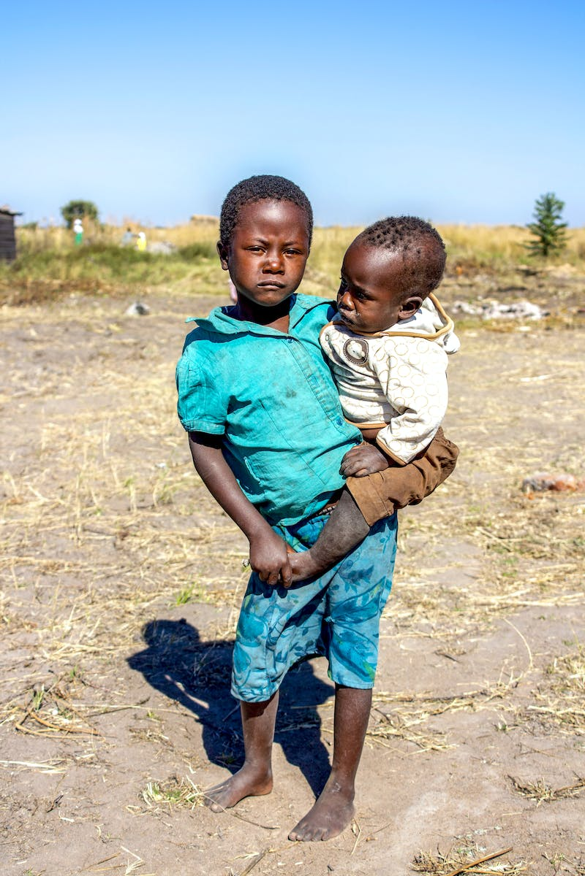
Early Life and Poverty
• Eduard Streltsov was born on July 21, 1937, in Moscow, Soviet Union.
• He grew up in a simple working-class family, with his father working as a carpenter and his mother in a daycare.
• The early years of Streltsov's life were marked by poverty and the hardships of World War II.
• Despite the challenges, Streltsov developed a passion for football and began playing for his factory team at the age of 13.
Photo by Pexels

Slide 4
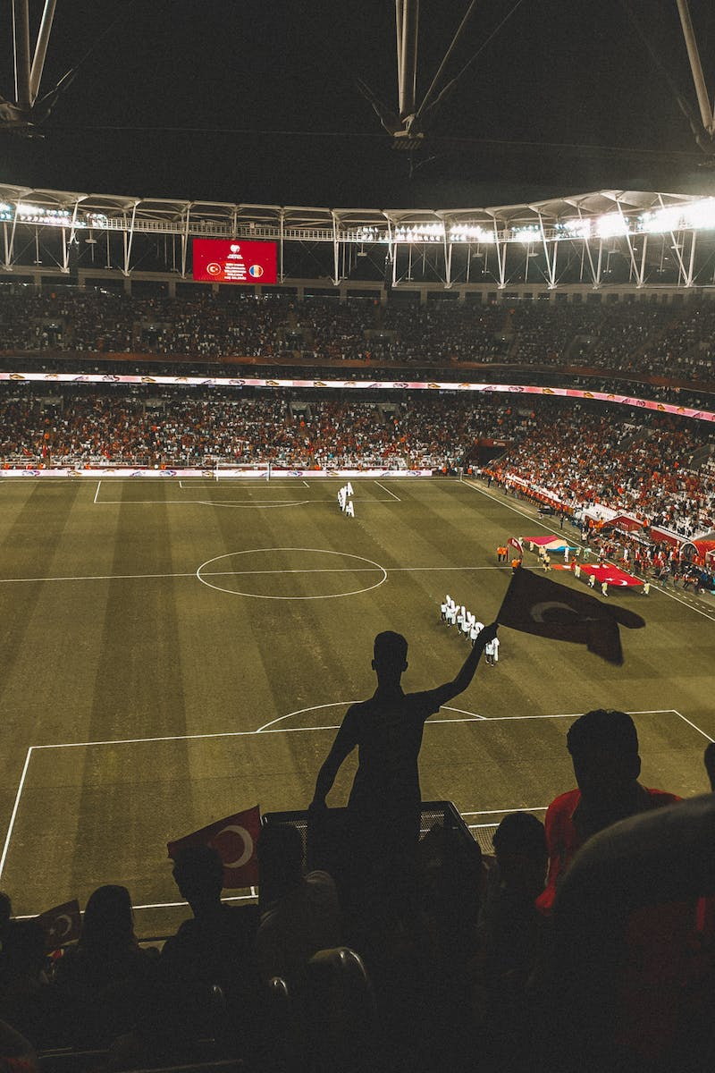
Rise to Prominence
• At the age of 16, Streltsov caught the attention of the Torpedo Moscow coach and joined the club's youth team.
• He quickly impressed and was promoted to the senior team, becoming one of the youngest players in the squad.
• Streltsov's talent and goalscoring ability helped Torpedo Moscow achieve success in the league.
• In 1955, he made his debut for the Soviet national team and scored a hat-trick in his first match.
Photo by Pexels

Slide 5
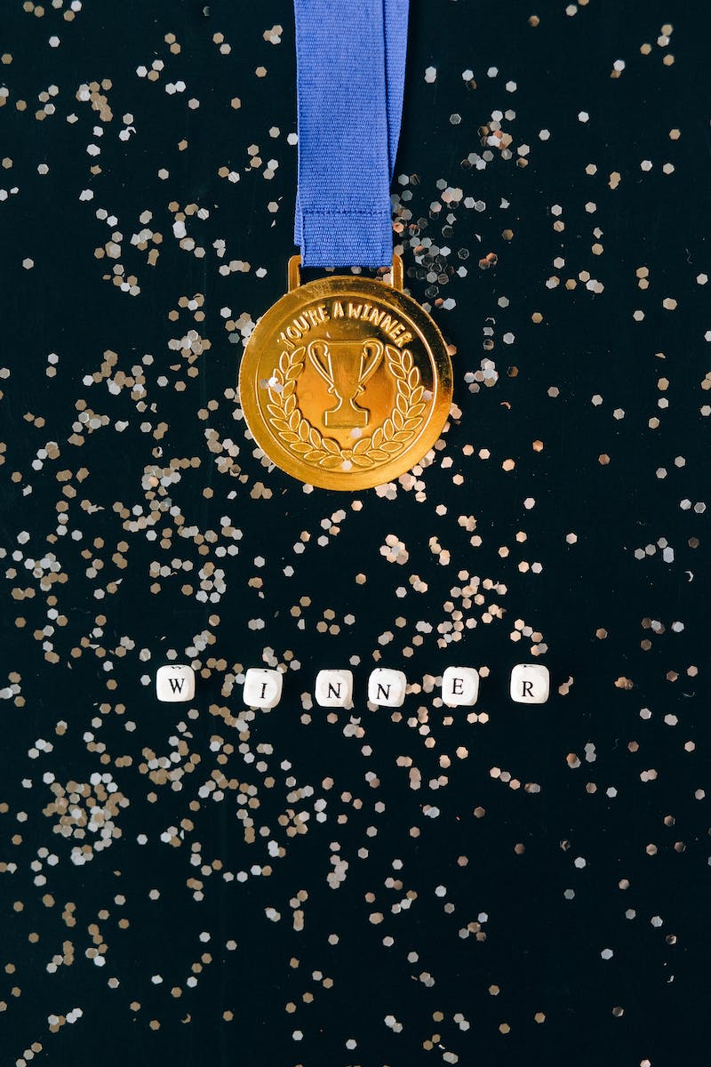
Olympic Glory and Controversy
• In the 1956 Olympics, Streltsov played a crucial role in helping the Soviet team win the gold medal.
• However, he was denied a medal as he was not allowed to play in the final due to a conflict with a teammate.
• Shortly after the Olympics, Streltsov was accused of rape and sentenced to 12 years in prison.
• Many believe the accusations were politically motivated and that Streltsov was wrongly convicted.
Photo by Pexels

Slide 6
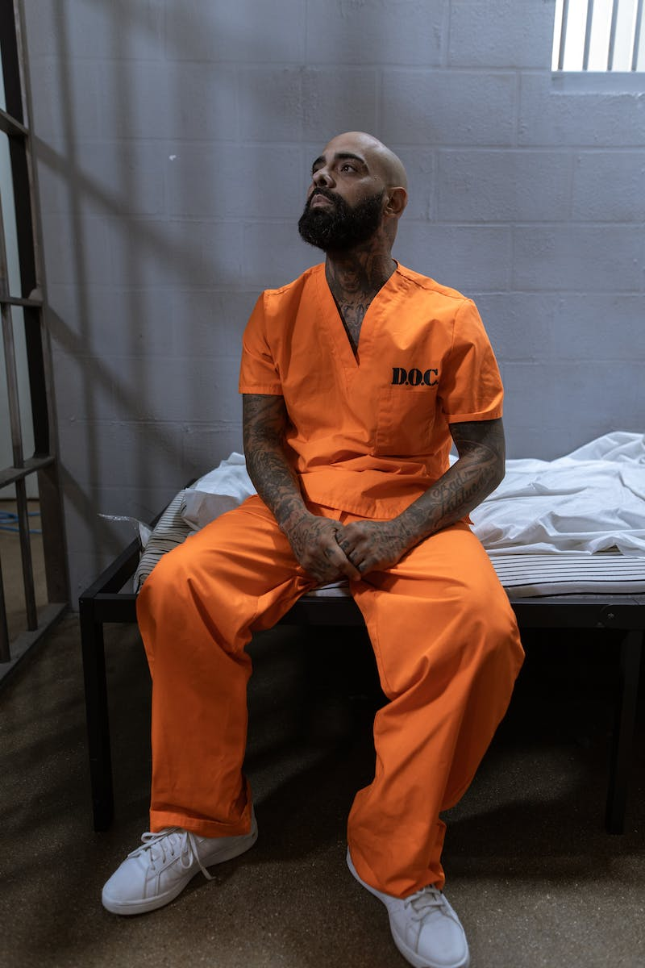
Imprisonment and Comeback
• During his time in prison, Streltsov faced physical attacks from fellow inmates and endured harsh conditions.
• After serving five years, he was released early and attempted to revive his football career.
• Streltsov rejoined Torpedo Moscow but struggled to reach his previous level of success.
• Despite the challenges, he continued to play and coach, leaving a lasting impact on the game.
Photo by Pexels

Slide 7
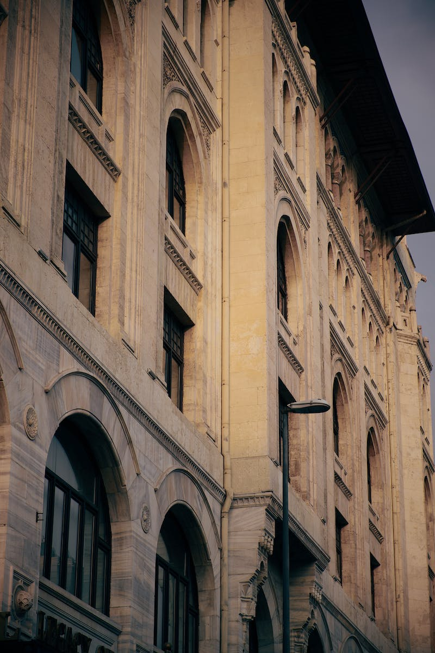
Legacy and Impact
• Although Streltsov's career was cut short, his impact on Soviet football cannot be overlooked.
• He is still considered one of the greatest talents of his generation.
• Many believe that with Streltsov in the lineup, the Soviet national team would have been a favorite in any World Cup.
• Streltsov's personal struggles and unfortunate circumstances serve as a reminder of the complexities of fame and justice.
Photo by Pexels

Slide 8
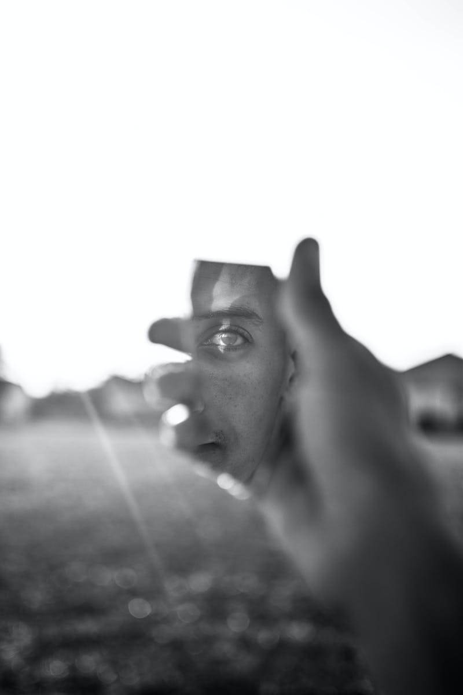
Conclusion
• Eduard Streltsov's story is a tragic tale of talent, success, controversy, and injustice.
• His journey from poverty to football stardom to imprisonment continues to captivate and provoke discussion.
• As we remember his legacy, let us reflect on the complexities of individual stories in the context of a larger society.
• Thank you for joining us in exploring the fascinating life of Eduard Streltsov.
Photo by Pexels

