Slide 1

Unleash Your Creativity: AI Storytelling for Kids!
Crafting Engaging Animal Tales with Artificial Intelligence – A Beginner's Guide.

Slide 2

Table of Contents
1
AI Scriptwriting: Unleash Your Story!
5
Animal Action Adventures!
2
Decoding AI Prompts
6
Story Starter Magic!
3
Dancing Cat Tales: AI's Creative Leap
7
Soaring Success: Birdsong Metrics
4
Story Word Bank: Animals
8
Animal Adventures Await!

Slide 3
9
Your Turn: Action Time!
10
Ignite Imagination: Prompt Power!

Slide 4

AI Scriptwriting: Unleash Your Story!
Stuck in a rut? AI can provide fresh story ideas, character concepts, and plot twists to spark your creativity.
Build compelling characters with rich backstories and motivations using AI-powered character profiling tools and insights.
Outline a gripping plot with AI assistance, ensuring a logical flow, satisfying climax, and memorable resolution for your script.
Elevate your dialogue with AI-generated options that capture character voice, advance the plot, and resonate with audiences effectively.
Photo by Pexels

Slide 5
Decoding AI Prompts
An AI prompt is a specific instruction given to an AI model to generate a response.
Think of it as special instructions for the computer to write a story.
Prompts guide the AI, influencing the style, content, and format of the output.
Prompts aren't just questions; they can be commands, scenarios, or creative briefs.

Slide 6



Dancing Cat Tales: AI's Creative Leap
AI Advantages
AI Limitations
Sparks creativity by providing unexpected and imaginative prompts, bypassing writer's block and generating novel ideas.
Offers a diverse range of story concepts quickly, enabling writers to explore multiple narratives in a short timeframe.
Useful for brainstorming and generating initial concepts for stories, providing a starting point for further development.
May produce prompts that lack depth or coherence, requiring significant refinement and adaptation from the writer to be useful.
Prompts might be generic or predictable, failing to inspire genuine creativity and leading to derivative storytelling.
AI-generated prompts lack the human element of understanding context and nuance, potentially leading to insensitive outcomes.

Slide 7
Story Word Bank: Animals
Lions symbolize courage. Use 'lion' to depict bravery, leadership, or overcoming challenges in your story.
Foxes are cunning. Use 'fox' to represent intelligence, trickery, resourcefulness, or navigating complex situations adeptly.
Owls represent wisdom. The 'owl' can signify knowledge, observation, guidance, and understanding hidden mysteries or situations.
Bears embody strength and gentleness. A 'bear' can show power, protection, or embracing inner strength and tranquility.

Slide 8
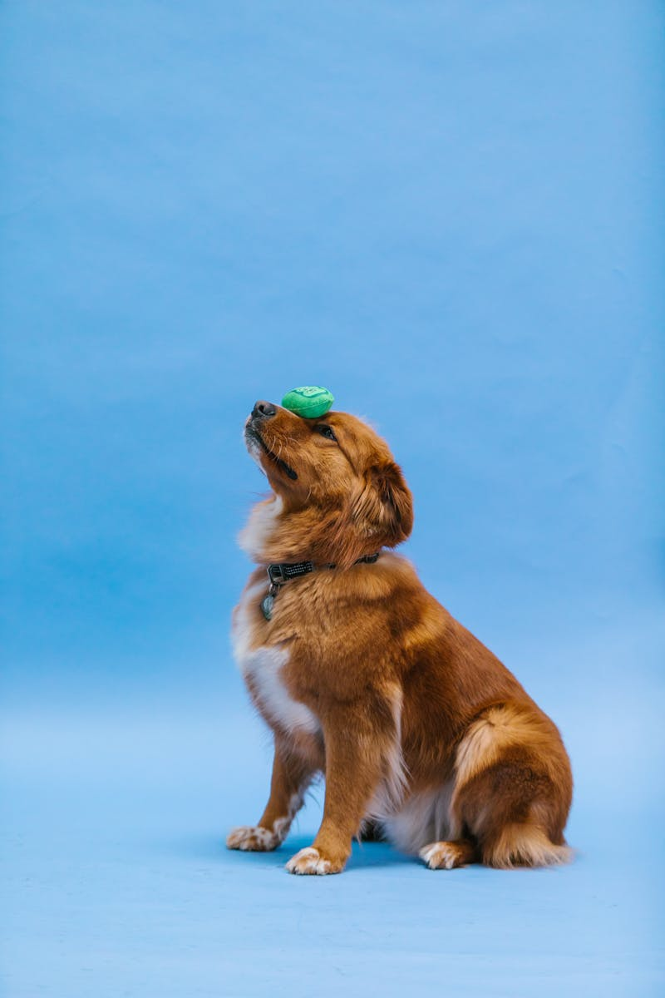
Animal Action Adventures!
Can our animals leap across canyons or climb the highest mountains? Let's explore acrobatic possibilities for our characters.
Delve into aquatic adventures! How can our animals swim across rivers or dive deep into the ocean depths? Uncover secrets.
Soaring through the skies! What unique ways can our animals take to the air? Wings, gliders, or something more fantastical?
Underground exploration! Can our animals dig elaborate tunnels or burrow to hidden realms? Unearth the mysteries below.
Photo by Pexels

Slide 9
Story Starter Magic!
Pick any animal! From a tiny ant to a colossal whale, the possibilities are endless for exciting tales.
Select a dynamic action word. Running, flying, building – give your animal something engaging to do.
Combine your animal and action to form a fantastic story prompt, ready for imaginative expansion.
Squirrel + Flying = A squirrel that can fly? What challenges will it face high above the trees?

Slide 10

Soaring Success: Birdsong Metrics
Species Richness
250+
Song Frequency
2k+
Audience Reach
500k
Positive Sentiment
95%

Slide 11

Animal Adventures Await!
1.Pick Wisely
2.Consider Traits
Selecting your favorite animal is the first step into our wild learning expedition today, so think carefully!
What qualities do you admire? Strength, speed, cunning? Consider all the possibilities when choosing.
3.Word Bank Help
4.No Repeats!
The provided word bank offers many potential animal selections. Feel free to use it as a guide!
Let's aim for uniqueness. Try to select an animal that hasn't been picked by anyone else earlier.

Slide 12
Your Turn: Action Time!
1.Brainstorm Ideas
2.Analyze Data
Generate innovative concepts and potential solutions. Think outside the box for fresh perspectives and original approaches.
Examine available information and statistics. Identify patterns and insights to inform strategic decisions and project progress.
3.Collaborate Team
4.Prioritize Tasks
Work together towards a shared objective. Share expertise, build relationships and accomplish collective goals successfully.
Identify crucial activities and allocate efforts strategically. Focus on what yields the greatest value and aligns with priorities.

Slide 13
Ignite Imagination: Prompt Power!
Crafting your own prompt unlocks limitless storytelling potential. Start with a simple idea and build from there.
Consider the key elements. What unique character or object will be at the heart of your narrative?
The action defines the story. What challenge will your subject face, or what will it achieve?
Generate multiple options for the blanks. Play with unexpected combinations for surprising results.

