Slide 1
Enhancing Photography with Props
Exploring the Impact of Backgrounds, Magazines, Plants, and Accessories

Slide 2
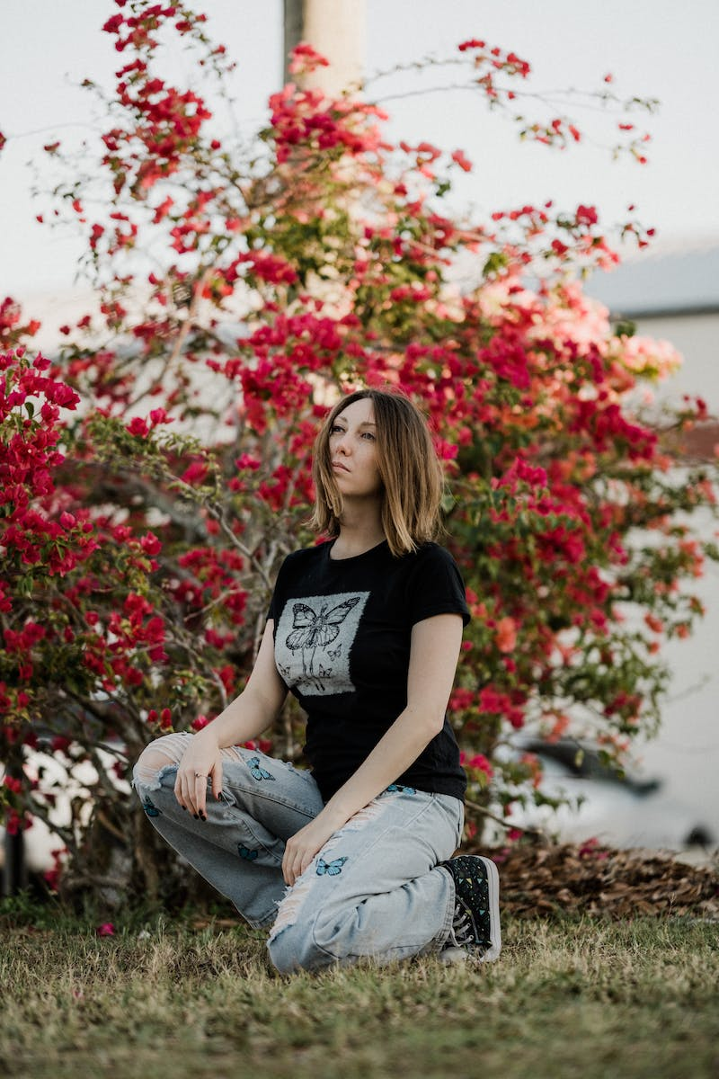
Introduction
• Props are essential for creating interesting and complex compositions in photography.
• Backgrounds, magazines, plants, and accessories can enhance the visual appeal of a photograph.
• Choosing the right props and using them effectively can significantly improve the overall quality of the image.
• In this presentation, we will explore different prop options and their impact on photography.
Photo by Pexels

Slide 3
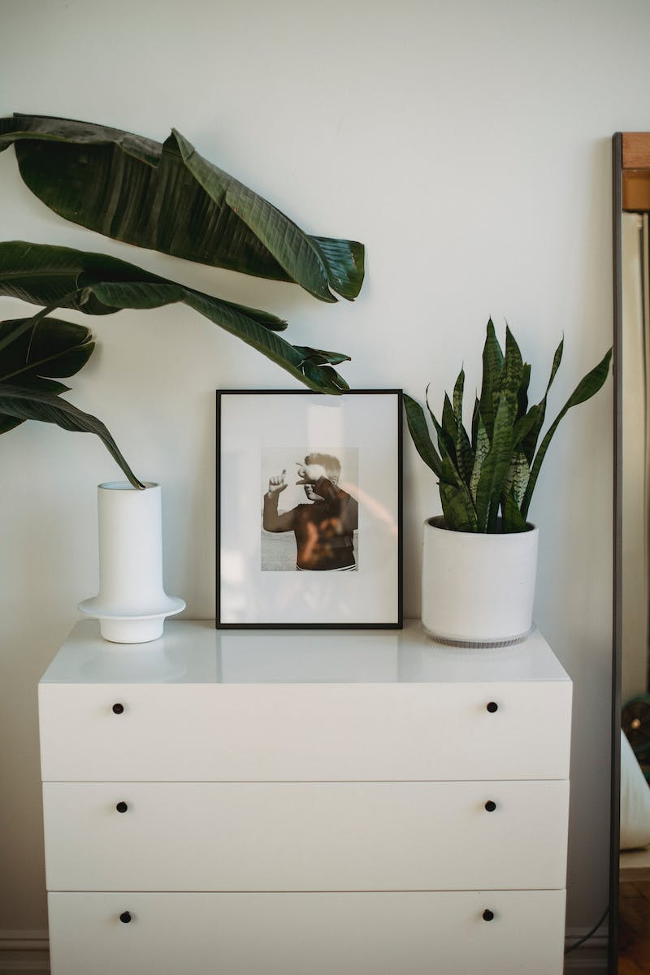
Backgrounds: Creating Compelling Compositions
• Photo backdrops are convenient tools for creating complex compositions.
• Choose lighter shades of backgrounds, such as gray or cool beige, to avoid distorting skin tones.
• Avoid using black or dark backgrounds as they can lead to overexposure of skin tones.
• Backgrounds are inexpensive, with sets typically costing around 300 rubles for 6.
• Two-sided backgrounds offer versatility for different types of shoots.
Photo by Pexels

Slide 4
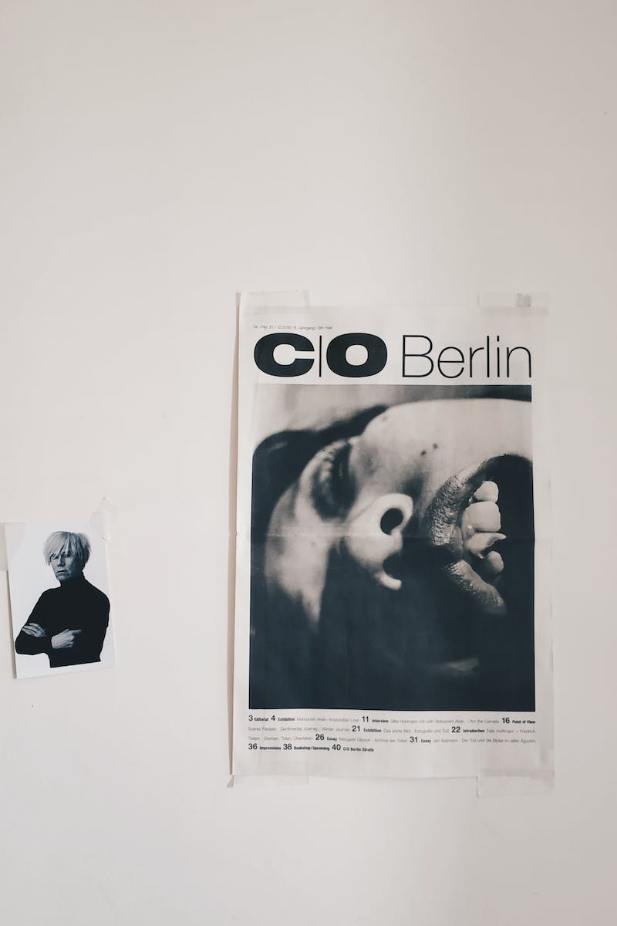
Magazines: Adding Interest to Photos
• Magazines and covers can be great props for creating visually appealing compositions.
• Look for beautiful and inspiring magazines like Vox.
• Old editions of magazines can often be found on online marketplaces like Avito.
• Use magazines for adding aesthetic value to your photoshoots and creating unique compositions.
Photo by Pexels

Slide 5
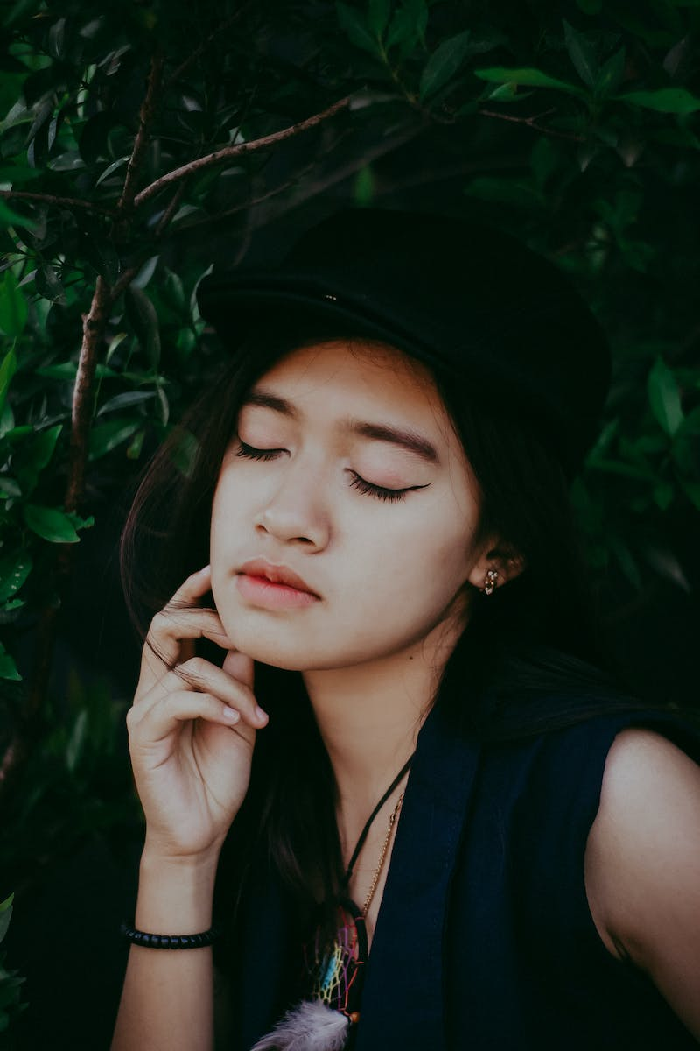
Plants: Enhancing Visual Appeal
• Plants can add a touch of natural beauty to your composition, provided they are of good quality.
• Avoid using low-quality, plastic-looking plants that easily give away their cheapness.
• Do not overcrowd the frame with plants; use them sparingly to maintain the focus on the main subject.
• Dried eucalyptus branches can be a great addition to your compositions.
Photo by Pexels

Slide 6
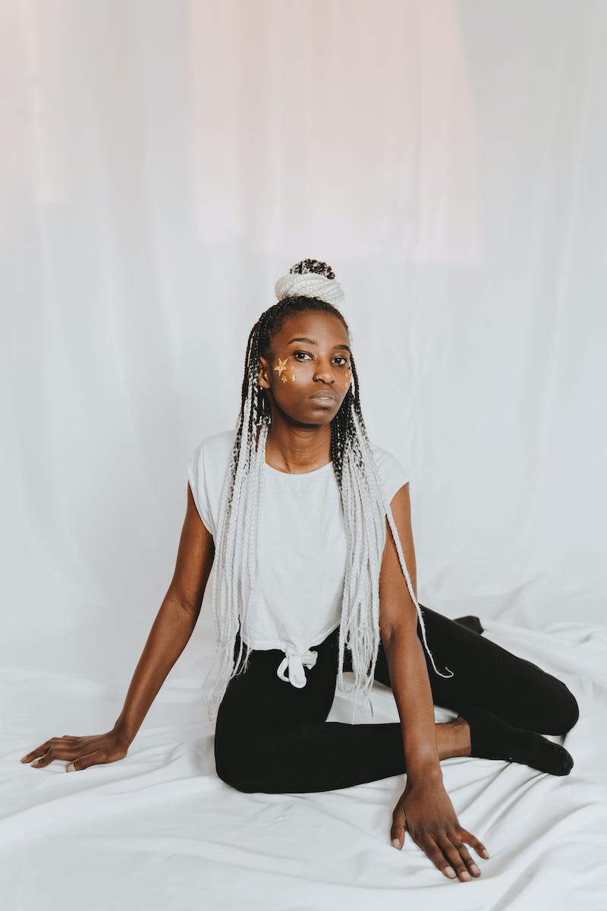
Accessories: Choosing Minimalistic Options
• Opt for minimalistic and subtle accessories that don't overwhelm the composition.
• Avoid using flashy or attention-grabbing accessories that distract from the main subject.
• Choose accessories that complement the overall theme and style of the photo.
• Simple items like rings, bags, and clothing details can add aesthetic value to the composition.
Photo by Pexels

Slide 7
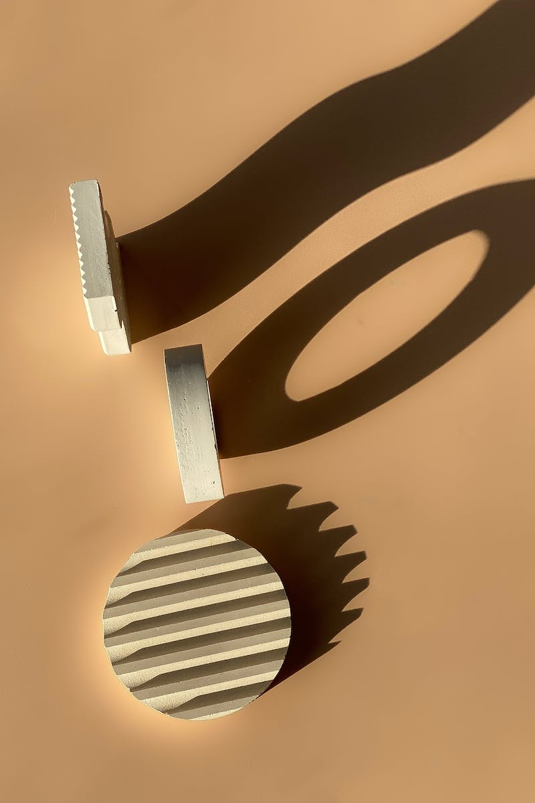
Conclusion
• By carefully selecting and using props, you can elevate the impact and appeal of your photography.
• Remember to avoid low-quality or cheap-looking props that detract from the composition.
• Experiment with different prop options to discover what works best for you.
• Utilize the provided checklist to help you in selecting appropriate props for your photoshoots.
Photo by Pexels

