Slide 1
Exploring the Complex Themes of Naoki Urasawa's Monster
A Philosophical Examination

Slide 2
Introduction
• Naoki Urasawa's Monster: A masterpiece in storytelling
• Rarely given the adoration it deserves
• Examining moral codes and their fragility
• Exploring philosophical conundrums and allegories
• An intriguing fascist, post-World War 2 German setting
Photo by Pexels

Slide 3
The Dichotomy Between Dr. Tenma and Johan Liebert
• Dr. Tenma: The good, human-loving doctor
• Johan Liebert: The abyssal nihilist
• Clashing moral philosophies - deontology vs. nihilism
• The moral responsibility of saving one life over another
• The tug of war between their ideologies
Photo by Pexels

Slide 4
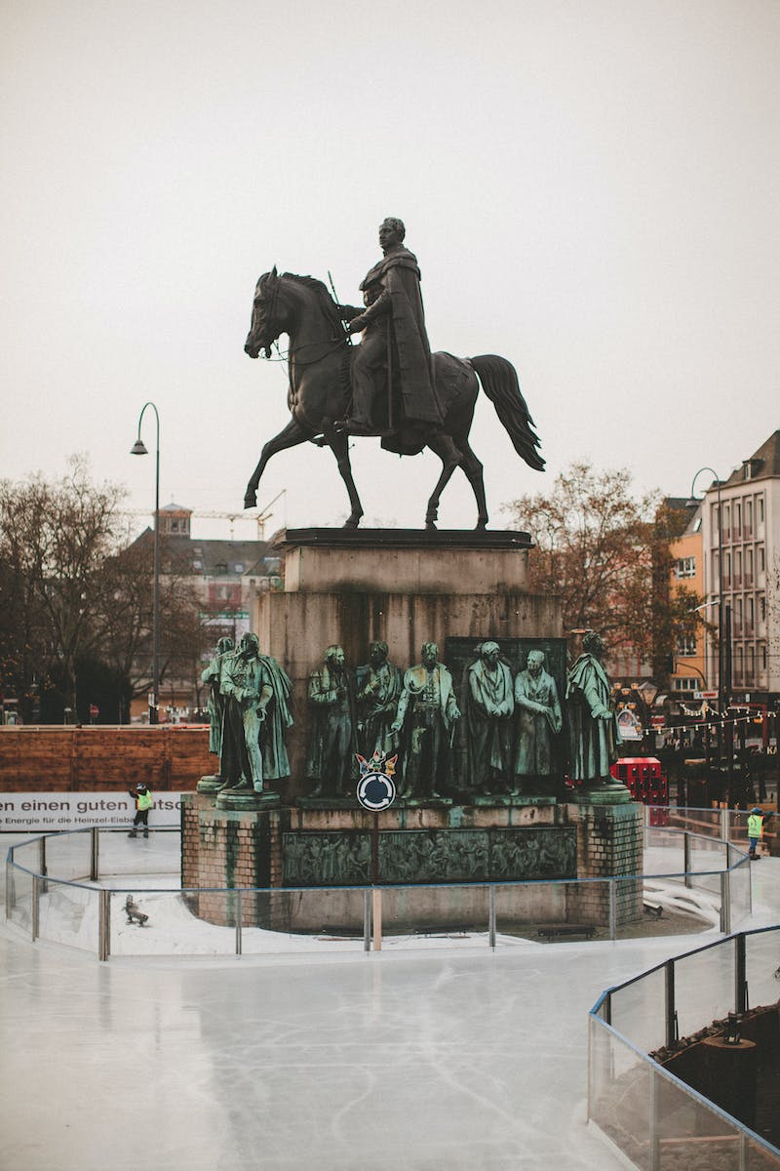
The Influence of Nietzsche and Kant
• Nietzsche's concept of the ubermensch
• Johan as a quasi-ubermensch and the limitations of his ideology
• Tenma's adherence to deontology and the value of human life
• The tension between self-preservation and moral principles
• Impact of Nietzsche and Kant's philosophies on the narrative
Photo by Pexels

Slide 5
Exploring Side Characters
• Roberto: The devoted follower, seeking nihilism
• Wolfgang Grimmer: Blind-faith and the loss of emotion
• Dieter: Apostles and ideological growth
• Heinrich Lunge: From egoist to panoramic wisdom
• The significance of each character's philosophy
Photo by Pexels

Slide 6
The Climactic Ruhenheim Arc
• Ruhenheim as a thematic and narrative focal point
• Franz Bonaparta and his dark experiments
• The philosophical battlefield of a small mountain town
• The culmination of violence and ideologies
• The mysterious landscape for a doomsday
Photo by Pexels

Slide 7
The Final Philosophical Standoff
• Tenma's internal struggle and moral doubts
• The ultimate trolley problem
• The primal instincts of self-preservation
• Johan's envisioned perfect suicide
• The open-ended conclusion and differing interpretations
Photo by Pexels

