Slide 1
Understanding Physical Material and its Impact on the Environment
Exploring the Intersection of Material Science and Sustainability

Slide 2
Introduction to Physical Material
• Physical material plays a crucial role in various industries and everyday life.
• It refers to substances with discernible physical properties and can exist in solid, liquid, or gas form.
• Understanding physical material is vital for engineering, construction, and innovation.
• Properties like density, conductivity, and strength define how material behaves in different scenarios.
Photo by Pexels

Slide 3
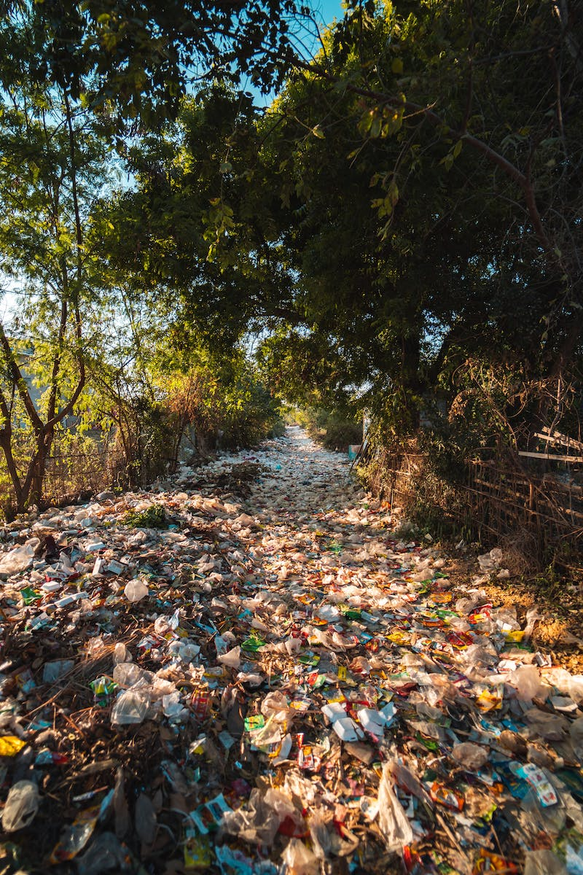
The Environmental Impact of Plastic Material
• Plastic material presents significant environmental challenges due to its non-biodegradable nature.
• Improper disposal and lack of recycling contribute to pollution and harm to ecosystems.
• Reducing plastic use, promoting recycling programs, and finding sustainable alternatives are critical for mitigating the impact.
• Awareness and responsible consumption are essential in combatting plastic pollution.
Photo by Pexels

Slide 4
Exploring Novel Sustainable Materials
• Researchers are continuously exploring alternative sustainable materials.
• By utilizing renewable resources, such materials aim to reduce environmental impact.
• Natural fibers, bioplastics, and recyclable metals are examples of sustainable material alternatives.
• These materials offer comparable performance while being more environmentally friendly.
Photo by Pexels

Slide 5
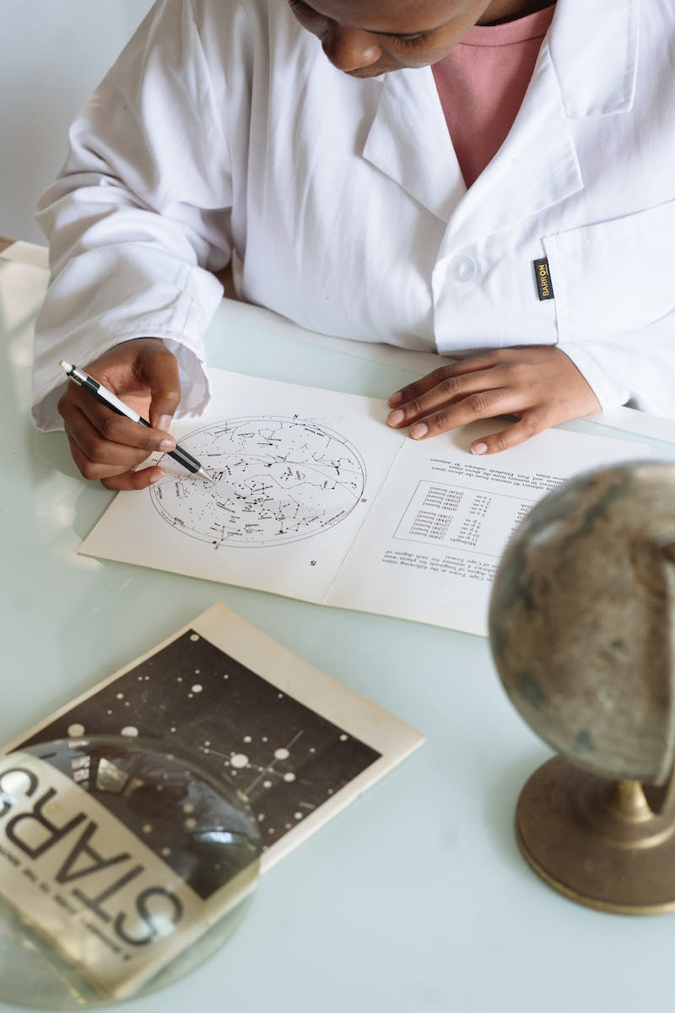
The Role of Material Science in Eco-Friendly Solutions
• Material science plays a crucial role in developing eco-friendly solutions.
• By understanding the properties and behavior of materials, scientists can create environmentally sustainable products.
• From energy-efficient building materials to eco-friendly packaging, material science drives innovation.
• Collaboration between material scientists, engineers, and environmental experts is essential in creating a greener future.
Photo by Pexels

Slide 6
Conclusion
• Understanding physical material and its impact on the environment is crucial for sustainable development.
• By reducing the use of environmentally harmful materials and embracing sustainable alternatives, we can mitigate the negative impact on our planet.
• Continued research and collaboration will drive advancements in material science, leading to a greener future for all.
Photo by Pexels

