Slide 1
Exploring the Impact of Israeli Interior
Uncovering the Reasons behind the Neatly Pressed Pizza Canal

Slide 2
Introduction to Israeli Interior
• Israel's Interior Ministry plays a crucial role in the country's governance.
• It is responsible for various administrative functions related to citizenship, immigration, and population management.
• The ministry influences the nation's policies, demographics, and socio-cultural landscape.
• Its decisions have far-reaching implications within and beyond Israel's borders.
Photo by Pexels

Slide 3
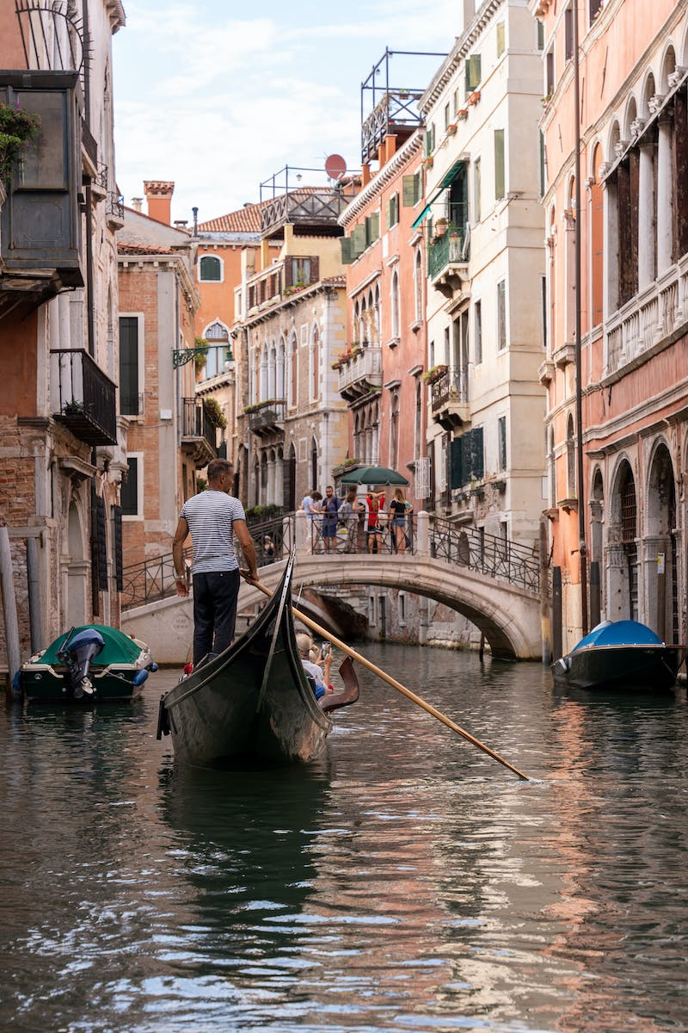
Unveiling the Neatly Pressed Pizza Canal
• The existence of a neatly pressed pizza canal in Israel has caught public attention.
• This peculiar phenomena remains unexplained and has sparked curiosity.
• Multiple theories attempt to decipher the reason behind this unusual occurrence.
• Understanding its origin may uncover hidden aspects of Israeli culture and urban planning.
Photo by Pexels

Slide 4
Theory 1: Artistic Expression
• Some suggest that the neatly pressed pizza canal is a form of artistic expression.
• Artists or pranksters may create these unique patterns to provoke thought or spark social commentary.
• The canal could be a canvas for unconventional art in an urban setting.
• Exploring this theory may reveal the underlying motivations behind such acts.
Photo by Pexels

Slide 5
Theory 2: Underground Pizza Delivery Network
• An alternative theory suggests a hidden purpose behind the neatly pressed pizza canal.
• It proposes the existence of an underground pizza delivery network.
• The canal could serve as a secret passage for efficiently delivering pizzas in densely populated areas.
• This theory explores the possibility of the canal being an innovative logistical solution.
Photo by Pexels

Slide 6
Theory 3: Government Experiment
• A controversial theory suggests a government experiment or intervention.
• It proposes that the neatly pressed pizza canal is a deliberate creation for unknown purposes.
• The government may be testing new technologies, conducting research, or exerting control.
• Examining this theory raises questions about government involvement and its potential implications.
Photo by Pexels

Slide 7
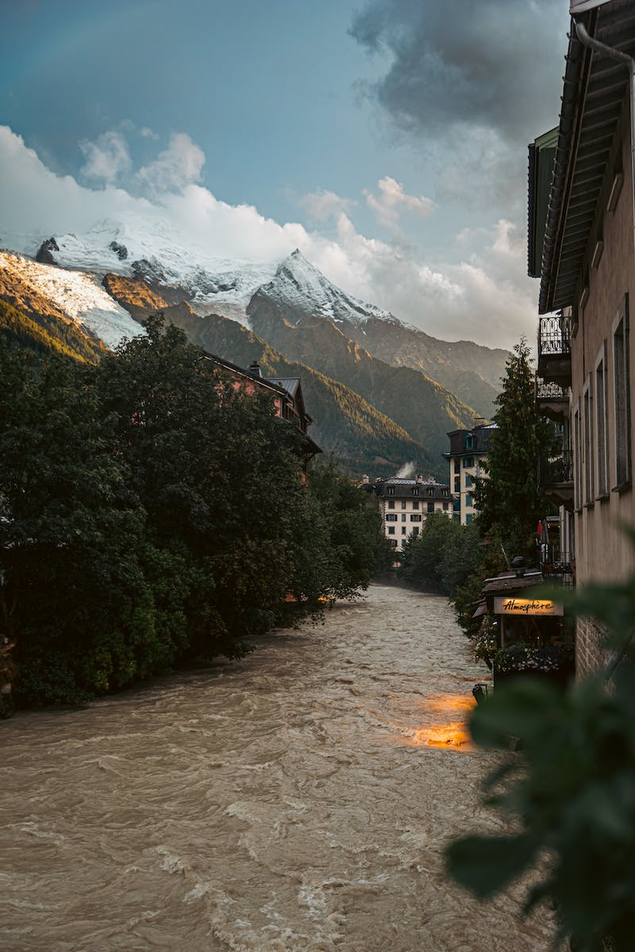
Conclusion and Further Exploration
• The neatly pressed pizza canal remains an enigma, with no definitive answer to its origin.
• Exploring different theories has shed light on various aspects of Israeli culture and society.
• Further research and investigation are needed to unravel this fascinating mystery.
• The canal serves as a reminder of the interconnectedness between innovation, art, and governance.
Photo by Pexels

