Slide 1
Giant Tablets: Samsung Galaxy Tab S9 Ultra vs Xiaomi P6 Max
A comparison of two large tablets with flagship features

Slide 2
Introduction
• Introduce the topic of giant tablets
• Mention the two tablets being compared: Samsung Galaxy Tab S9 Ultra and Xiaomi P6 Max
• Highlight their features and similarities
• Emphasize the focus of the presentation on comparing and discussing these tablets
Photo by Pexels

Slide 3
Specifications
• Samsung Galaxy Tab S9 Ultra: 14.6-inch AMOLED display, Dex mode, Snapdragon 8 Gen 2, LPDDR5X RAM, up to 1TB storage
• Xiaomi P6 Max: 14-inch IPS display, workspace mode, Snapdragon 888+ Gen 1, LPDDR5 RAM, up to 512GB storage
• Highlight the main differences in display technology, processors, and storage capacities
Photo by Pexels

Slide 4
Design and Build
• Samsung Galaxy Tab S9 Ultra: Sleek and thin design, metal body, slim bezels, punch-hole camera
• Xiaomi P6 Max: Sturdy build, slim profile, flat edges, hole-punch camera, magnetic connector for keyboard
• Highlight the design differences between the two tablets, including the materials used and the presence of a magnetic connector in Xiaomi P6 Max
Photo by Pexels

Slide 5
Display and Sound
• Samsung Galaxy Tab S9 Ultra: Dynamic AMOLED 2X display, higher resolution, Dolby Atmos support, 4 speakers
• Xiaomi P6 Max: IPS display, lower resolution, 8 speakers with support for Dolby Atmos
• Highlight the differences in display technology, resolution, and sound quality
Photo by Pexels

Slide 6
Battery and Charging
• Samsung Galaxy Tab S9 Ultra: 11,200mAh battery, 45W wired charging, 15W reverse wireless charging
• Xiaomi P6 Max: 10,000mAh battery, 67W wired charging, no reverse wireless charging
• Highlight the differences in battery capacity and charging speeds
Photo by Pexels

Slide 7
Software and Features
• Samsung Galaxy Tab S9 Ultra: One UI 5.1, multi-window support, Dex mode, extensive stylus capabilities
• Xiaomi P6 Max: MIUI 14, VPS Office, limited multi-window support, stylus functionalities
• Highlight the different software interfaces, multi-window support, and stylus capabilities
Photo by Pexels

Slide 8
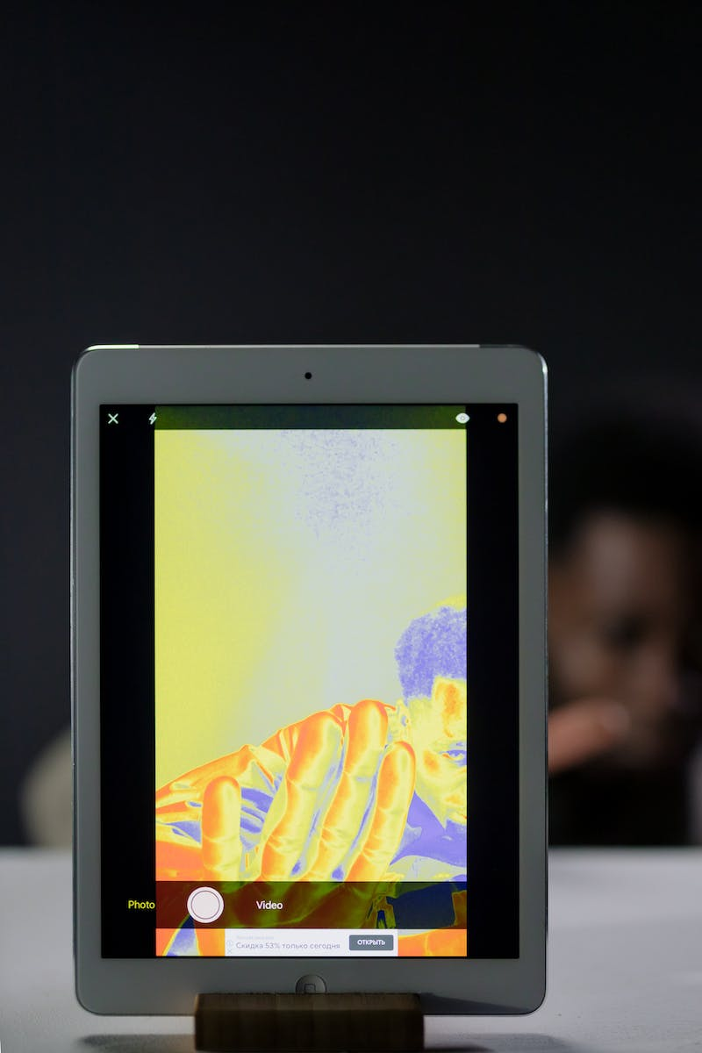
Camera Capabilities
• Samsung Galaxy Tab S9 Ultra: 12MP + 12MP rear cameras, 12MP wide-angle front camera
• Xiaomi P6 Max: 50MP + 2MP rear cameras, 20MP front camera
• Highlight the differences in camera specifications
Photo by Pexels

Slide 9
Conclusion
• Samsung Galaxy Tab S9 Ultra: Expensive, premium tablet, ideal for Android enthusiasts, extensive features and stylus capabilities
• Xiaomi P6 Max: Affordable, feature-packed tablet, suitable for multimedia consumption and light productivity tasks
• Reiterate the key differences, pricing, and target audience for each tablet
Photo by Pexels

