Slide 1
April 2025
Unearthing Canada's Resources: A Mining Overview
Exploring the opportunities, challenges and future of mining in Canada

Slide 2
Table of Contents
1
Canada: Mining Giant
5
Sustainable Mining: A Balanced View
2
Canada's Mineral Wealth
6
Canada's Mining Landscape: Regulation & Responsibility
3
Mining: A Canadian Economic Pillar
7
Mining's Tech Revolution
4
Canada's Mining Landscape
8
Building Bridges: Mining & Community

Slide 3
Table of Contents
9
Mining Industry: Weighing the Scales
10
Canada's Mining Future

Slide 4
Canada: Mining Giant
1.Global Leader
2.Rich History
Canada ranks among the world's top mining nations, known for its expertise and resources.
Mining has deep roots in Canada, shaping its development and contributing to its identity.
3.Economic Impact
4.Diverse Resources
The mining sector is a major economic driver, providing jobs and generating significant revenue nationwide.
Canada boasts a wide range of mineral resources, including precious metals, base metals, and energy minerals.

Slide 5
Canada's Mineral Wealth
Upsides
Downsides
Canada's mineral wealth fuels economic growth, creating jobs and attracting significant foreign investment in various provinces.
The mining sector contributes substantially to government revenue through taxes and royalties, supporting public services nationwide.
Canadian mining companies often adhere to high environmental and ethical standards, promoting responsible resource extraction and processing.
Mining activities can have significant environmental impacts, including habitat destruction, water pollution, and greenhouse gas emissions concerns.
Resource extraction may lead to social disruptions in local communities, affecting Indigenous land rights and traditional ways of life adversely.
The boom-and-bust cycles in commodity prices can create economic instability and job losses within the mining regions unpredictably.

Slide 6
Mining: A Canadian Economic Pillar
GDP Contribution
7%
Export Revenue
200B$
Jobs Supported
626k
Rural Employment
60%

Slide 7
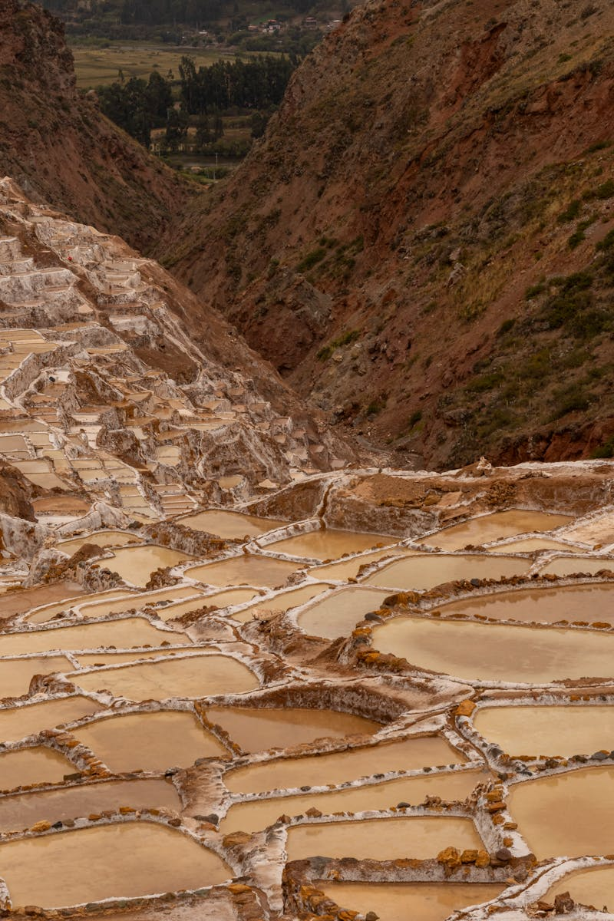
Canada's Mining Landscape
Ontario is a mining hub, with gold, nickel, and other resources driving significant economic activity and employment opportunities across the province.
Quebec's vast mineral wealth, including iron ore and rare earth elements, positions it as a key player in the global mining market.
British Columbia's copper, coal, and precious metals contribute significantly to Canada's mining output and export revenue generation.
Saskatchewan's potash and uranium deposits make it a vital source for global fertilizer and nuclear energy production and distribution markets.

Slide 8
Sustainable Mining: A Balanced View
Benefits
Challenges
Reduced habitat destruction through careful planning and land rehabilitation efforts after mining.
Lower carbon footprint achieved with energy-efficient technologies and renewable energy sources powering operations.
Improved water quality due to advanced wastewater treatment and prevention of chemical runoff into local ecosystems.
High initial investment in eco-friendly technologies and sustainable practices, increasing operational costs significantly.
Complex regulatory frameworks and permitting processes can cause delays and hinder project development timelines.
Potential for unforeseen environmental incidents, despite best efforts, requiring rapid response and costly remediation.

Slide 9
Canada's Mining Landscape: Regulation & Responsibility
Stringent regulations minimize the environmental impact of mining operations, safeguarding ecosystems and water resources.
Prioritizing the health and safety of mining workers through comprehensive regulations and safety protocols at all sites.
Canada's mining industry operates under a robust framework of federal and provincial regulations and policies.
Government agencies actively enforce mining regulations through inspections, audits, and compliance monitoring programs.

Slide 10
Mining's Tech Revolution
Automated systems boost productivity, offering precise control and consistent performance in various mining operations.
Data analysis drives smarter decisions, optimizing resource allocation and predicting potential equipment failures effectively.
Remote sensing techniques enhance exploration, providing detailed geological data for efficient mineral discovery and mapping.
Robotics minimize human risks in dangerous environments, performing tasks such as surveying and material handling safely.

Slide 11
Building Bridges: Mining & Community
1.Open Dialogue
2.Mutual Respect
Establish transparent communication channels for ongoing information sharing and addressing community concerns proactively.
Acknowledge and value the cultural heritage and rights of Indigenous communities impacted by mining activities.
3.Shared Benefits
4.Environmental Stewardship
Collaborate to create economic opportunities and ensure that communities benefit directly from mining operations.
Implement responsible environmental practices that minimize impacts on traditional lands and natural resources.

Slide 12
Mining Industry: Weighing the Scales
Potential Benefits
Key Challenges
Provides essential raw materials for various industries, driving economic growth and supporting manufacturing sectors globally.
Creates significant employment opportunities in extraction, processing, and related support services, especially in rural areas.
Generates substantial revenue for governments through taxes and royalties, funding public services and infrastructure projects.
Volatile commodity prices create economic instability, impacting profitability and investment decisions within the sector.
Insufficient infrastructure, like transportation networks and energy supply, hinders efficient operations and increases costs.
Significant environmental impact including habitat destruction, water pollution, and greenhouse gas emissions requires careful mitigation.

Slide 13
2020
✓
Canada's Mining Future
Critical Minerals List
Canada identifies 31 minerals critical for economic and national security. This list prioritizes investment and development, highlighting the importance of a secure domestic supply chain for essential resources used in manufacturing and technology.
Canada's mining industry has strong prospects.
Global demand drives critical mineral growth.
✓
2021
Battery Metals Boom
Increased demand for electric vehicles drives investment in Canadian lithium, nickel, and cobalt projects. Mining companies expand exploration and development activities to meet the growing need for battery metals in North America and globally, promising economic growth.
2022
✓
Indigenous Partnerships Grow
Canadian mining companies increasingly prioritize partnerships with Indigenous communities. Agreements focus on environmental stewardship, shared economic benefits, and respect for Indigenous rights, fostering sustainable mining practices and reconciliation efforts across the country.

