Slide 1
Cognitive Impairment in Schizophrenia: Understanding and Treatment
Examining the impact of cognitive impairment on daily functioning and exploring treatment options

Slide 2
Introduction
• Good afternoon and welcome to the brain and behavior Research Foundations meet the scientist monthly webinar series
• Dr. Jeff Bo, President and CEO of the Foundation, will be your host for today's webinar
• Dr. Amanda McMacquarie will present on cognitive impairment in psychosis: what it is and how it's treated
• The brain behavior research foundation funds innovative ideas in neuroscience and psychiatry to better understand and treat brain and behavior disorders
Photo by Pexels

Slide 3
Overview of Schizophrenia
• Schizophrenia is a complex psychiatric disorder characterized by psychotic symptoms
• While effective treatments for psychosis symptoms exist, functional outcomes remain a challenge
• Cognitive impairment is a core feature of schizophrenia, with approximately 80% of individuals experiencing cognitive deficits
• Despite its advances, schizophrenia remains a leading cause of disability for young adults
Photo by Pexels

Slide 4
Assessment of Cognitive Impairment
• Cognitive impairment in schizophrenia can be objectively assessed through neuro evaluations conducted by clinical psychologists
• The Matrix Consensus Cognitive Battery (MCCB) is a recommended cognitive assessment battery for research studies
• The MCCB assesses various cognitive domains including speed of processing, attention, working memory, verbal and visual learning, reasoning, and social cognition
• Cognitive performance in schizophrenia is consistently found to be below expectations even when falling within normal limits
Photo by Pexels

Slide 5
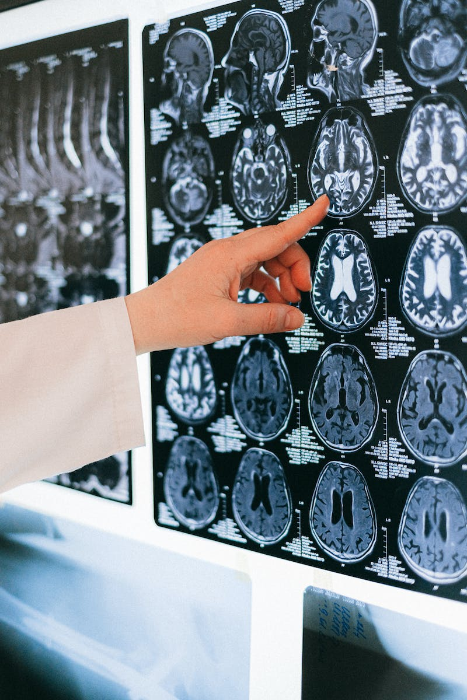
Profile of Cognitive Impairment
• Cognitive impairment in schizophrenia is characterized by a diffuse pattern of deficits across cognitive domains
• It affects both lower order perception processing and higher order executive functions
• Studies show consistent and large effects of cognitive impairment in individuals with schizophrenia
• Cognitive performance is not significantly impacted by clinical factors or medications
Photo by Pexels

Slide 6
Neurodevelopmental Nature of Cognitive Impairment
• Schizophrenia is now recognized as a neurodevelopmental disorder with cognitive impairments starting early in life
• Cognitive impairments are present before the onset of psychosis and remain relatively stable over time
• Studies with clinical high-risk individuals provide insights into the trajectory of cognitive impairment preceding the onset of psychosis
• The timing of the onset of cognitive impairment is still an open question
Photo by Pexels

Slide 7
Cognition and Community Functioning
• The link between cognition and community functioning is well-established in the literature
• Cognitive impairment is associated with reduced community functioning, including social relationships, work/school success, independent living, and engagement in fulfilling activities
• The relationship between cognition and functioning holds early in the illness course and among clinical high-risk individuals
• Cognitive impairment predicts later community functioning over time
Photo by Pexels

Slide 8
Intervening Factors: Social Cognition
• Social cognition refers to the mental operations underlying social interactions
• People with schizophrenia often exhibit social cognitive impairment across domains such as emotion processing, theory of mind, and social cue perception
• Social cognition is associated with community functioning, and improvements in social cognition can lead to improved functioning
• Targeting social cognition is a potential treatment approach
Photo by Pexels

Slide 9
Intervening Factors: Defeatist Beliefs
• Defeatist beliefs refer to negative attitudes and beliefs about one's ability to perform tasks
• Defeatist beliefs are associated with reduced motivation to engage in activities and poor functioning
• Targeting defeatist beliefs can improve functioning and increase motivation
• Cognitive interventions and psychotherapy can address defeatist beliefs as part of treatment
Photo by Pexels

Slide 10
Intervening Factors: Negative Symptoms
• Negative symptoms in schizophrenia include reduced motivation and drive to engage in activities
• Negative symptoms are associated with cognitive impairment and poor functioning
• Psychotherapy and targeted interventions can address negative symptoms and improve cognitive functioning
• Addressing negative symptoms can lead to improved community functioning
Photo by Pexels

Slide 11
Treatment Approaches: Pharmacological Interventions
• Pharmacological interventions can directly target cognitive impairment in schizophrenia
• Some neurotransmitter systems and medications show promising effects on cognitive performance
• However, the effects of medication on cognition can vary and may have side effects
• Combining medications with other forms of treatment, such as cognitive training, may be more effective
Photo by Pexels

Slide 12
Treatment Approaches: Cognitive Training
• Cognitive training involves structured activities to improve cognitive performance
• Both restorative and compensatory approaches can be used in cognitive training
• Cognitive training can lead to improvements in cognitive performance but transfer to untrained tasks and community functioning is challenging
• Personalized cognitive training and strategies for near and far transfer of skills are avenues for further research
Photo by Pexels

Slide 13
Treatment Approaches: Physical Exercise
• Physical exercise has shown promise in improving cognitive performance in schizophrenia
• Aerobic exercise has been associated with improvements in overall cognition, working memory, attention, and social cognition
• Combining cognitive training and exercise can yield greater improvements in cognition and functioning
• Further research is needed to explore optimal exercise approaches and long-term effects
Photo by Pexels

Slide 14
Treatment Approaches: Non-Invasive Neurostimulation
• Non-invasive neurostimulation techniques involve applying electrical or magnetic stimulation to modulate brain activity
• Repetitive transcranial magnetic stimulation (rTMS) has shown promise in improving working memory performance
• Further research is needed to determine the reliability of these effects and the optimal stimulation parameters
• Non-invasive neurostimulation may be a complementary treatment approach for cognitive impairment

Slide 15
Treatment Approaches: Targeting Social Cognition
• Social skills training and social cognition training can improve social cognition in schizophrenia
• Improved social cognition can lead to enhanced community functioning
• These interventions involve instruction, role-play exercises, and cognitive strategies
• Bridging components can facilitate the generalization of skills to real-world settings
Photo by Pexels

Slide 16
Treatment Approaches: Addressing Defeatist Beliefs
• Psychotherapy and cognitive interventions can address defeatist beliefs
• Targeting defeatist beliefs can improve motivation and functioning
• Treatment approaches can involve cognitive restructuring, goal-setting, and support
• Addressing defeatist beliefs is an important part of a comprehensive treatment plan
Photo by Pexels

Slide 17
Treatment Approaches: Psychotherapy for Negative Symptoms
• Psychotherapy can address negative symptoms and improve cognitive functioning
• Targeted interventions, such as cognitive-behavioral therapy (CBT), can be effective
• Cognitive-behavioral therapy for negative symptoms focuses on identifying and challenging negative beliefs and increasing activity levels
• Preliminary evidence suggests that psychotherapy can lead to improvements in functioning
Photo by Pexels

Slide 18
Conclusion
• Cognitive impairment is a core feature of schizophrenia and impacts daily functioning
• The link between cognition and functioning is well-established
• Understanding the factors along the pathway between cognition and functioning can inform treatment approaches
• Pharmacological interventions, cognitive training, physical exercise, neurostimulation, and psychotherapy can all play a role in improving cognitive impairment and functioning
Photo by Pexels

